Slide 1
Sarojmoni Sonowal
ASSISTANT PROFESSOR, DEPARTMENT OF ZOOLOGY
PUB KAMRUP College

Slide 3
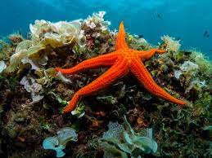
General Characteristics
They are exclusively marine , free living & live in bottom

Slide 4
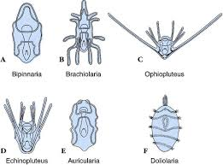
Larval forms of Echinodermata---- Bilaterally Symmetrical

Slide 5
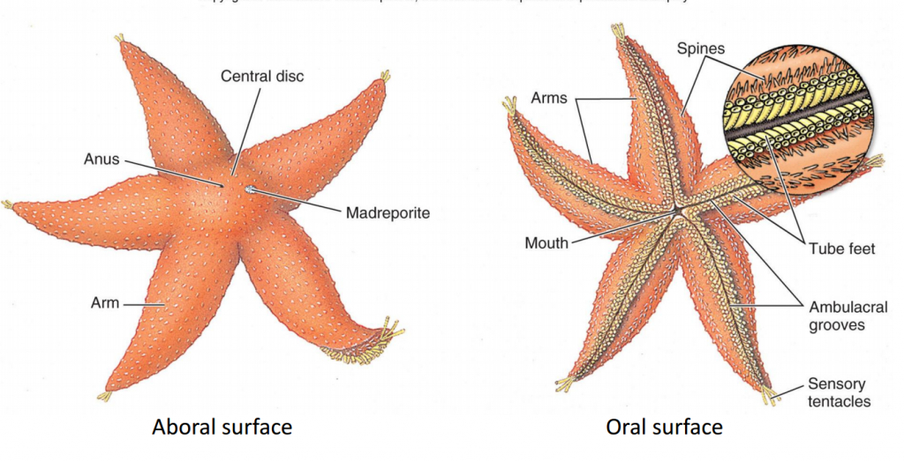
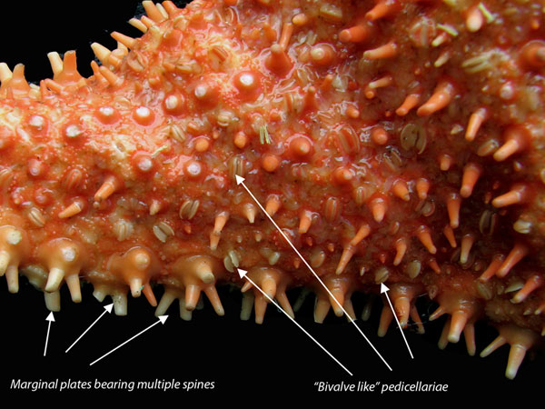
Body with distinct Oral and Aboral sides
Body contains five radiating grooves called ambulacra
Endoskeleton is made up of separate calcareous plates or spines.
Distinct Head absent
Some Echinoderms (eg asteroids & echinoids) bears pedicellariae or tuber cells- defense and cleaning algae and other debris from the body
Water Vascular System (or ambulacral system) is present which helps in circulation of nutrients, gaseous exchange.

Slide 6
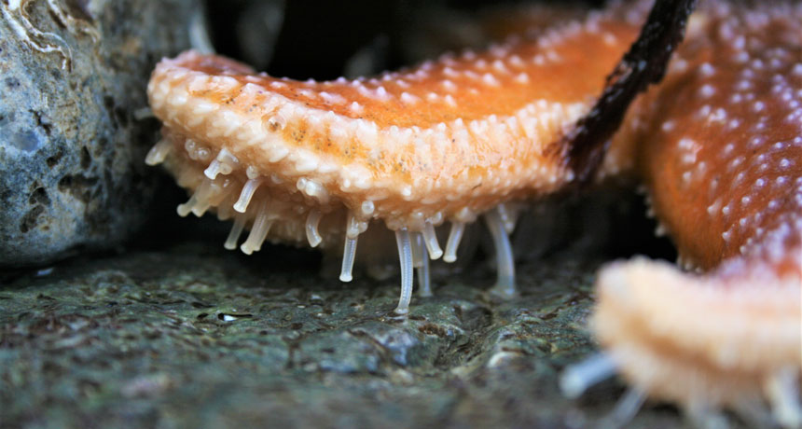
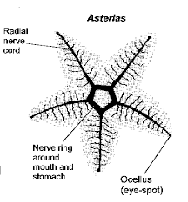
Water vascular System contains Tube feet or Podia for locomotion
Digestive system complete.
Respiratory organs includes– dermal branchae or skin gills (star fish), genital bursa (brittle star), peristomial gills (sea urchins) and cloacal respiratory tree (holothurian)
Open type of Circulatory System. Heart absent & Use Water Vascular system to bring oxygen.
Nervous system is without brain but with a circumoral ring around mouth and radial nerves that extends into each arm
Sense organs are poorly developed.
Excretory System is absent without any excretory organs

Slide 7
Sexes are separate
Reproduction - sexual and asexual mode
Regeneration capacity occurs
Fertilization is External. Few are viviparious
Development is indirect (Free swimming larval forms )

Slide 8
Echinodermata

Slide 9
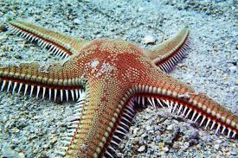
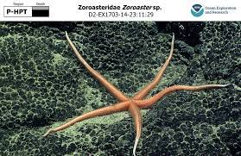
Subphylum : Eleuthrozoa
4 Classes
CLASS 1: ASTEROIDEA
Common name– Sea Stars
Body flattened, star shaped with 5 arms
Mouth on Oral side(directed downwards) and anus on Aboral side(directed upwards)
Possesses tube feet with suckers
Pedicellariae on body surface for cleaning and capturing preys.
Respiration by Papullae or dermal branchae
Larva– Bipinnaria, Branchiolaria
Examples: Asterias, Astropecten, Zoraster

Slide 10
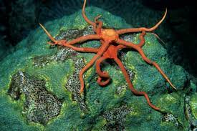
CLASS 2: OPHIUROIDEA Commonly called– brittle stars
Body flat with 5 long fragile looking worm like arms
Central disc distinct from arms
Mouth present but anus, intestine and ambulacral groove absent.
Tube feets without suckers
Pedicellariae absent
Respiration and excretion through genital bursa
Larva – pluteus
Example: Ophiothrix, Ophuria, Gorgonocephalus

Slide 11
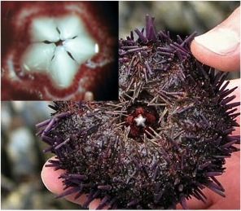
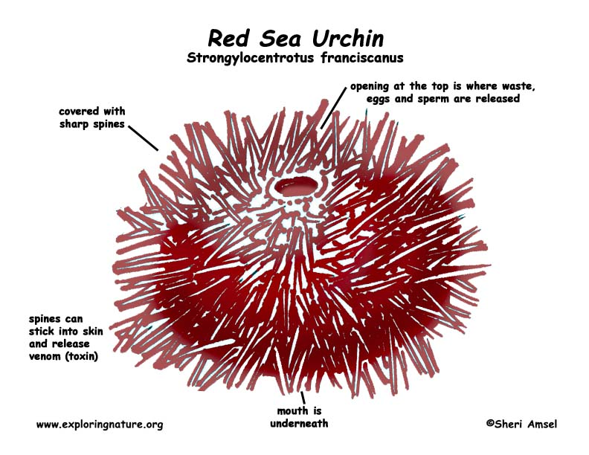
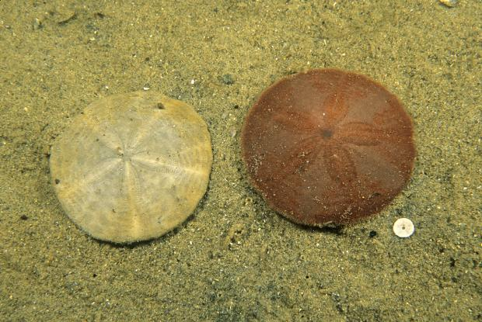
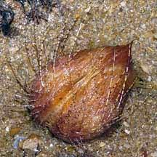
CLASS 3: ECHINOIDEA commonly called Sea Urchins, heart urchins & sand dollars
Body Round or oval or disc shaped
Body devoid of Arms
Mouth and Anus present
Mouth with specialized teeth
called Aristotle lantern.
Body covered by rigid
skeleton or test
Tube feet with suckers
larva- echinopluteus
Examples: Echinus, Clypeaster

Slide 12
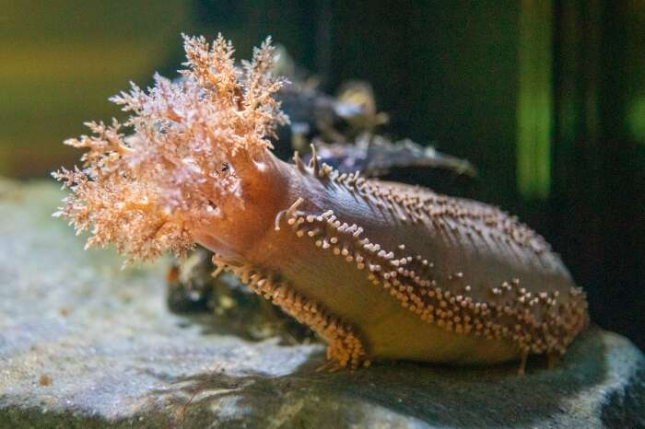
CLASS 4 : HOLOTHUROIDEA Commonly name – sea cucumber
Body large, elongated like a cucumber
Without arms & spines
Mouth and anus at opposite ends. 10 to 30 tentacles around mouth.
Tube feet with suckers
Respiration through cloacal Respiratory tree
Larva--- Auricularia, Dollio larva, Pentacularia
Examples: Holothuria, cucumaria

Slide 13
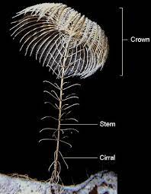
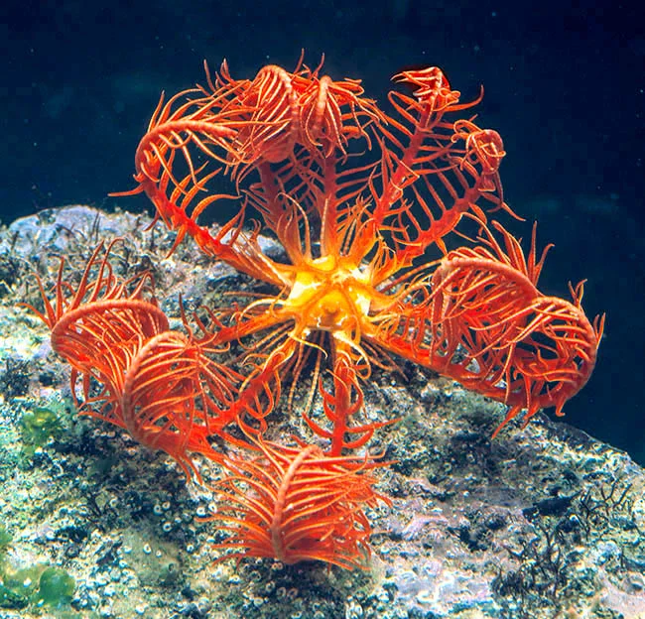
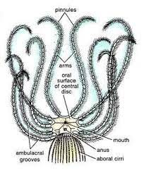
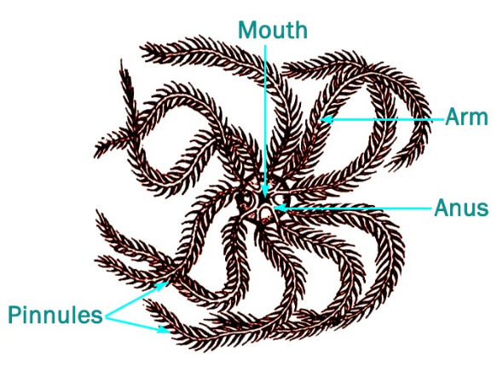
Subphylum : Petmetozoa 1 Class
CLASS: CRINOIDEA
Commonly called sea lilies or feather stars
Extinct forms bear stalk of attachment
Living form devoid of stalk
Body- Arms- 5 to 10, arms bifurcated with
two pinnules each side.
Pinnules bears reproductive organs and tubefeet
without suckers.
Mouth and anus present on oral surface
Aboral surface with cirri- attachment &
movement
Example: Antedon (feather star)
Delocrinus, Rhodocrinus

Slide 14
THANK YOU
Note: Pictures used in the ppt have been downloaded from google and different sites

