Slide 1
PHYLUM MOLLUSCA
Sarojmoni Sonowal
Assistant Professor, Zoology
Pub Kamrup College

Slide 2
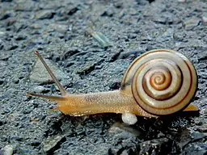
Phylum Mollusca Johanson (1950)
Second Largest Phylum- 80,000 living species
Mollusc – soft body
Study of Mollusca – Malacology
Study of their shells - Choncology

Slide 3
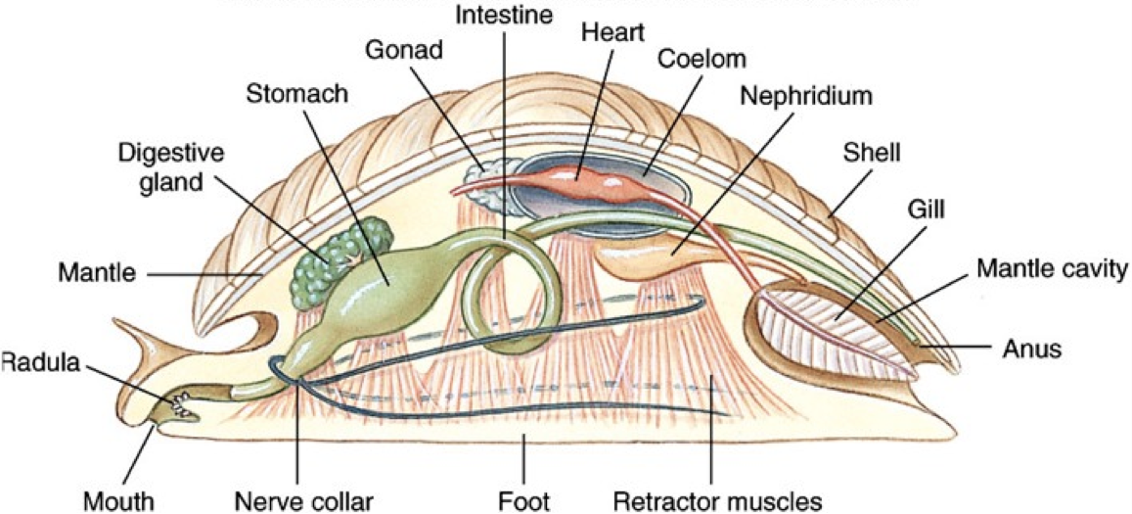
General characteristics of Mollusca
Mostly marine, few are freshwater and terrestrial form
Triploblastic, coelomate animals but coelom is greatly reduced
Generally exhibits Bilateral symmetry but few are asymmetrical
(Class Gastropoda- adults shows asymmetry and larva shows bilateral symmetry)
Body soft, unsegmented and bears organ system level of organization
Soft and fleshy body of the Mollusca is covered by a fleshy fold of body wall called mantle or pallium.
Mantle usually secretes a shell.

Slide 4
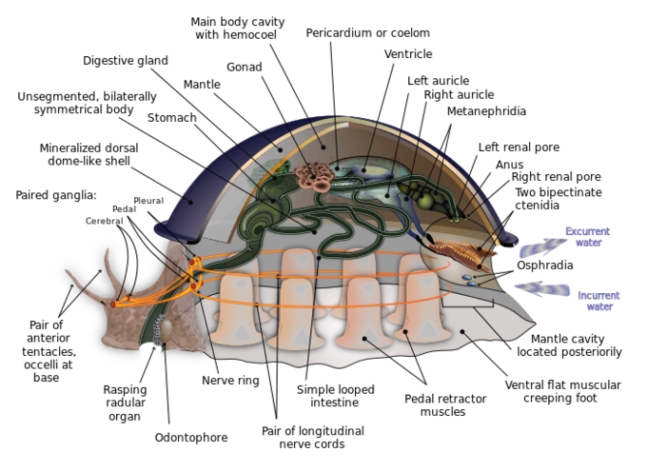
General characteristics of Mollusca
Body covered by calcareous shell- exoskeleton.
but few have internal shell or no shell present
Mollusca body is divided into Head, ventral foot and visceral mass (contains the organ systems)
Mollusc bears sense organs- eye, tentacles and osphadia
Digestive tract is complete- mouth present at anterior side and ends with anus at posterior side. Digestive tract is straight or U shaped in some (E.g. Snail)

Slide 5
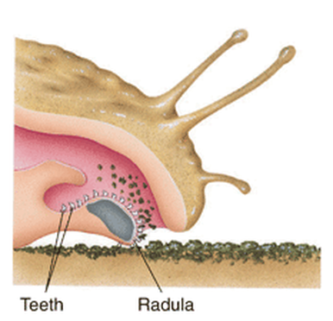
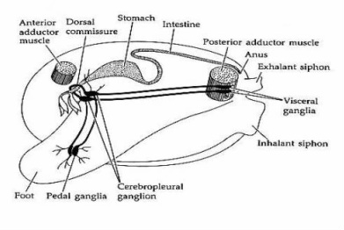
General characteristics of Mollusca
Mouth contains a flexible, tongue like structure called rasping radula to which many tiny teeth are attached.
Open type of Circulatory system except class Cephalopods (E.g. Octopus)
Respiratory system consists of gills or ctenidia or pulmonary sac provided with osphradium
Respiratory pigment- haemocyanin present.
Blood appears blue in color
Nervous system consists of pairs of ganglia- pedal ganglia, pleural ganglia and visceral ganglia connected by connectives and nerves.
2 pairs of nerve cord also originates near the mouth.

Slide 6
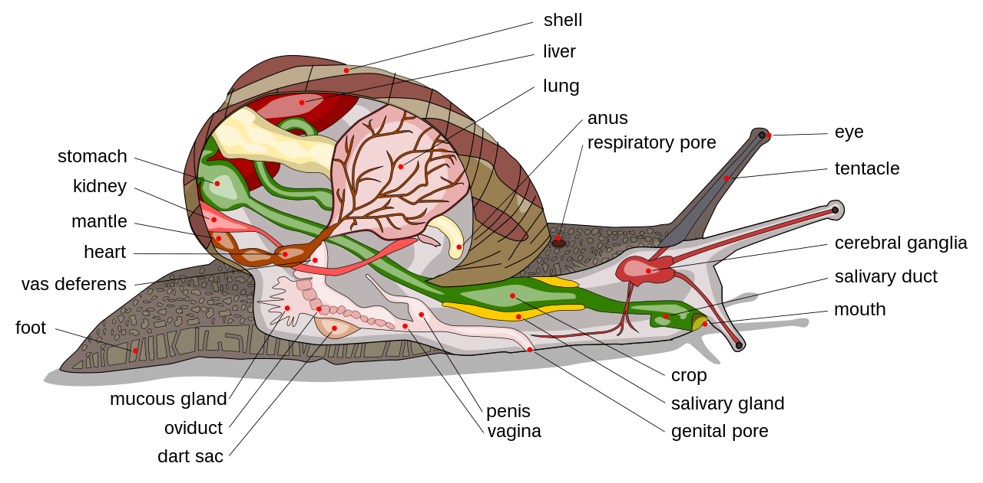
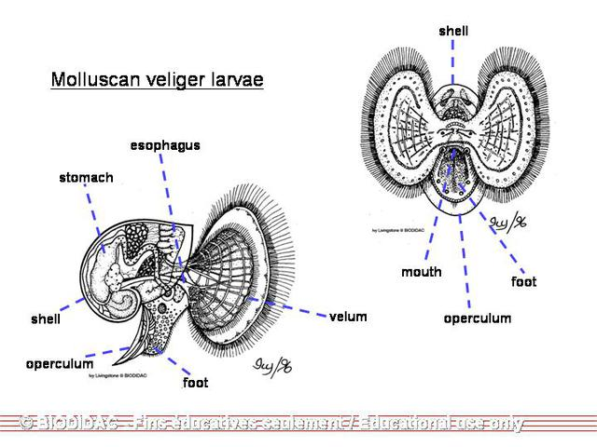
General characteristics of Mollusca
Excretion by paired metanephridia(1 or 2 or 4 pairs )– which are sac like structure called Bojanus or keber’s organ. Metanephridia opens into mantle cavity.
Usually sexes separate but few are hermaphrodite (Gastropoda)
Fertilization – Internal or external
Development may be direct or indirect in some.
During metamorphosis passes through Veliger larva similar to trochophore larva of Annelida.

Slide 7
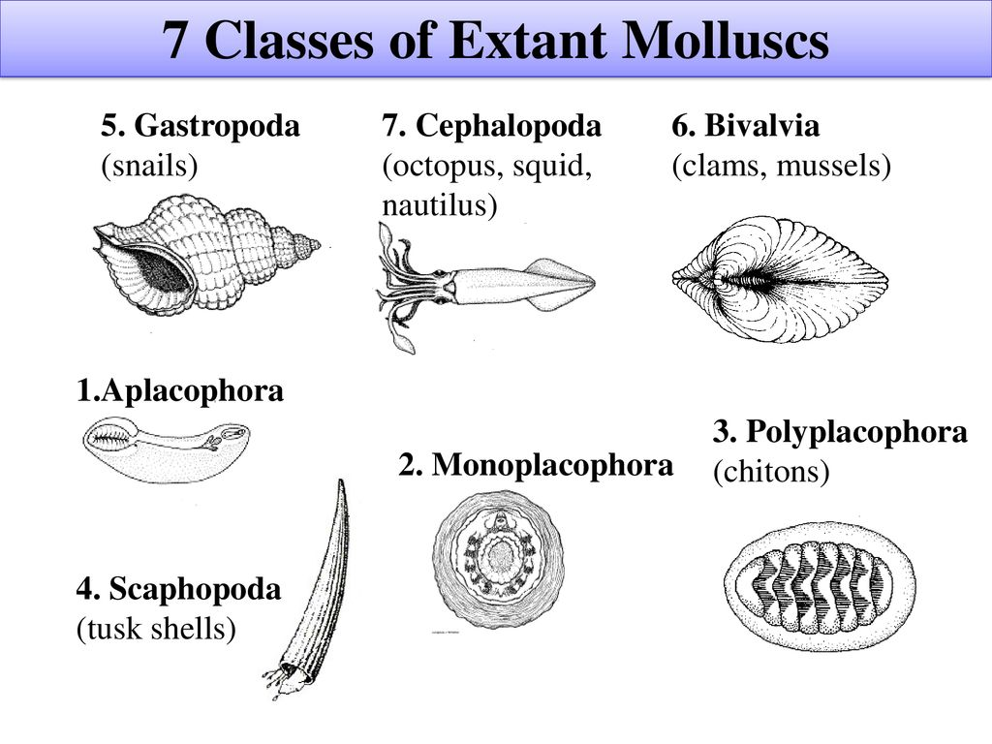
Classification of Mollusca
Classification is carried out as per Barnes(1987), with some modifications from Ruppert and Barnes (1996)

Slide 8
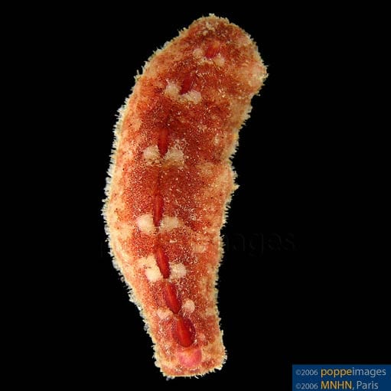
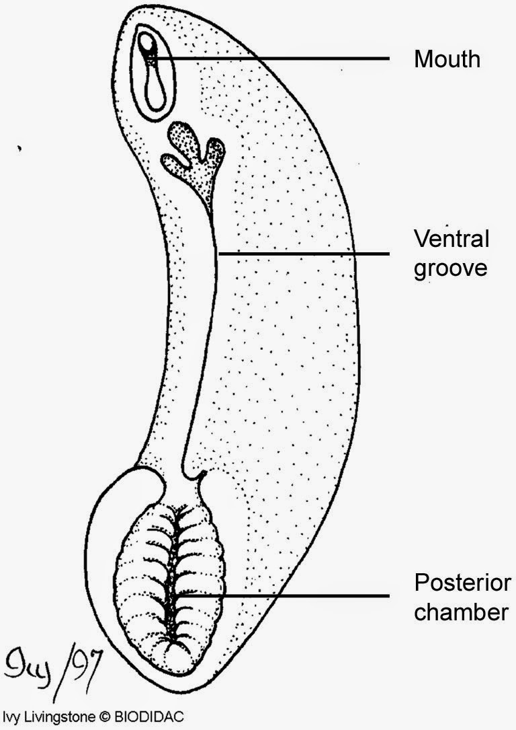
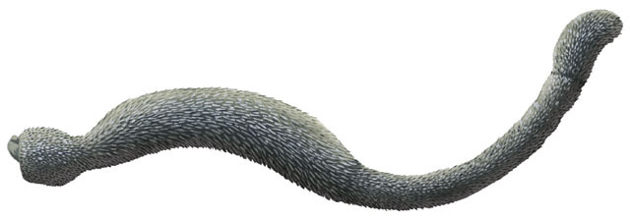
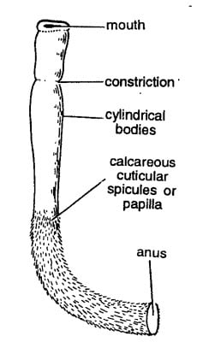
CLASS 1- APLACOPHORA (SOLENOGASTERS)
Small, worm like marine, primitive mollusc
Animals without any shells. Cuticle contains calcareous spicules
Body cylindrical and bilaterally symmetrical
Head, mantle , foot absent
Straight alimentary canal and mouth bears radula
Mid ventral longitudinal groove may be present or absent
Eg: Neomenia, Chaetoderma
Neomenia
Chaetoderma

Slide 9
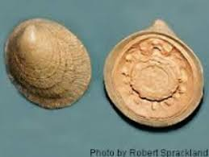
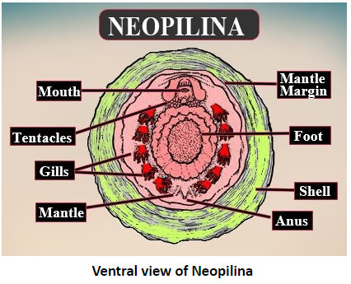
CLASS 2- monoPLACOPHORA
Shell consists of single valve or piece
Body bilaterally symmetrical and segmented
Head & foot present. Foot is flat
5 to 6 pairs of external gills arrange serially in pallial groove
Dioecious animals
Eg: Neopilina,

Slide 10
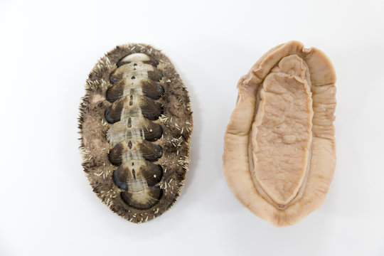
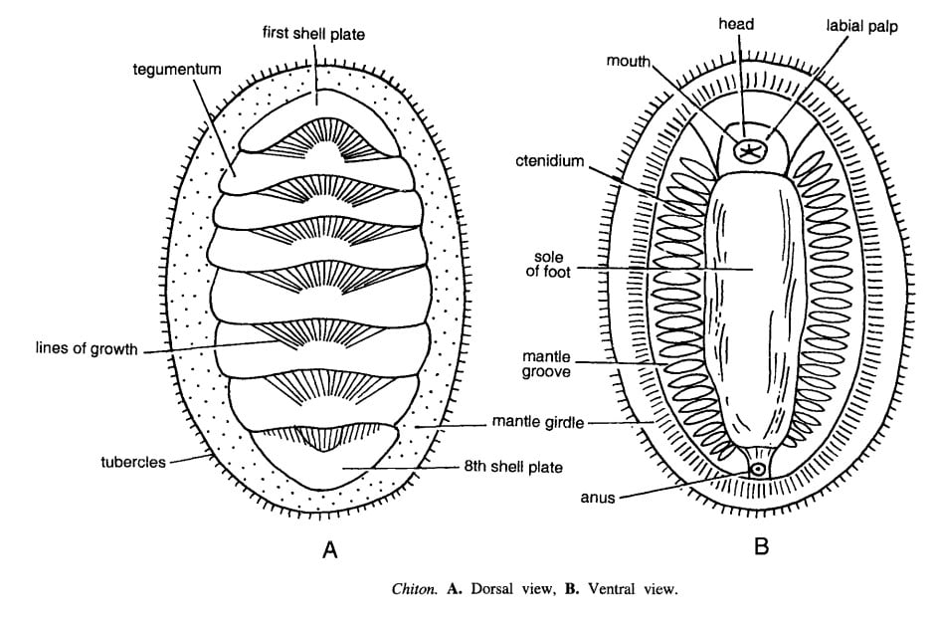
CLASS 3- POLYPLACOPHORA
Shell formed of 8 calcareous plates
Body Dorsoventrally flattened and bilaterally symmetrical
Foot ventral and flat
Head devoid of eyes and tentacles
Mouth contains radula with 17 teeth
Nephridia 1 pair
Dioecious animals
Eg: Chiton, Lepidopleurus
Chiton

Slide 11
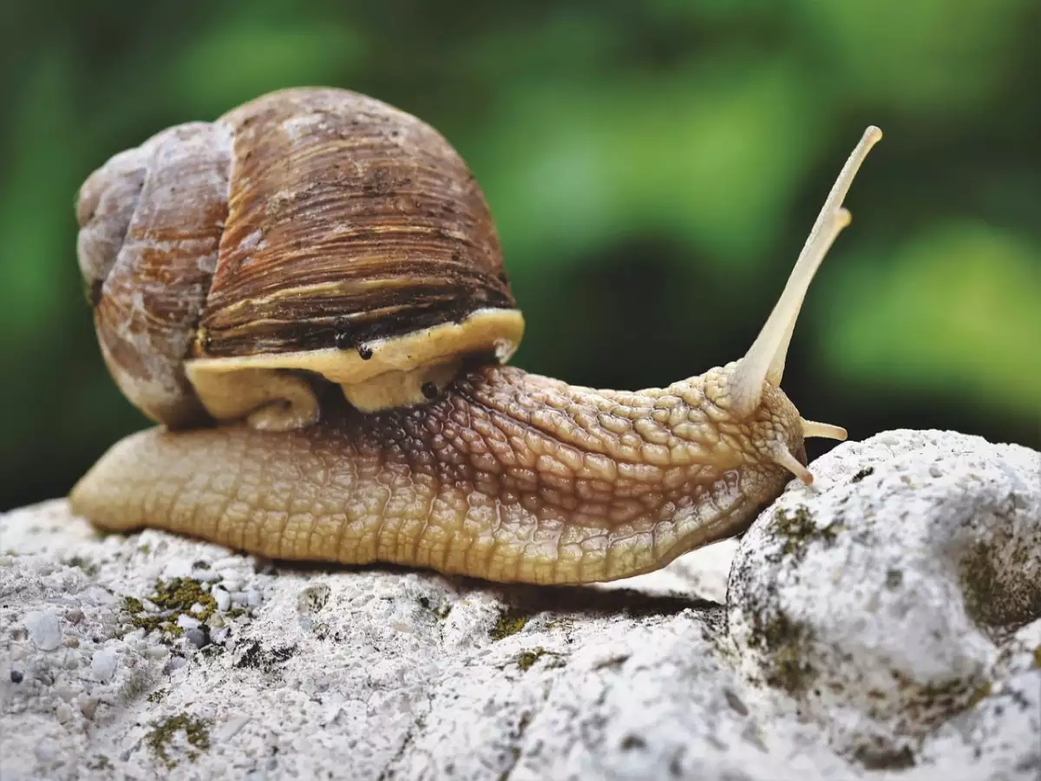
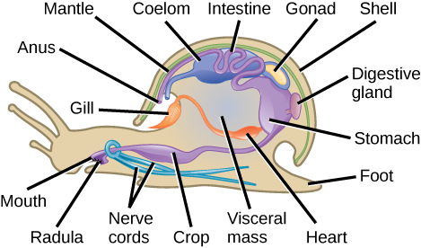
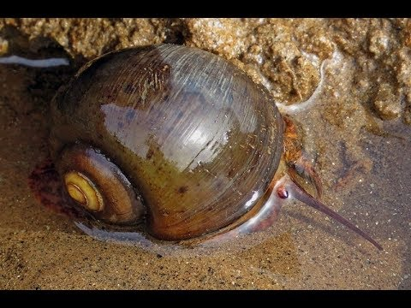
CLASS 4- GASTROPODA
Body asymmetrical and bears spirally coiled shell
Marine, freshwater and terrestrial forms
Foot present on belly
Respiration by gills or lungs
Alimentary canal U shaped
Anus, mantle cavity, ctenidia placed anteriorly
Excretion by single or paired metanephridia
Eg: Pila globosa (Apple snail), Patella, Valvata
Pila globosa

Slide 12
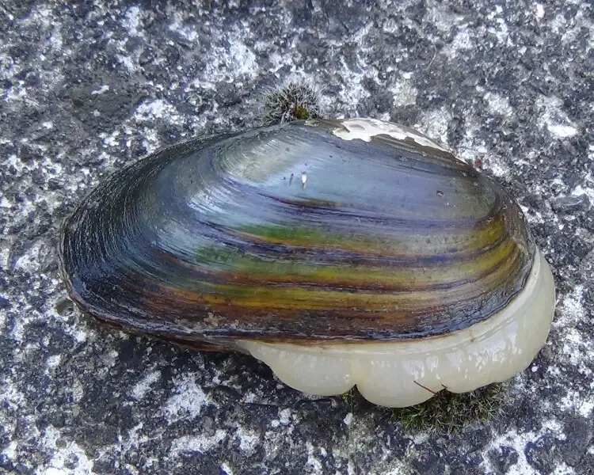
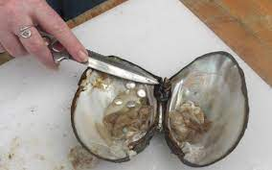
CLASS 5- Bivalvia (pelecypoda)
Shell divided into 2 valves
Bilaterally symmetrical and laterally compressed body
Head, radula and tentacles absent
Marine or terrestrial form
Respiratory gills & excretory kidneys are paired
E.g. Unio, Pinctada vulgaris

Slide 13
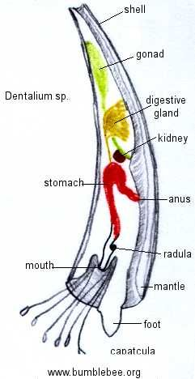
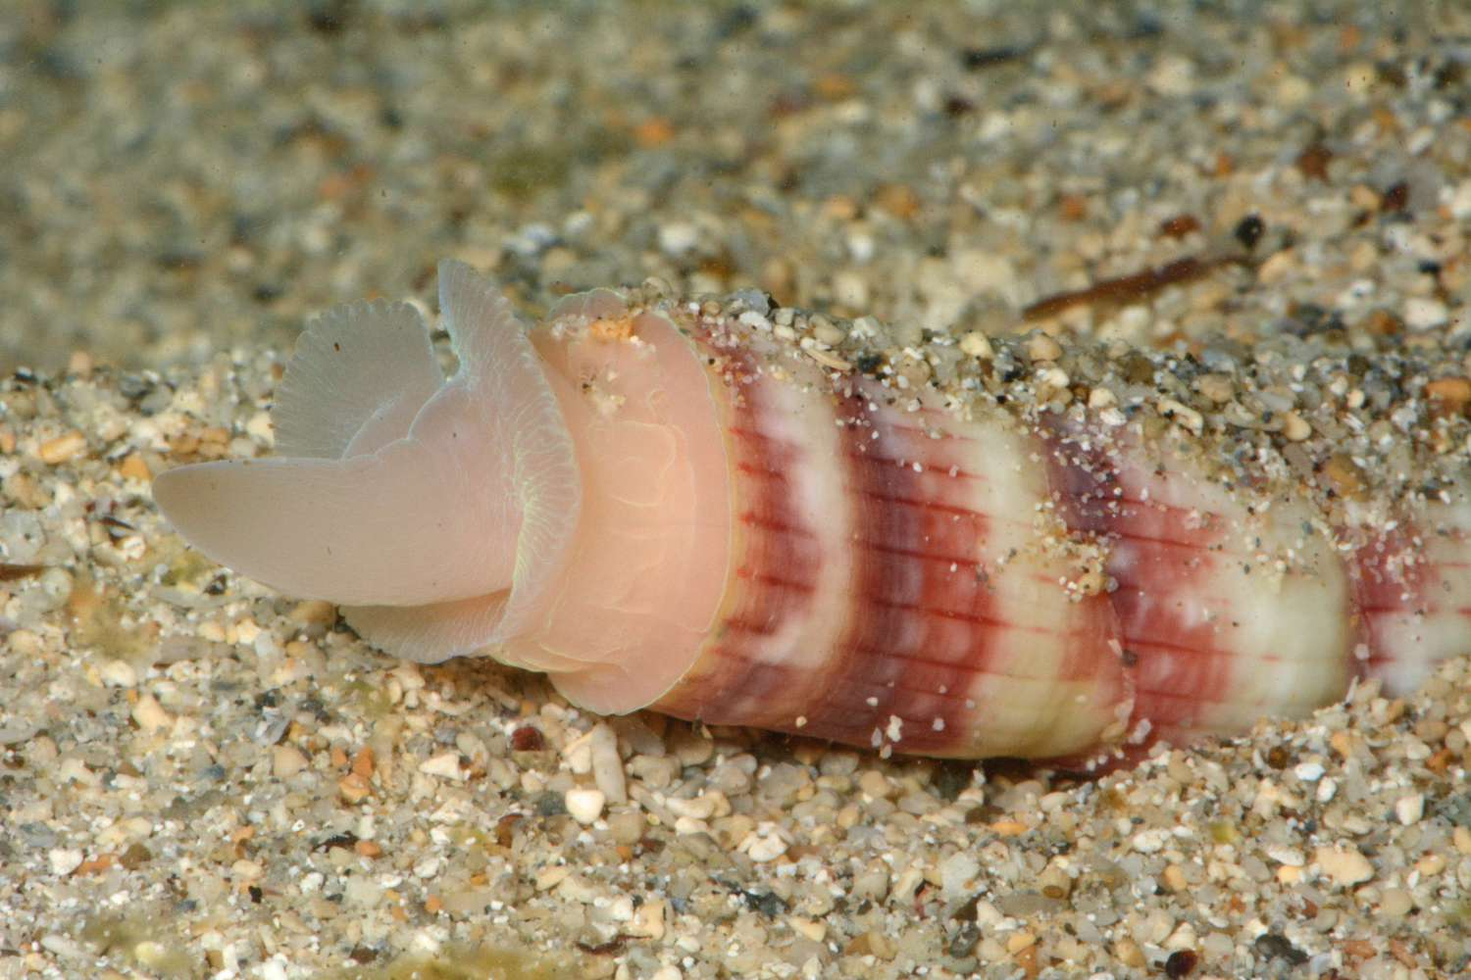
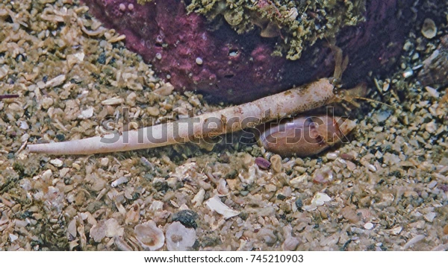
CLASS 6- SCAPHOPODA
Marine forms
Shell is tusk like tubular and open at both ends
Gills, tentacles, osphradium and eyes are absent
Foot boat shaped used for digging
Radula with large flattened teeth
Mantle cavity is large and extends entire length of the ventral surface
Eg: Dentalium, Siphonodentalium
Dentalium

Slide 14
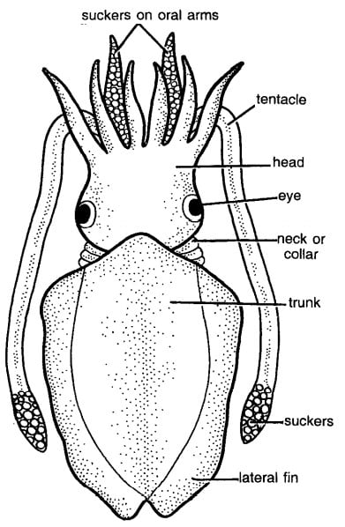
CLASS 7- cephalopoda
Foot arises from Head and encircles the mouth
Foot modifies to suckers bearing tentacles and arms
Shell external or internal
Mouth bears jaw and radula
Closed circulatory system
Heart with 2 or 4 auricles
Eg: Sepia, Loligo, Octopus
Octopus
Loligo

Slide 15
Note: Pictures used in the ppt have been downloaded from google and different sites
Source:internet

