Slide 1
Human Gene Therapy

Slide 2
Introduction

Slide 3
Genetic Counseling

Slide 4
Treating Genetic Disease
Removing an affected body part.
Replacing an affected body part or biochemical with material from a donor.
Delivering pure, human proteins derived from recombinant DNA technology to compensate for the effects of a mutation.
Gene therapy, to replace mutant alleles.

Slide 5
Gene Therapy
Use of DNA as a pharmaceutical agent to treat disease.
First conceptualized in 1972.
Approved Gene Therapy experiment in 1990.

Slide 6
The boy who lived in a bubble: Incredible images show child who spent his entire life sealed from the outside world in the desperate hope scientists would find a cure for his auto-immune disease.
David Vetter was born in September 1971 with a deadly genetic disease.
He was placed in a bubble due to Severe Combined Immune Deficiency.
David's elder brother, also David, died after eight months due to the illness.
Medics used David's experience to successfully treat others with SCID

Slide 7
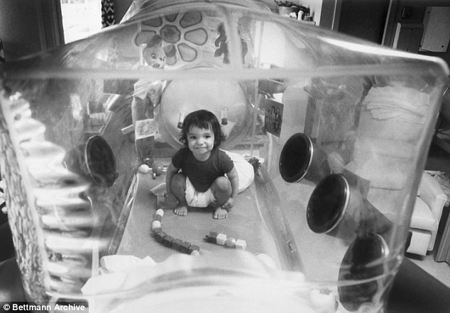
David was placed in his plastic bubble after he was born and remained cocooned until he was 12.

Slide 8
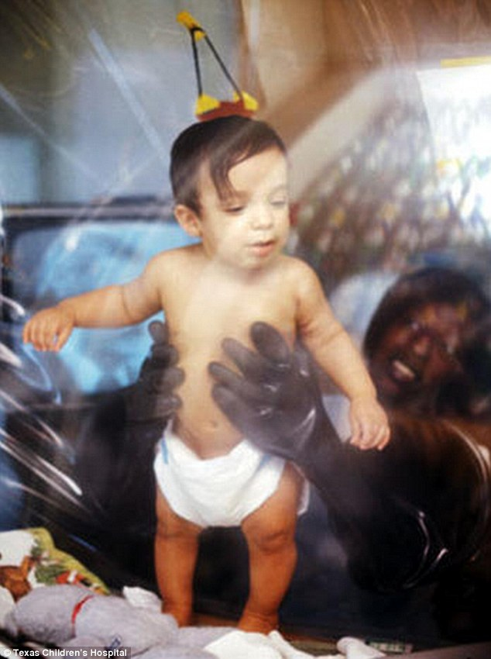
Medics could only touch David using a special pair of gloves in a bubble designed by NASA

Slide 9
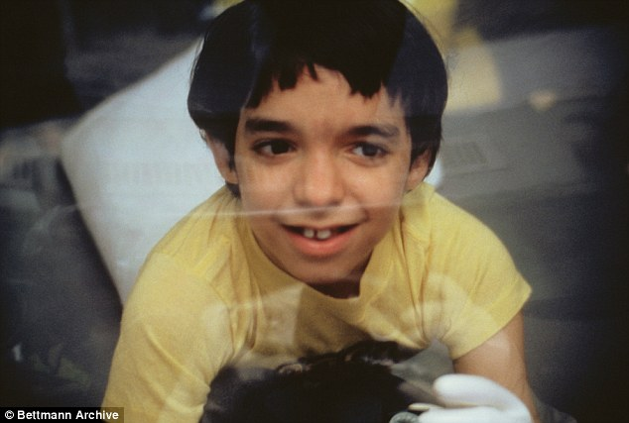
David Vetter, known as the Bubble Boy, spent 12 years living inside a hermetically-sealed cocoon

Slide 10
Severe Combined Immunodeficiency Disease (SCID)
David Vetter, the “Boy in the Bubble”, received bone marrow from his sister → unfortunately he died from a form of blood cancer.
SCID is caused by an Adenosine Deaminase Deficiency (ADA).
Gene is located on chromosome 22 (32 Kbp, 12 exons).
Deficiency results in failure to develop functional T and B lymphocytes.

Slide 11
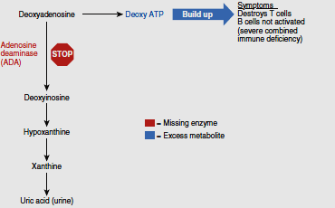

Slide 12
Severe combined immune deficiency (SCID) due to adenosine deaminase (ADA) deficiency .
Lack of ADA blocks a biochemical pathway that normally breaks down a metabolic toxin into uric acid, which is then excreted.
The substance that ADA normally acts upon builds up and destroys T cells. Without helper T cells to stimulate B cells, no antibodies are made.
The child becomes very prone to infections and cancer, and usually does not live beyond a year in the outside environment.

Slide 13
ADA is involved in purine degradation
Accumulation of nucleotide metabolites = TOXIC to developing T lymphocytes
B cells don’t mature because they require T cell
Patients cannot withstand infection → die if untreated

Slide 14
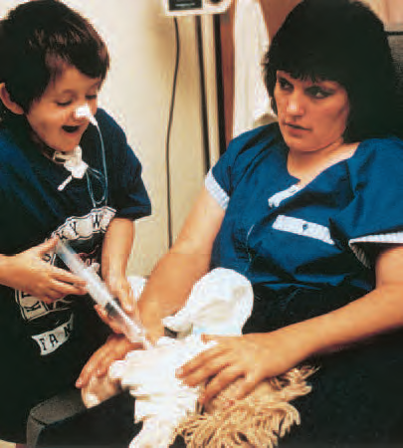
The Pioneers: Inherited Immune Deficiency
Severe combined immune deficiency (SCID)
Laura Cay Boren

Slide 15
For the first few years of her life, Laura Cay Boren didn’t know what it was like to feel well.
From her birth in July 1982, she fought with infection. Colds rapidly became pneumonia, and routine vaccines caused severe abscesses. In February 1983, doctors identified Laura’s problem—severe combined immune deficiency (SCID) due to adenosine deaminase (ADA) deficiency.
The Duke University Medical Center, where Laura celebrated her first and second birthdays, became her second home.
In 1983 and 1984, she received bone marrow transplants from her father, which temporarily bolstered her immunity.
Red blood cell transfusions also helped, but Laura was still spending more time in the hospital than out.
By the end of 1985, she was gravely ill. She had to be fed through a tube.

Slide 16
Then Laura was chosen to participate in a trial for a new treatment, and in 1986, she received her first injection of PEG-ADA. This is the missing enzyme, ADA, from a cow and stabilized with polyethylene glycol (PEG) chains.
Previous enzyme replacement without PEG didn’t work, because what remained of the immune system destroyed the injected, unaltered enzyme.
Patients needed frequent doses, which provoked the immune system further, causing severe allergic reactions.
Laura’s physicians hoped that adding PEG would keep ADA in her blood long enough to work.
Laura began responding to PEG-ADA almost immediately. After 3 months of treatment, toxins no longer showed up in her blood, but her immunity was still suppressed.

Slide 17
After 6 months, though, Laura’s immune function neared normal
for the first time ever—and stayed that way, with weekly doses of PEG-ADA.
Her life changed dramatically as she ventured beyond the hospital’s germ-free rooms.
By summer 1988, she could finally play with other children without fear of infection.
She began first grade in fall 1989, but had to repeat the year—she had spent her time socializing!
Sadly, Laura Cay passed away shortly before her 19th birthday, from lung damage.

Slide 18
The gene therapy approach began on September 14, 1990.
Four-year-old Ashanthi De Silva sat up in bed at the National Institute of Health in Bethesda, Maryland, and began receiving her own white blood cells intravenously.
Earlier, doctors had removed the cells and inserted functioning ADA genes.
The gene delivery worked, but did not alter enough cells to restore immunity.
It had to be repeated, or PEG-ADA given at intervals. However, Ashanthi is now healthy.

Slide 19
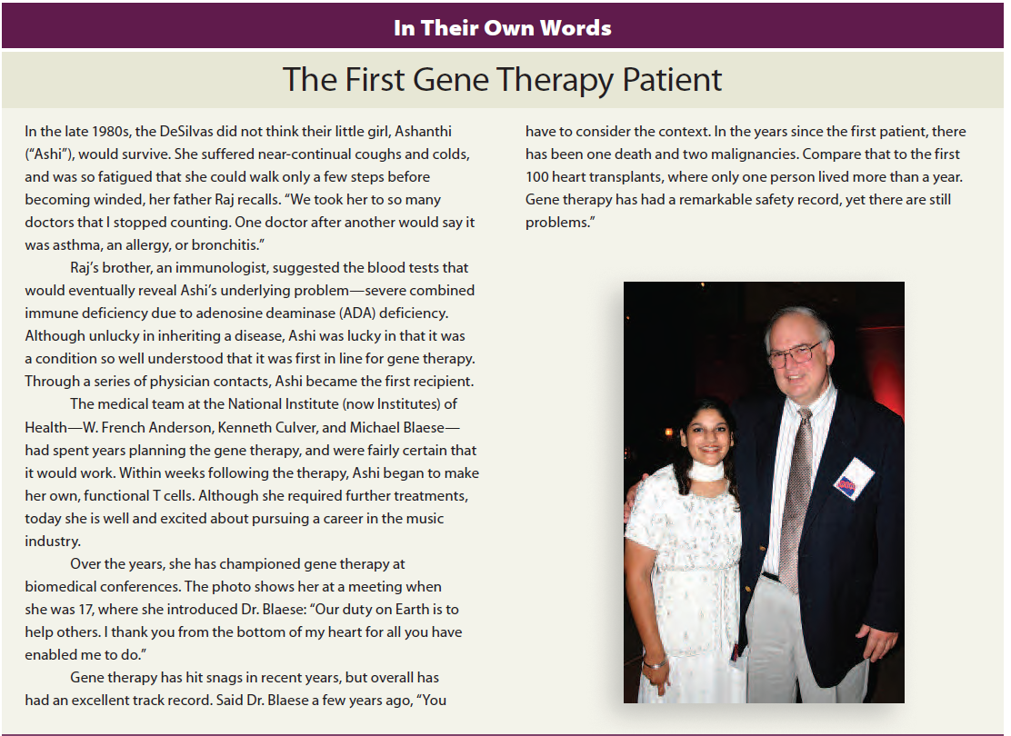

Slide 20
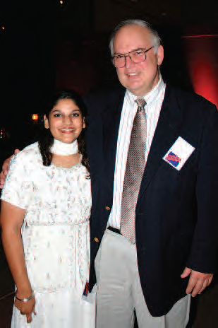
September 14, 1990 at NIH, French Anderson and R. Michael Blaese perform the first gene therapy Trial.
Ashanti (4 year old girl) Her lymphocytes were gene-altered (~10⁹) ex vivo
→ retrovirus vector used as a vehicle for gene introduction using to carry ADA gene (billions of retroviruses used)
Cynthia (8 year old girl) treated in same year.

Slide 21
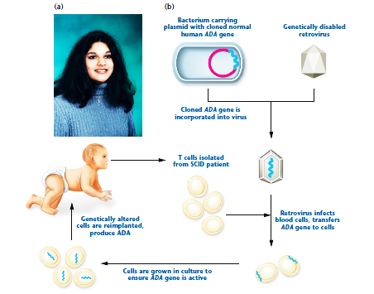

Slide 22
Crystal and Leonard Gobea had already lost a 5-month old baby to ADA deficiency when amniocentesis revealed that their second fetus was affected.
They and two other couples participated in an experiment. Andrew Gobea and the other two babies received their own bolstered cord blood cells on the fourth day after birth, with PEG-ADA to prevent symptoms in case the gene therapy did not work right away.
T cells carrying normal ADA genes gradually appeared in their blood. By the summer of 1995, the three toddlers each had about 3 in 100 T cells carrying the ADA gene, and they continued to improve.

Slide 23
A few years after the three children with ADA deficiency were treated, another gene therapy trial for SCID began in France.
Nine baby boys with a type of X-linked SCID had T cell progenitors removed and given the gene they were missing, which encodes part of a cytokine receptor.
The therapy worked, but caused leukemia in three boys when the retrovirus that delivered the therapeutic gene inserted into a protooncogene.
The boys were successfully treated for the leukemia.

Slide 24
A Major Setback
Eighteen-year-old Jesse Gelsinger died in September 1999, days after receiving gene therapy

Slide 25
Ornithine transcarbamylase (OTC) deficiency Urea cycle disorder (1/10,000 births).
Encoded on X chromosome. Females usually carriers, sons have disease.
Urea cycle = series of 5 liver enzymes that rid the body of ammonia (toxic breakdown product of protein).
If enzymes are missing or deficient, ammonia accumulates in the blood and travels to the brain and leads to coma, brain damage or death.

Slide 26
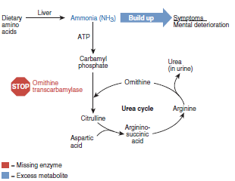

Slide 27
Jesse Gelsinger:
Gene therapy began Sept. 13, 1999.
He went to Coma on Sept. 14, Brain dead and life support terminated on Sept. 17, 1999.
Cause of death: Respiratory Disease Syndrome.

Slide 28
Requirements for Approval of Clinical Trials for Gene Therapy
Knowledge of defect and how it causes symptoms.
An animal model.
Success in human cells growing in vitro.
No alternate therapies, or patients for whom existing therapies are not possible or have not worked.
Safe experiments.

Slide 29
TYPES OF GENE THERAPY

Slide 30
Germline gene therapy
Alters the DNA of a gamete or fertilized ovum. As a result, all cells of the individual have the change.
Germline gene therapy is heritable—it passes to offspring.
It is not being done in humans, although it creates the transgenic organisms
Somatic gene therapy
Corrects only the cells that an illness affects.
It is nonheritable: A recipient does not pass the genetic correction to offspring.
Clearing lungs congested from cystic fibrosis with a nasal spray containing functional CFTR genes is a type of somatic gene therapy.

Slide 31
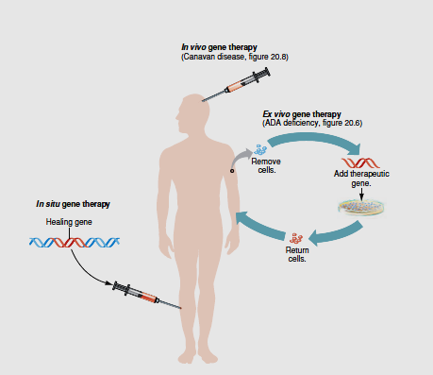
Gene therapy approaches vary in invasiveness
Ex vivo gene therapy:
Cells can be altered outside the body and then infused.
In situ gene therapy:
The functional gene plus the DNA that delivers it (the vector) are injected into a very localized and accessible body part, such as a single melanoma skin cancer.
In vivo gene therapy:
(in the living body)
In the most invasive approach, the gene and vector are introduced directly into the body.

Slide 33
In vivo techniques usually utilize viral vectors
Virus : carrier of desired gene
Virus is usually “crippled” to disable its ability to cause disease.
Viral methods have proved to be the most efficient to date.
Many viral vectors can stable integrate the desired gene into the target cell’s genome.

Slide 35
In-situ Gene Therapy
Direct administration of therapeutic gene to the affected tissues.
Injection into a tumor nodule or organs such as GLIOMA-malignant progression of glial cells.

Slide 36
Techniques of Gene Therapy
Addition
Normal gene inserted into a non-specific location within the genome to replace non- functional gene.
Replacement
Abnormal gene swapped for a normal gene through homologous recombination.
Correction
Abnormal gene repaired through selective reverse mutation.

Slide 37
Delivering methods of a Gene
Physical Methods
Microinjection.
Direct DNA injection.
Gene gun.
Electroporation.

Slide 38
Chemical Methods
Receptor mediated gene delivery.
Embryo therapy through IVF-technology.
Biological Methods
Retrovirus.
Adeno-associated virus.
Adeno virus.

Slide 39
Vectors used in gene therapy
Vectors | Advantages | Disadvantages
Retrovirus | -Efficient transfer -Long term expression | Transfers DNA only to dividing cells, inserts randomly; risk of producing wild type virus; insertional mutation.
Adenovirus | -Transfers to non dividing cells -Can carry large therapeutic genes | Causes immune reaction.
Adeno-associated virus | -Does not cause immune reaction to nonpathogenic -Does not integrate so no risk of insertional inactivation | Holds small amount of DNA; hard to produce.
Herpes virus | -Can insert into cells of nervous system; | Hard to produce in large quantities.
Lentivirus | -Can accommodate large genes -Capable of infecting non dividing cells -Insertional inactivation is low | Safety concerns.

Slide 40
Vectors used in gene therapy
Vector | Advantages | Disadvantages
Gene pills | -Pill deliver the gene to the intestine
Liposomes | -No replication; does not stimulate immune reaction | Low efficiency
Direct injection | -No replication; directed toward specific tissues | Low efficiency; does not work well within some tissue

Slide 41
A few somatic gene therapies under investigation.
Endothelium
Genetically altered endothelium can secrete a needed protein directly into the bloodstream.
Skin
Skin cells grow well. A person can donate a patch of skin after a genetic manipulation, the sample can grow to the size of a bathmat within 3 weeks, and the skin can be grafted back onto the person. Skin grafts can be genetically modified to secrete therapeutic proteins.

Slide 42
A few somatic gene therapies under investigation.
Muscle
Muscle comprises about half of the body’s mass, is easily accessible, and is near a blood supply. treatments for muscular dystrophies.
Liver
This largest organ is an important candidate for gene therapy because it has many functions and can regenerate. To treat some inborn errors, as little as 5 percent of the liver’s 10 trillion cells would need to be corrected.

Slide 43
Lungs
The respiratory tract is easily accessed with an aerosol spray. Several aerosols to treat cystic fibrosis replace the defective gene, but the correction is short-lived and localized.
Nervous Tissue
Neurons are difficult targets because they do not divide. Gene therapy can alter other cell types, such as fibroblasts to secrete nerve growth factors or manufacture the enzymes necessary to produce certain neurotransmitters. Then the altered cells are implanted.

Slide 44
Cancer
About half of current gene therapy trials target cancer. These approaches enable cancer cells, or their neighbors, to produce proteins that dampen oncogene expression, bolster tumor suppression, strengthen or redirect the immune response, or induce apoptosis

Slide 45
Two Success Stories
Efforts begun in 1995 to treat Canavan disease continued, despite Jesse Gelsinger’s fate.
Canavan disease is an ideal candidate for gene therapy for several reasons:
1. The gene and protein are well known.
2. There is a window of time when affected children are healthy enough to be treated.
3. Only the brain is affected.
4. Brain scans can monitor response to experimental treatment.
5. No traditional treatment exists.

Slide 46
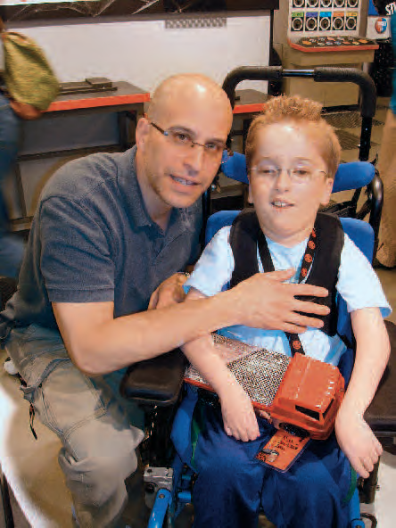
Fighting Canavan Disease
Max Randell was not expected to survive his first 2 years. Today, he is on the brink of adolescence, thanks to gene therapy

Slide 47
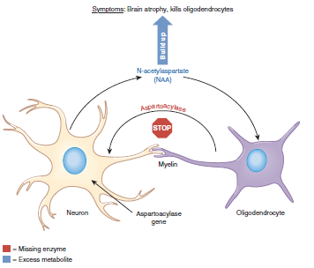

Slide 48
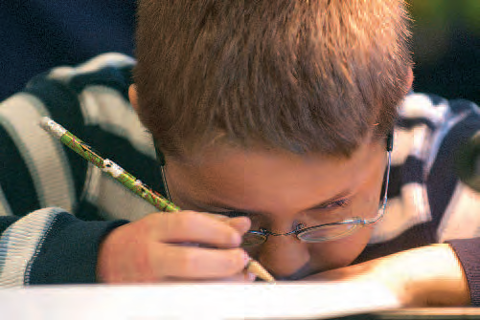
Gene therapy for Leber’s congenital amaurosis II

Slide 49
Scientific
1. Which cells should be treated, and how?
2. What proportion of the targeted cell population must be corrected to alleviate or halt progression of symptoms?
3. Is overexpression of the therapeutic gene dangerous?
4. Is it dangerous if the altered gene enters cells other than the intended ones?
5. How long will the affected cells function?
6. Will the immune system attack the introduced cells?
7. Is the targeted DNA sequence in more than one gene?

Slide 50
Bioethical
Does the participant in a gene therapy trial truly understand the risks?
If a gene therapy is effective, how will recipients be selected, assuming it is expensive at first?
Should rare or more common disorders be the focus of gene therapy research and clinical trials?
What effect should deaths among volunteers have on research efforts?
Should clinical trials be halted if the delivered gene enters the germline?

Slide 51
Success of Gene Therapy
Successes in 2009-11 bolstered new optimism in the promise of GENE THERAPY.
Retinal disease Leber’s Congenital Amaurosis
X- Linked SCID
ADA- SCID
Adrenoleuco Dystrophy
Parkinson’s disease
Has led to renewed interest in gene therapy

Slide 52
Cystic fibrosis
“Crippled” adenovirus selected (non-integrating, replication defective, respiratory virus)
Gene therapy trials – 3 Research teams, 10 patients/team
2 teams administered virus via aerosol delivery into nasal passages and lungs
1 team administered virus via nasal passages only
Only transient expression observed → because adenovirus does not integrate into genome like retroviruses

Slide 53
Using Stem Cell for Gene Therapy
HSCs ideal for gene therapy
Self renewable, hence repeated administration of gene therapy can be reduced or eliminate
Easily isolated from blood, bone marrow and umbilical cord.

Slide 54
Myoblasts: injected into muscle tissues.
Neural stem cells: potent for treating gliomas.
ESCs provide maintenance for therapeutic effects rather than adult stem cells.

Slide 55
Chimeraplasty
Non-viral method.
Changing of DNA sequences in a person’s genome.
Synthetic strand composed of RNA and DNA(chimeraplast) used.
Chimeraplast enters a cell and attaches itself to a target gene.

Slide 56
Enhancement Gene Therapy ? ? ?
Finding the right genes to alter-most human traits are controlled by multiple genes.
“NATURE verses NURTURE”-No human trait is determined solely by genes.

