Slide 1
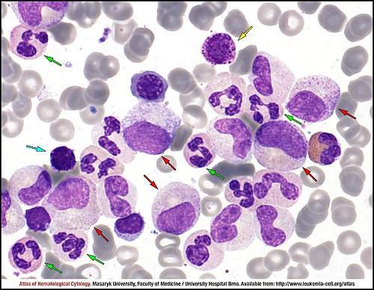
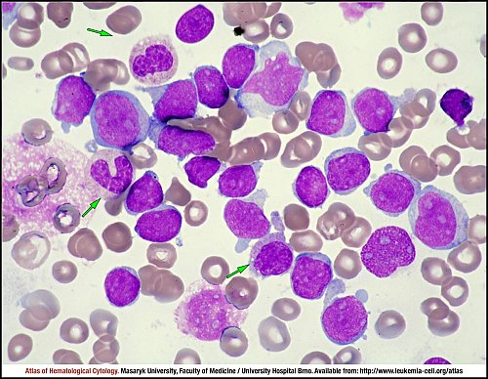
A Few Basics: What is CML?
Cancer of bone marrow stem cells
Three phases: chronic, accelerated, blast
Most patients are diagnosed in chronic phase
  Often without symptoms
Untreated, all patients progress to accelerated / blast phase within 3-5 years
Atlas of Haematological Cytology [online]. 2016 [cit. 2018-9-16]. Available from WWW: http://www.leukemia-cell.org/atlas.

Slide 2
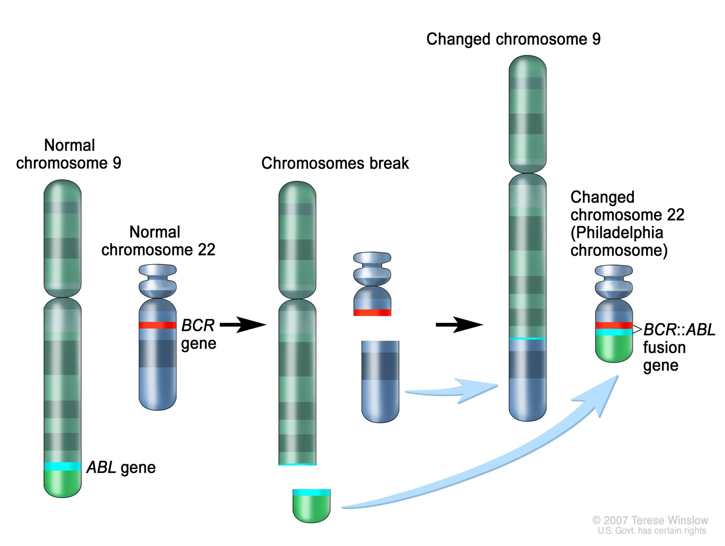
WHAT DOES HAPPEN IN CML ?
PHILADELPHIA CHOROMOSME?

Slide 3
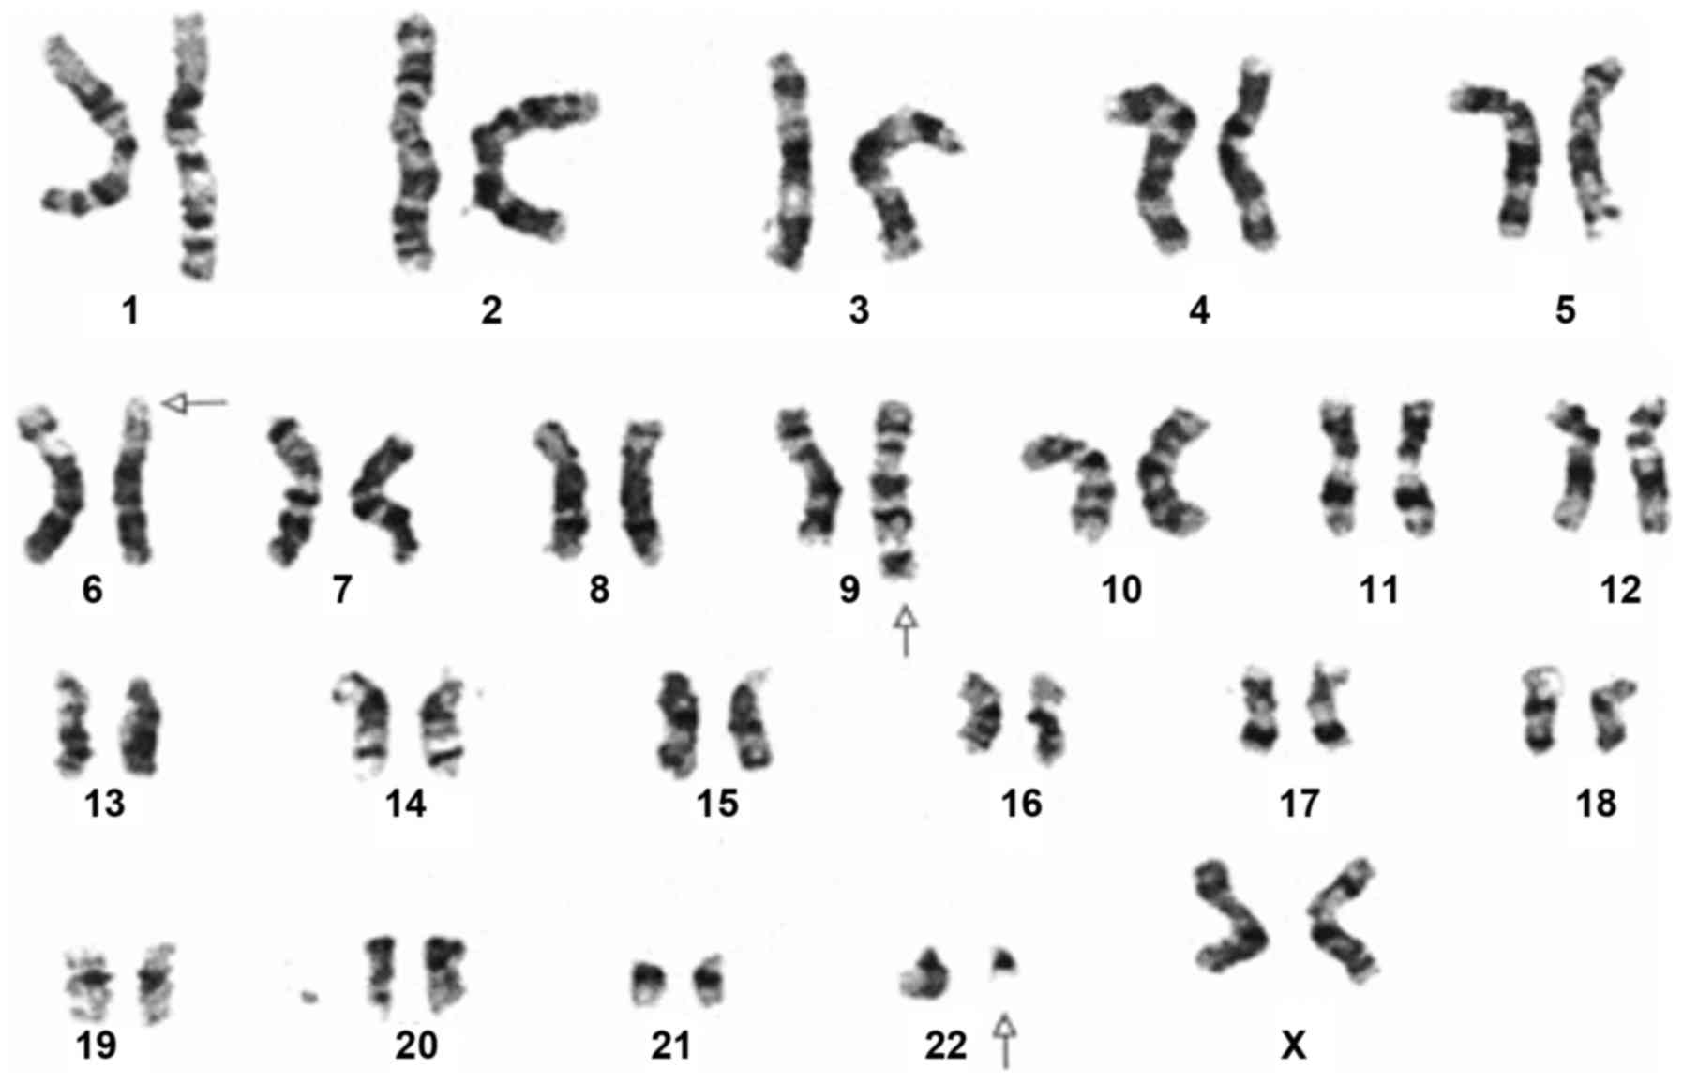
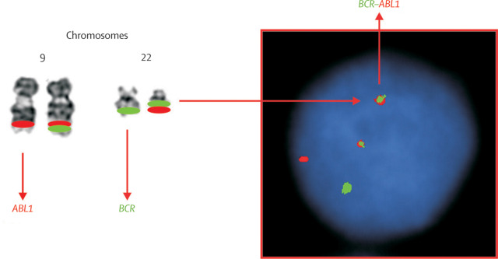
A Few Basics: What is CML?
Characterized by a translocation between chromosomes 9 and 22, denoted as t(9;22) which results in an abnormal juxtaposition of two genes, bcr and abl
Images courtesy of Spandidos Publications and The Lancet

Slide 4
How Do We Know If Treatment is Working?
Hematologic response (CBC [complete blood count])
  Normal blood counts
Cytogenetic response (bone marrow cytogenetics [“karyotype”])
  Major (MCyR): < 35% of cells have the Philadelphia chromosome
  Complete (CCyR): 0% of cells have the Philadelphia chromosome
Molecular response (Quantitative PCR, International Scale [qPCR, IS])
  MR3 (0.1%) aka “major molecular response” or MMR
  MR4.5 (0.01 – 0.001%)
  Complete or deep molecular response (CMR or DMR): no detectable bcr/abl

Slide 5
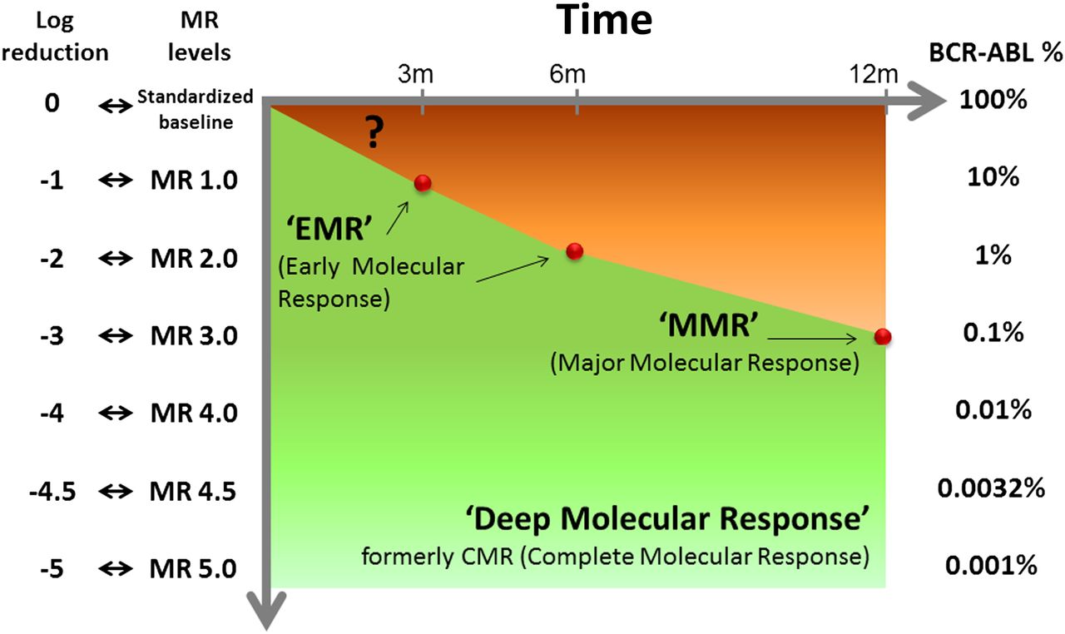
How Do We Know if Treatment is Working?
Baccarani M, Soverini S. Blood 124:469-47, 2014.

Slide 6
Impact of TKIs
Until imatinib approved (FDA 2001), most patients treated with supportive care, hydroxyurea, interferon, and allogeneic hematopoietic cell transplantation (“bone marrow transplant”)
Tyrosine kinase inhibitors (“TKIs”) have revolutionized this disease
Bower H et al. J Clin Oncol 34:2851-57, 2016.

Slide 7
Treatment Advances for CML: TKIs
Bosutinib
  Overcomes most imatinib-resistant mutations
  Approved for 1st line therapy in late 2017
  BELA trial (2012), 502 patients: bosutinib 500 mg vs imatinib 400 mg, evaluated at 12 months
    CCyR (primary endpoint) equivalent: 70% (B) vs 68% (I)
    MMR better for bosutinib: 41% (B) vs 27% (I)
  BEFORE trial (2017), 536 patients: bosutinib 400 mg vs imatinib 400 mg, evaluated at 12 months
    MMR (primary endpoint) better for bosutinib: 47% (B) vs 37% (I)
    CCyR also better for bosutinib: 77% (B) vs 66% (I)
    Significantly more diarrhea (8% vs 1%) with bosutinib

Slide 8
Treatment Advances for CML: TKIs
Ponatinib
  The only commercially available TKI effective for patients with T315I mutations
  Significant cardiovascular risks
Radotinib*
  Structurally similar to imatinib and nilotinib
  Approved in Korea for 1st line and later therapy
  2nd line: 77 patients (2014)
    MCyR 65%, CCyR 47%, MMR 14% at 12 months
  1st line radotinib 300 mg vs imatinib 400 mg: 241 patients
    MMR 52% (R) vs 32% (I), CCyR 91% (R) vs 77% (I)
    *Radotinib is not FDA-approved
Kim SH et al. Haematologica 99(7): 1191-1196, 2014.
Kwak JY et al. Clin Cancer Res Dec 2017, Epub ahead of print.

Slide 9
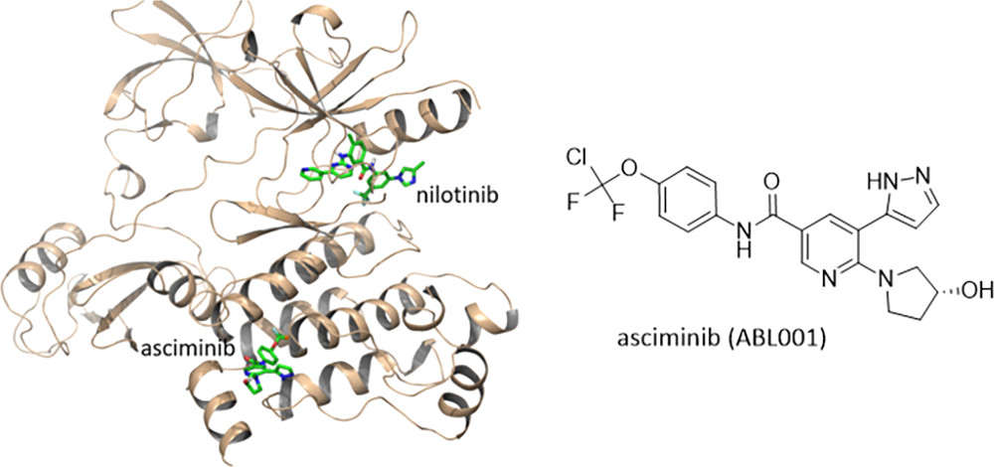
Treatment Advances for CML
Asciminib (ABL001)*
  Potent and selective inhibitor of BCR-ABL
  Different site from other TKIs, allowing possible co-treatment
  Promising early data
  Resistance may occur
    ABL mutations
    Proteins that pump drug out of the cells
  4 open clinical trials, alone or in combination with existing TKIs
  *Asciminib is not FDA approved
Schoepfer J et al. J Med Chem, Sep 2018. Epub ahead of print.

Slide 10
Treatment Advances for CML
Targeting leukemic stem cells (LSCs)
  JAK2 and STAT5 pathways: ruxolitinib
  PPARγ inhibitors: pioglitazone
  Autophagy inhibitors: hydoxychloroquine
  Immune activation: IFNα, IL-1 receptor antagonists, others
Bhatia R. Hematology Am Soc Hematol Educ Program. 2017 Dec 8;2017(1):115-120

Slide 11
Treatment-Free Remission
Dec 2017: FDA approved a discontinuation indication for nilotinib
History:
  2007: 12 patients on imatinib with undetectable bcr/abl > 2 years
    6 remained in remission
  2010: STIM trial: 100 patients (69 with 1-year follow up)
    39 patients (43%) remained in remission
    Longer duration of imatinib predicted freedom from relapse
  2013: TWISTER, and others, confirmed that for about 40-50% of patients, long-term treatment-free remission is possible
Rousselot P et al. Blood 109:58-60, 2007.
Mahon FX et al. Lancet Oncol 11:1029-35, 2010.
Ross DM et al. Blood 122(4):515-22, 2013.

Slide 12
Treatment-Free Remission: Who is eligible?
Ability to monitor bcr/abl transcript on IS testing
  b2a2 or b3a2 transcript
No prior resistance to TKIs
  Some recent studies suggest some 2nd line patients may be successfully discontinued
No prior accelerated or blast phase
Minimum of 3 – 5 years on TKI, but longer (8 years) is preferred
Minimum of 12 months undetectable bcr/abl on IS testing, but longer (2 years) is preferred
Willingness to comply with intensive follow up qPCR testing

Slide 13
Treatment Free Remission: How to monitor?
Most patients relapse within 6-9 months
qPCR for bcr/abl in IS lab with prompt results:
  Every 4 weeks during year 1
  Every 6 weeks during year 2
  Every 12 weeks during year 3 and thereafter
Upon loss of response, re-initiate effective TKI therapy immediately and monitor bcr/abl every 2 weeks until MMR is regained / sustained
Nilotinib (and imatinib) withdrawal syndromes have been described
Not all patients wish to discontinue therapy

