Slide 1
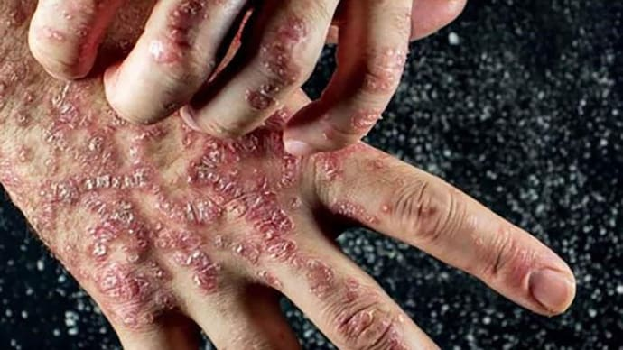
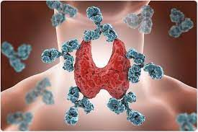
Immunological disorders
Lecture includes:
Hypersensitivities
Autoimmune-diseases
Immunodeficiencies- HIV

Slide 2
What can go wrong with your immune system which leads to Immuno-deficiency?
When your immune system doesn't work the way it should, it is called an immune system disorder. You may:
Be born with a weak immune system. This is called primary immune deficiency.
Get a disease that weakens your immune system. This is called acquired immune deficiency.
Have an immune system that is too active. This may happen with an allergic reaction.
Have an immune system that turns against you. This is called autoimmune disease.

Slide 3
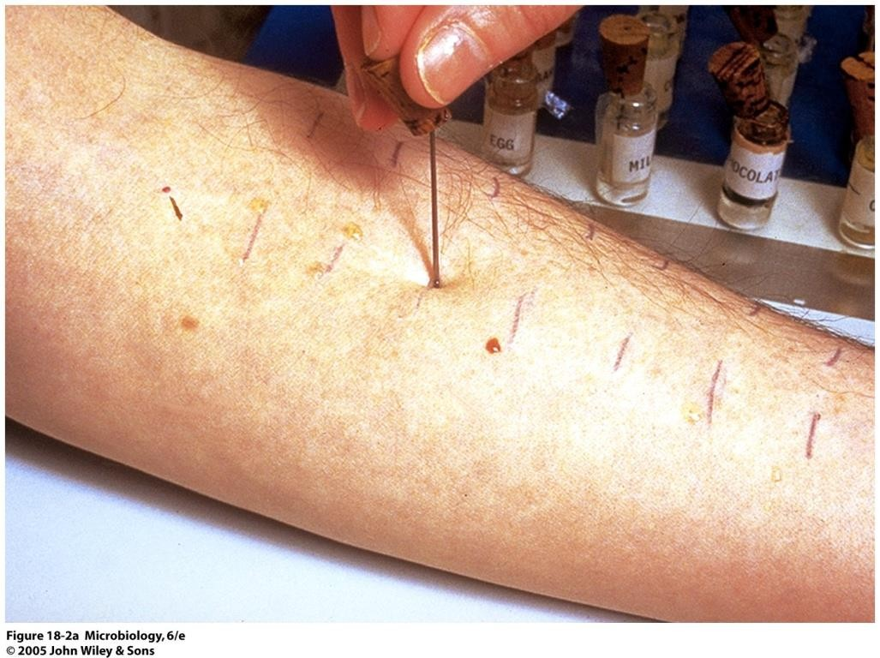
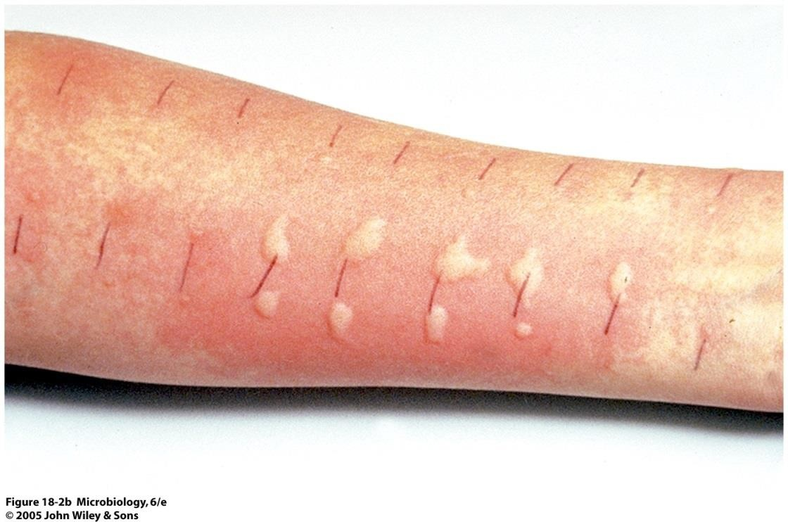
Hypersensitivities

Slide 4
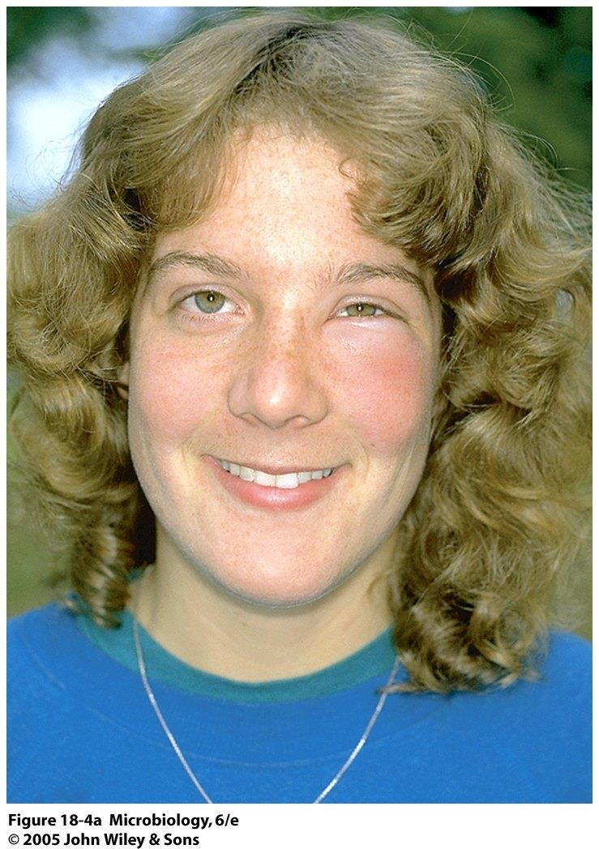
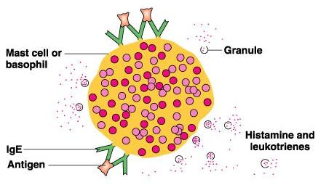
Type I: anaphylactic reactions
Sensitization: B cell makes IgE to Ag; IgE
binds to mast/basophil cells
Secondary exposure: immediate reaction due to crosslinking of > 1 IgE by Ag on mast/basophil cell → degranulation
Reaction time: usually <30 minutes

Slide 5
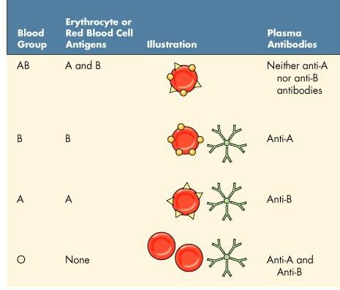
Type II: cytotoxic reactions ABO blood group system
IgG and IgM bind to cell →
activates complement and macrophage → cell
death
Reaction time: 5-12 hours

Slide 6
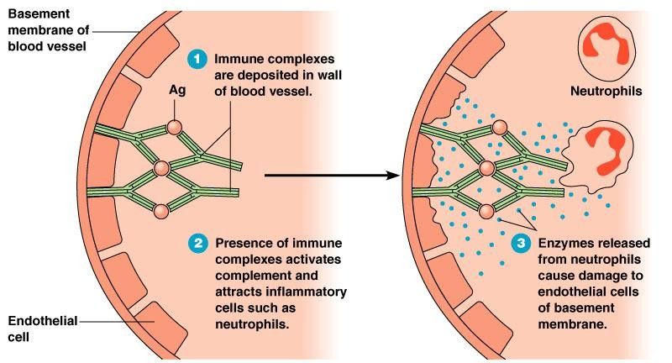
Type III: immune complex reactions
Immune reaction against soluble antigens
Ratio of antibody to antigen (slight excess of antigen) → binding occurs → complex sticks into basement membrane of cells → triggers inflammation via neutrophils
Reaction time: 3-8 hours

Slide 7
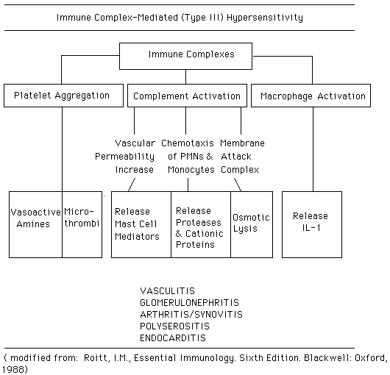

Slide 8
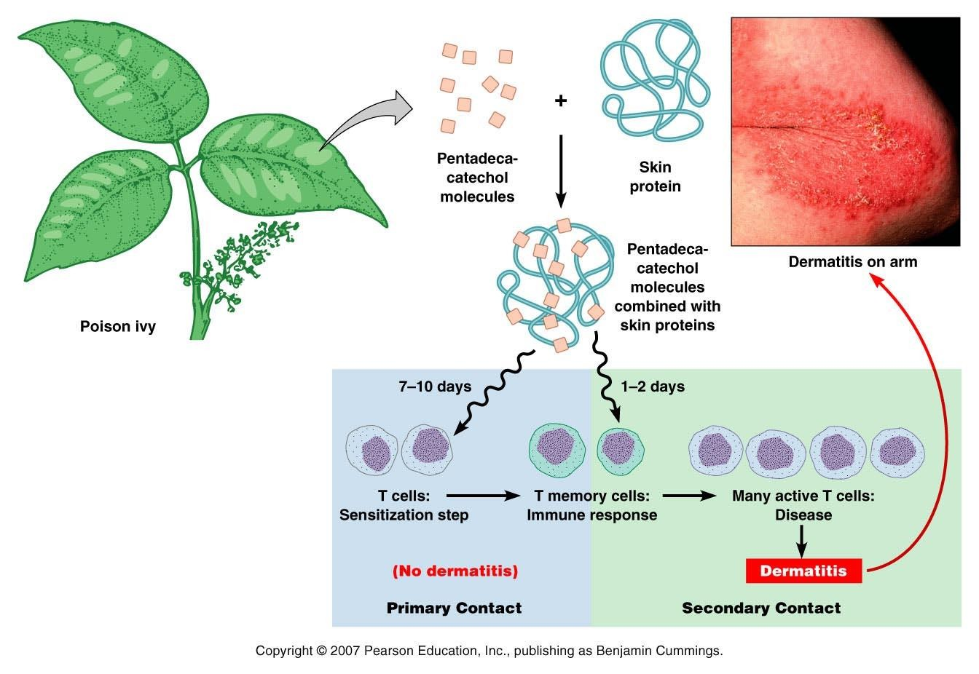
Type IV: cell mediated reactions
Sensitization: Ag phagocytized and presented by macrophage → stimulates T-cells
Secondary exposure: memory
T cells activate T cells/ macrophage which migrate to
site and release cytokines
Reaction time: 1-2 days (“delayed hypersensitivity reaction”)

Slide 9
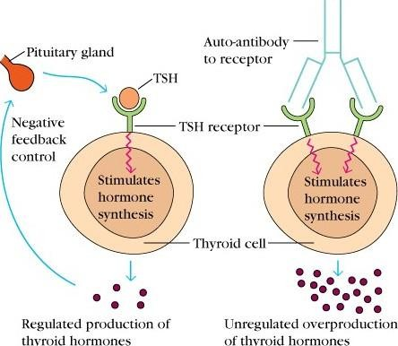
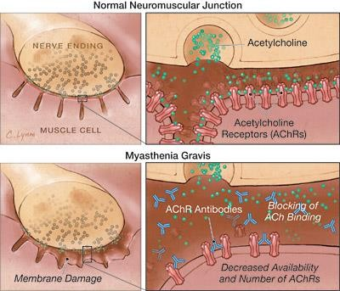
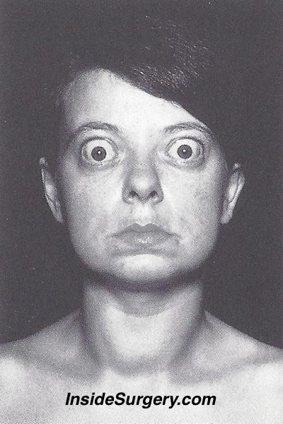
Autoimmune diseases- cytotoxic reactions
Myasthenia gravis
Grave’s disease

Slide 10
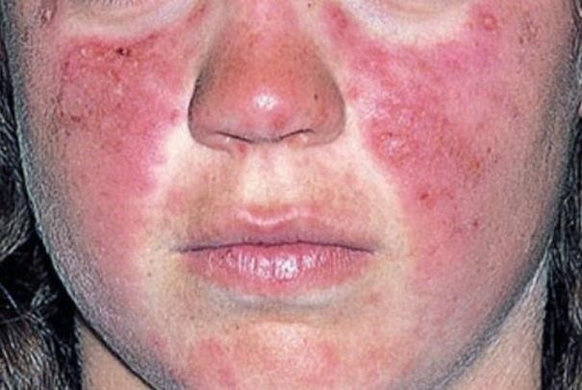
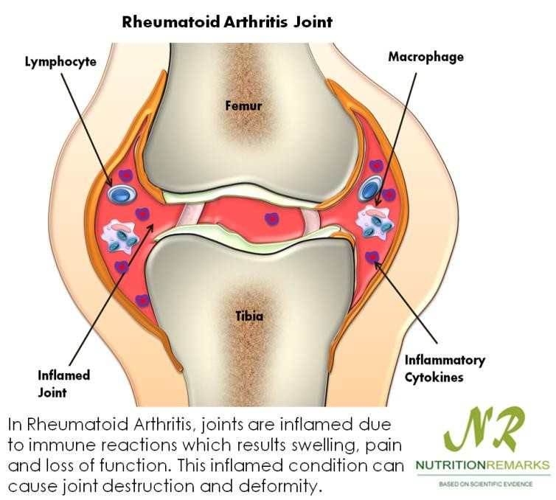
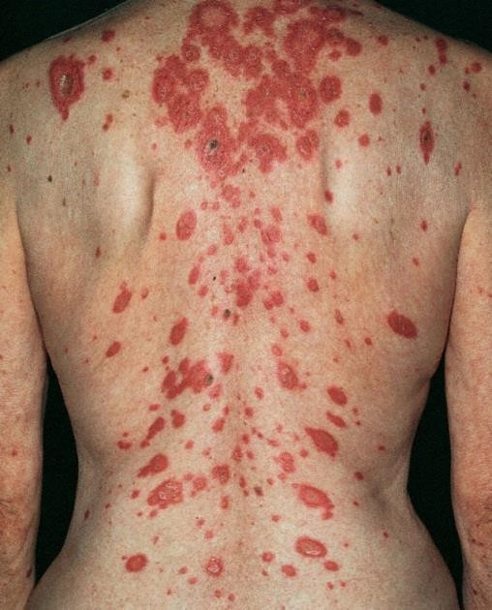
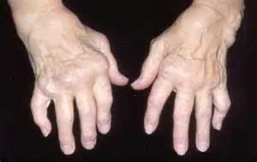
Autoimmune diseases- immune complex reactions
LUPUS
Rheumatoid arthritis

Slide 11
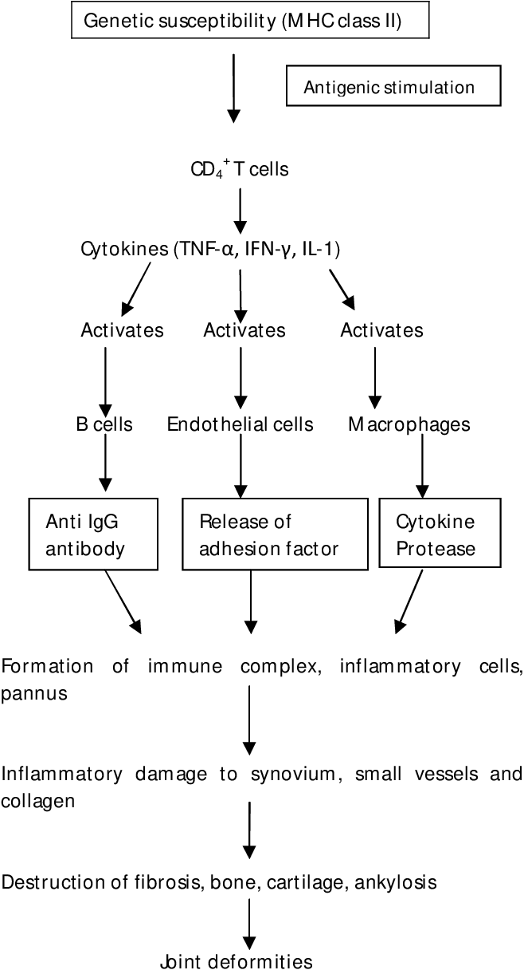

Slide 12
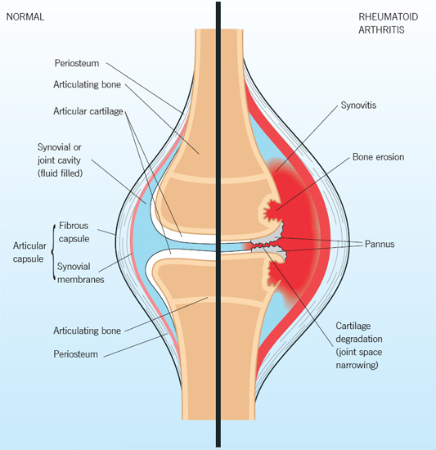

Slide 13
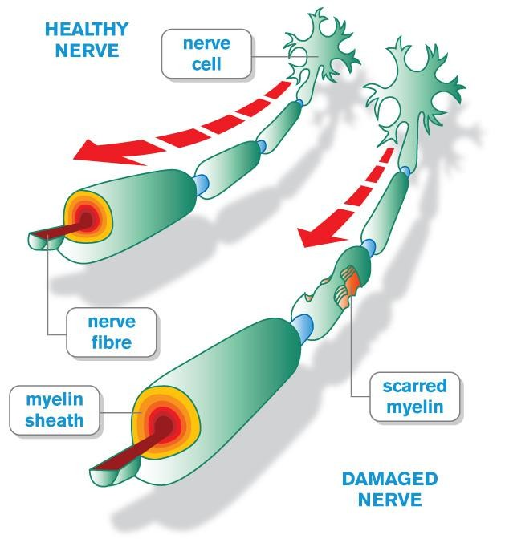
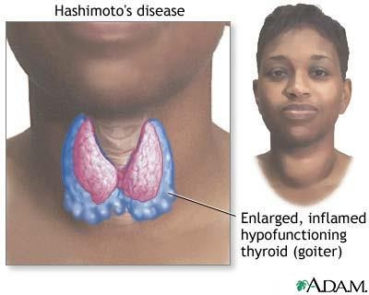
Autoimmune diseases- cell mediated reactions
Hashimoto’s thyroiditis
Multiple sclerosis

Slide 14
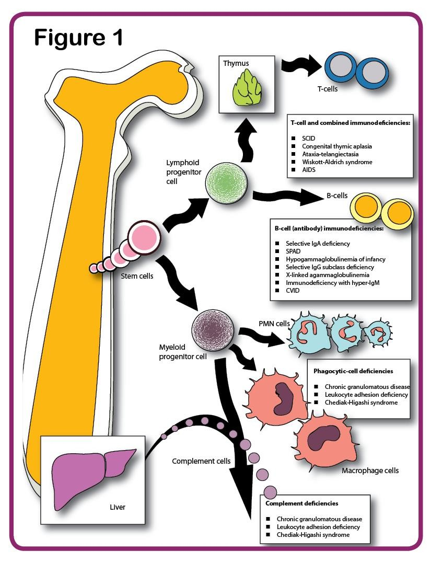
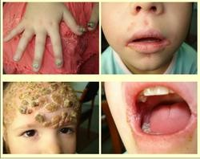
Immunodeficiencies- congenital
Severe Combined Immunodeficiency Disorder (SCID)
IgA immunodeficiency
tommythedoc.weebly.com

Slide 15
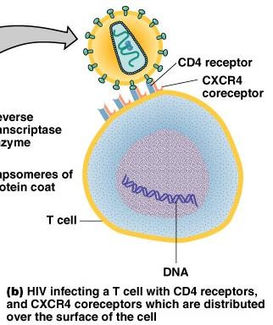
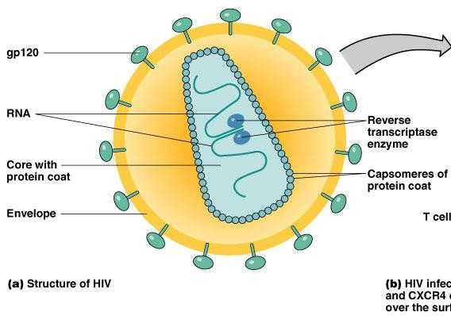
Immunodeficiencies- acquired
HIV
tommythedoc.weebly.com

Slide 16
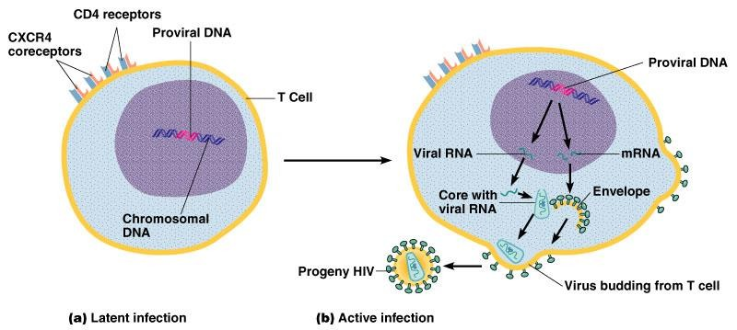
HIV infection
Helper T cell infection

Slide 17
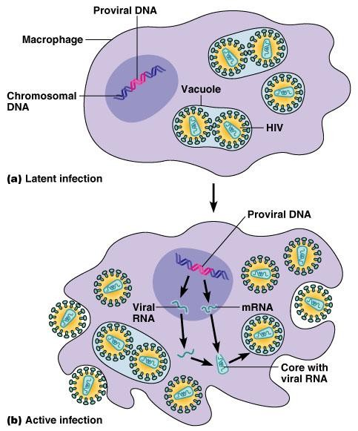
HIV infection
Macrophage infection

Slide 18
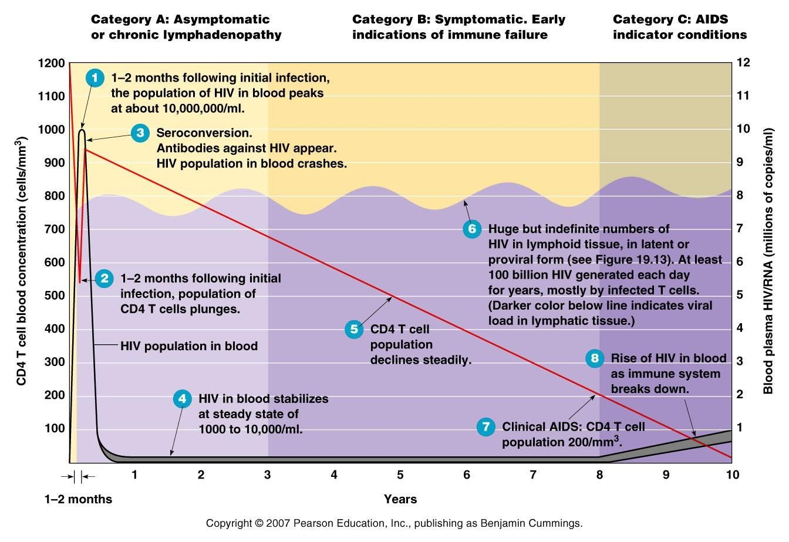
Stages of HIV infection

Slide 19
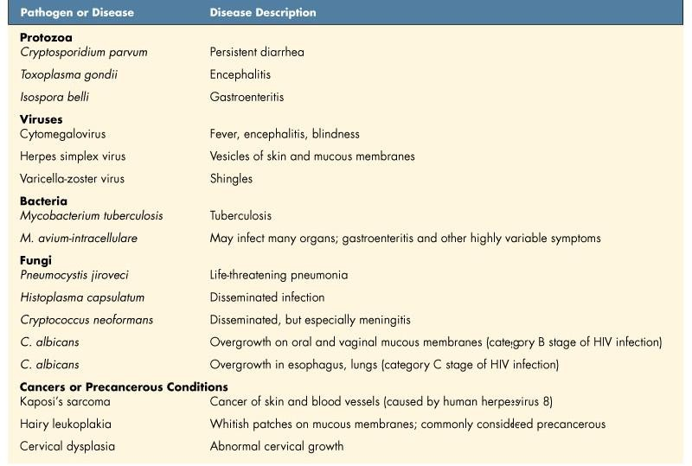
Diseases associated with HIV infection
Table 19.5

Slide 20
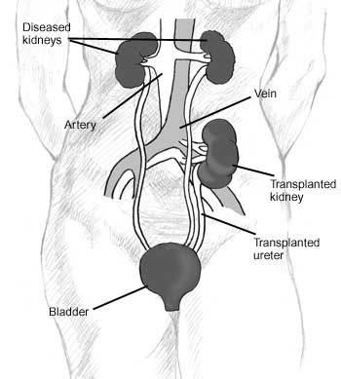
Transplants- an induced disorder of the immune system
Transplant types with increasing risk of immune rejection
Autograft Isograft Allograft
Xenograft

Slide 21
Stem cells- a way around tissue transplant rejection?
Totipotent stem cells: first few cells produced after fusion of sperm
and egg; capable of generating all tissue types
Pluripotent stem cells: cells derived from totipotent cells; capable of
generating multiple tissue types from the three germ layers
Multipotent stem cells: cells capable of generating cells of related type (e.g. Hematopoietic stem cells can form blood and lymphatic tissue)
Unipotent stem cells: cells can only form one cell type, but can
regenerate

Slide 22
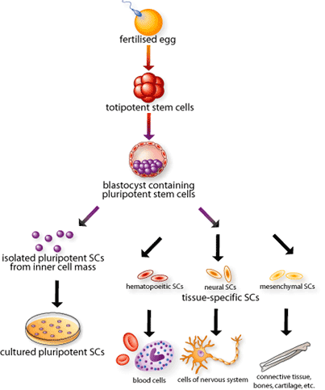
Stem cells

Slide 23
Stem cell sources
THE PRESENT
Embryonic stem (ES) cells: pluripotent
Umbilical cord stem cells: multipotent and some pluripotent
Adult stem cells: rarely pluripotent, mostly unipotent
AND FUTURE
- Induced pluripotent stem cells (iPSC): insertion of 4 genes into fibroblast with retroviral vector (11/07)
- iPSCs from murine embryonic fibroblasts using recombinant cell- penetrating reprogramming proteins (4/09)
- iPSCs using fibroblasts and microRNA (4/11)
- iPSCs from exfoliated renal epithelial cells (11/12)

Slide 24
Independent study
Attendance is still counted at this point in the semester.
You must attend all classes for Case Study material.
Print out Case Study Handout, Glossary, and first Case Study: Skin and Eye Diseases and bring to class on Thursday

