Slide 1
HUMAN DIGESTIVE SYSTEM & ASSOCIATED GLANDS
Sarojmoni Sonowal
Assistant Professor
Pub kamrup College, Baihata Chariali

Slide 2
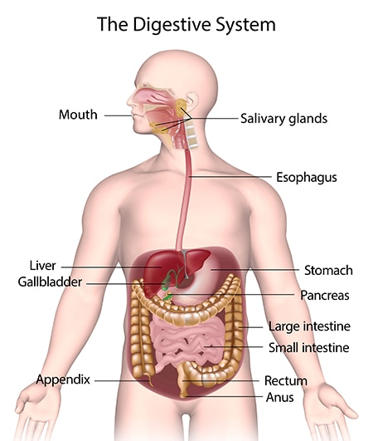
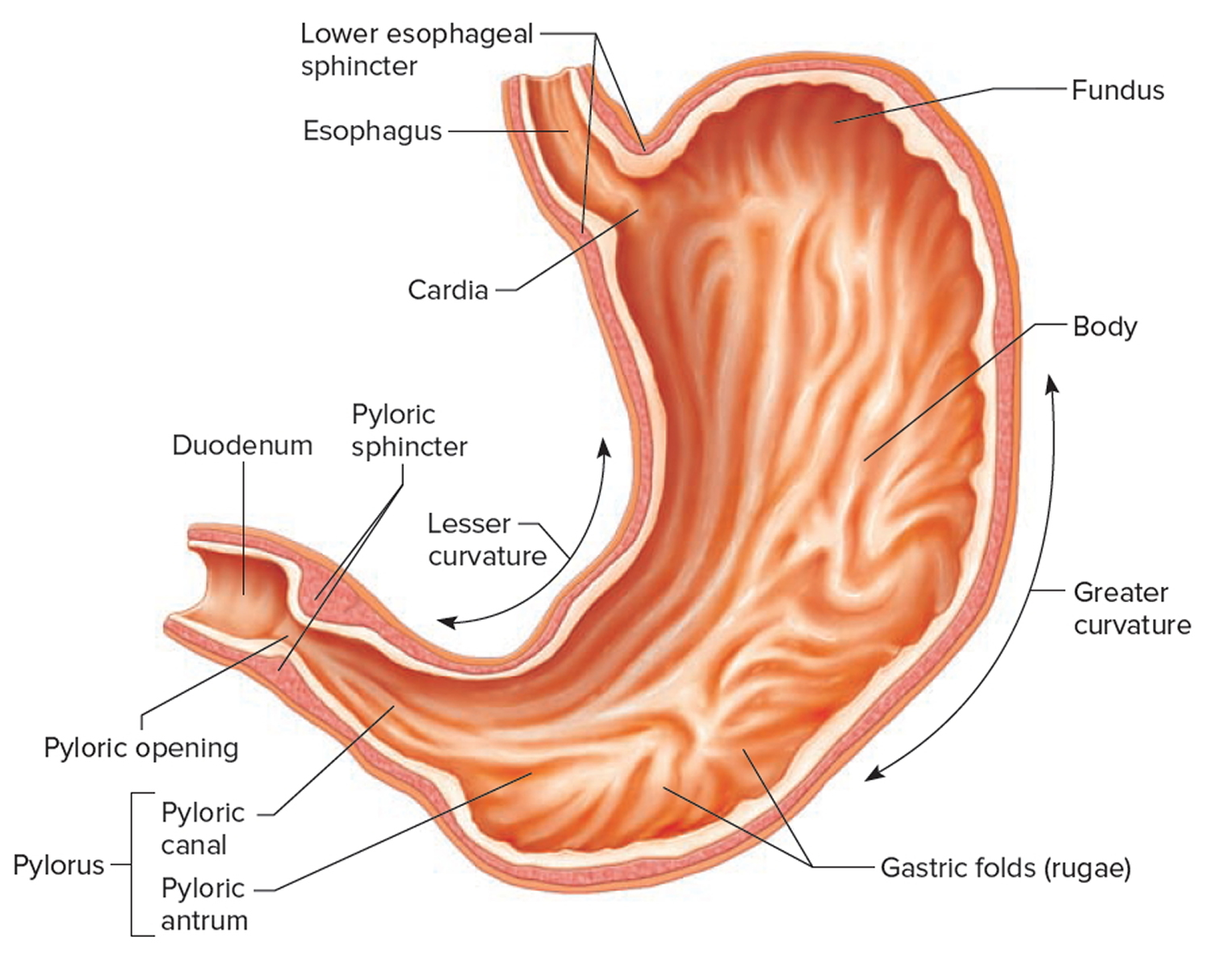
STOMACH
Stomach is the most distensible portion of the alimentary canal
Thick, muscular J shaped Organ
Measures about 30 cms x 10 cms
Formed of different parts
Cardia: The cardia is the top part of your stomach. It receives the oesophagus and guarded by cardiac sphincter.
2. Fundus: It is a rounded section next to the cardia. It's below your diaphragm.
3. Body (corpus): It is the largest section of your stomach, domed shaped. In the body, your stomach contracts and begins to mix food.
4. Pylorus: The pyloric antrum lies below the body. It holds food until your stomach is ready to send it to your small intestine.
Lower and narrow part of the stomach which opens in the duodenum by pyloric sphincter.

Slide 3
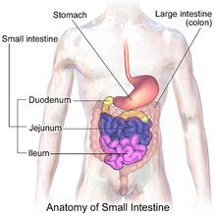
SMALL INSTESTINE
Small intestine is a narrow tube like structure, longest part of the alimentary canal about 5-6 m long.
Occupies the central and lower parts of abdominal cavity
Divided into 3 parts:
Duodenum: C shaped, widest and shortest segment- (25cm long)
Receives the hepatopancreatic duct, the opening of which is guarded by sphincter of Oddi--Chemical neutralization and digestion
Jejunum (middle part, about 2m long)
primary function: Absorption
Ileum (longest part, about 3 m long). It finally opens into caecum. Opening is guarded by ilio caecal valve
Absorbs remaining nutrients particularly vitamin B12.

Slide 4
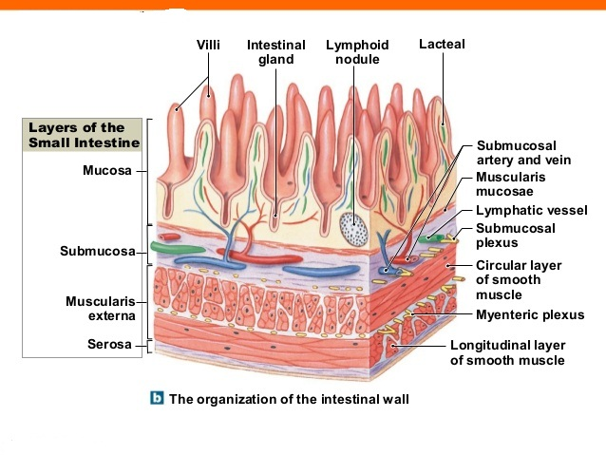
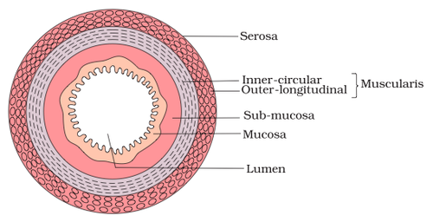
4 LAYERS OF THE SMALL INTESTINE
Wall of the small intestine is made up of 4 layers
Serous
Muscularis
Submucous
mucous

Slide 5
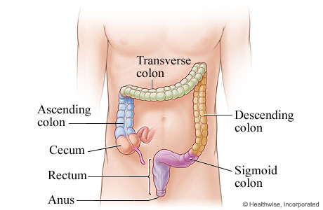
LARGE INTESTINE
Large intestine is 1.5 m long, shorter but wider than small intestine.
It is formed of 3 parts:
CAECUM: pouch like structure which ends into a tubular structure called vermiform appendix.
COLON: Long sized structure which is differentiated into 4 regions—reabsorbs water, sodium and other minerals.
Ascending colon
Transverse colon
Descending colon
Sigmoid or pelvic colon
3. RECTUM: 13 cm long concerned with temporary storage of faeces.

Slide 6
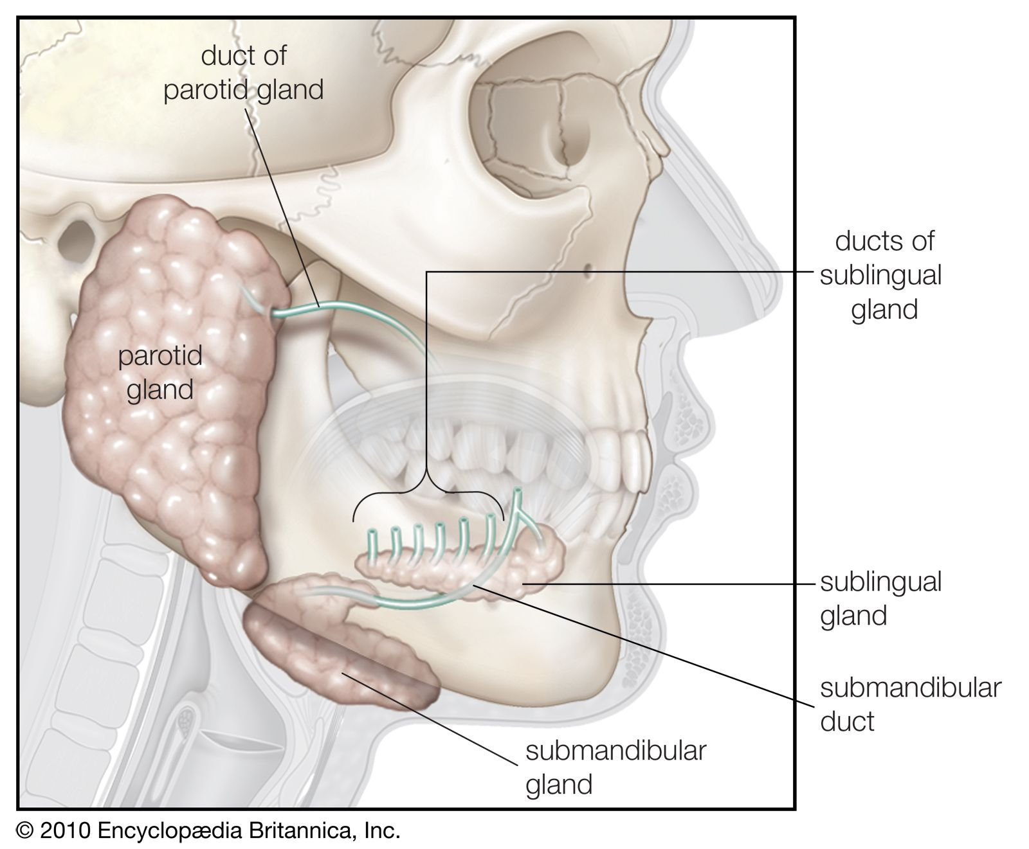
ASSOCIATED DIGESTIVE GLANDS
Digestive glands are those which secretes digestive juices for the digestion of food. They are of following types:
SALIVARY GLANDS: 3 Pairs- Secretes saliva
PAROTID GLAND
SUBMANDIBULAR GLAND
SUB LINGUAL GLAND
SALIVA COMPOSITION
Colorless liquid with p H =6.8
Saliva is formed of 98-99% water, 0.2 % salts, mucus, ptyalin and lysozyme.
FUNCTION
Saliva lubricates and makes the passage of food easy
The water in saliva keeps mouth moist.
Saliva contains salivary amylase helps in digestion
It contains lysozyme- killing bacteria.

Slide 7
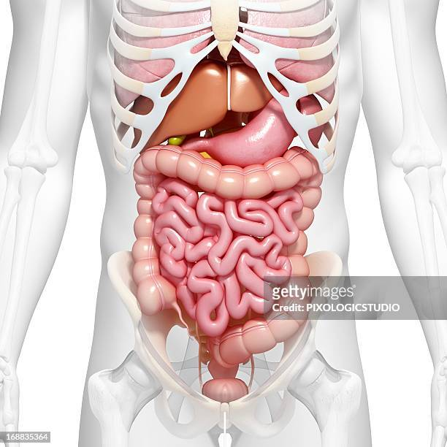
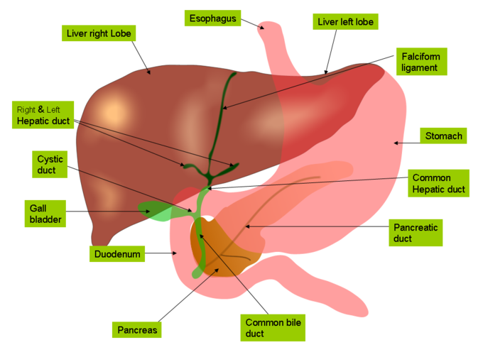
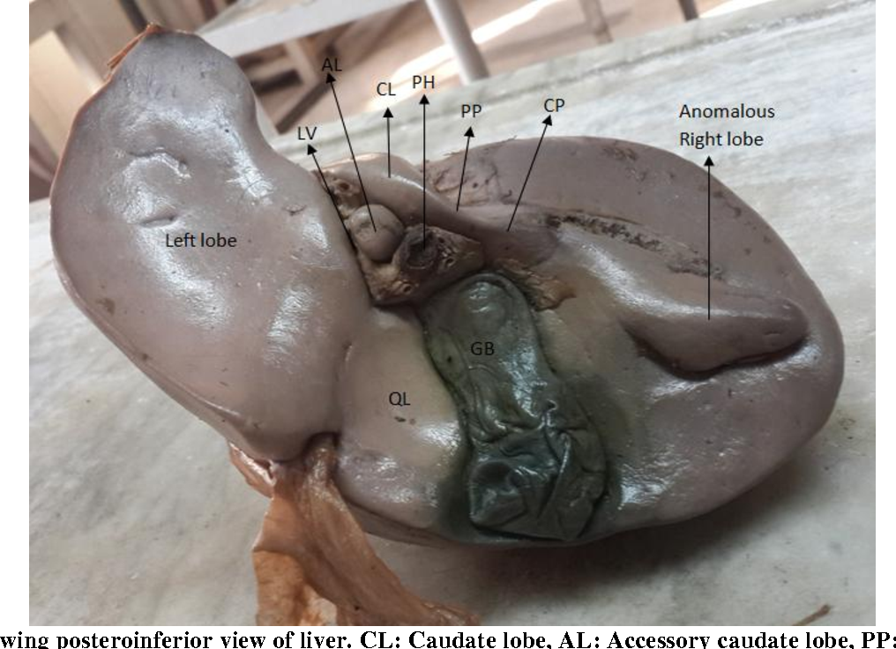
ASSOCIATED GLANDS
2. LIVER- Largest gland
Upper surface is convex and lower surface is concave
Glisson’s capsule covers the liver
Multilobulated gland- 2 main (anterior) and 2 small lobes (posterior)
On lower surface of the right liver lobe-gall bladder present(stores bile about 60ml)
Bile drains from liver to intestine by common bile duct.

Slide 8
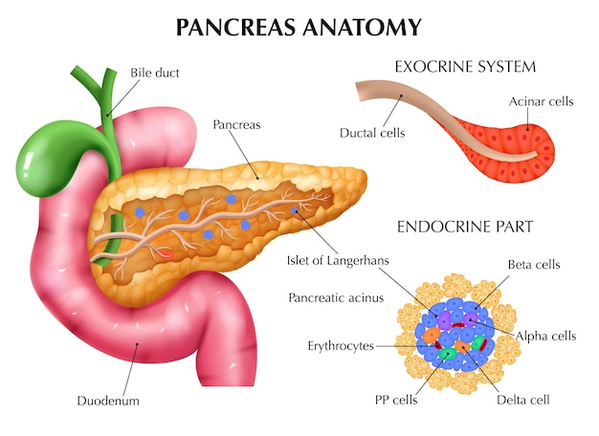
ASSOCIATED GLANDS
3. PANCREAS
Second largest gland, yellow colored, 12-15 cm long.
Divided into 3 regions – head , body and tail
Heterocrine gland
exocrine part contains glandular cells that secretes pancreatic juices. About 1500ml of pancreatic juices is secreted daily
Endocrine parts secretes hormones

Slide 9
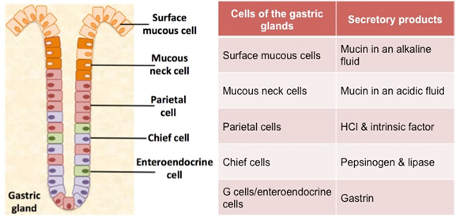
4. GASTRIC GLANDS (Stomach)
Tubular glands found in the mucosa of stomach wall
Gastric glands are of 3 types:
CARDIC GLAND (Secretes alkaline mucus)
PYLORIC GLAND (Secretes alkaline mucus)
FUNDIC GASTRIC GLANDS – 4 types of cells
Chief or peptic cells- Two proenzymes (pepsinogen & prorenin) and an enzyme gastric lipase.
Oxyntic (Parietal cells)- HCl
Goblet cells- mucus
Argentaffin cells- Gastrin hormone
All these collectively called gastric juices.

Slide 10
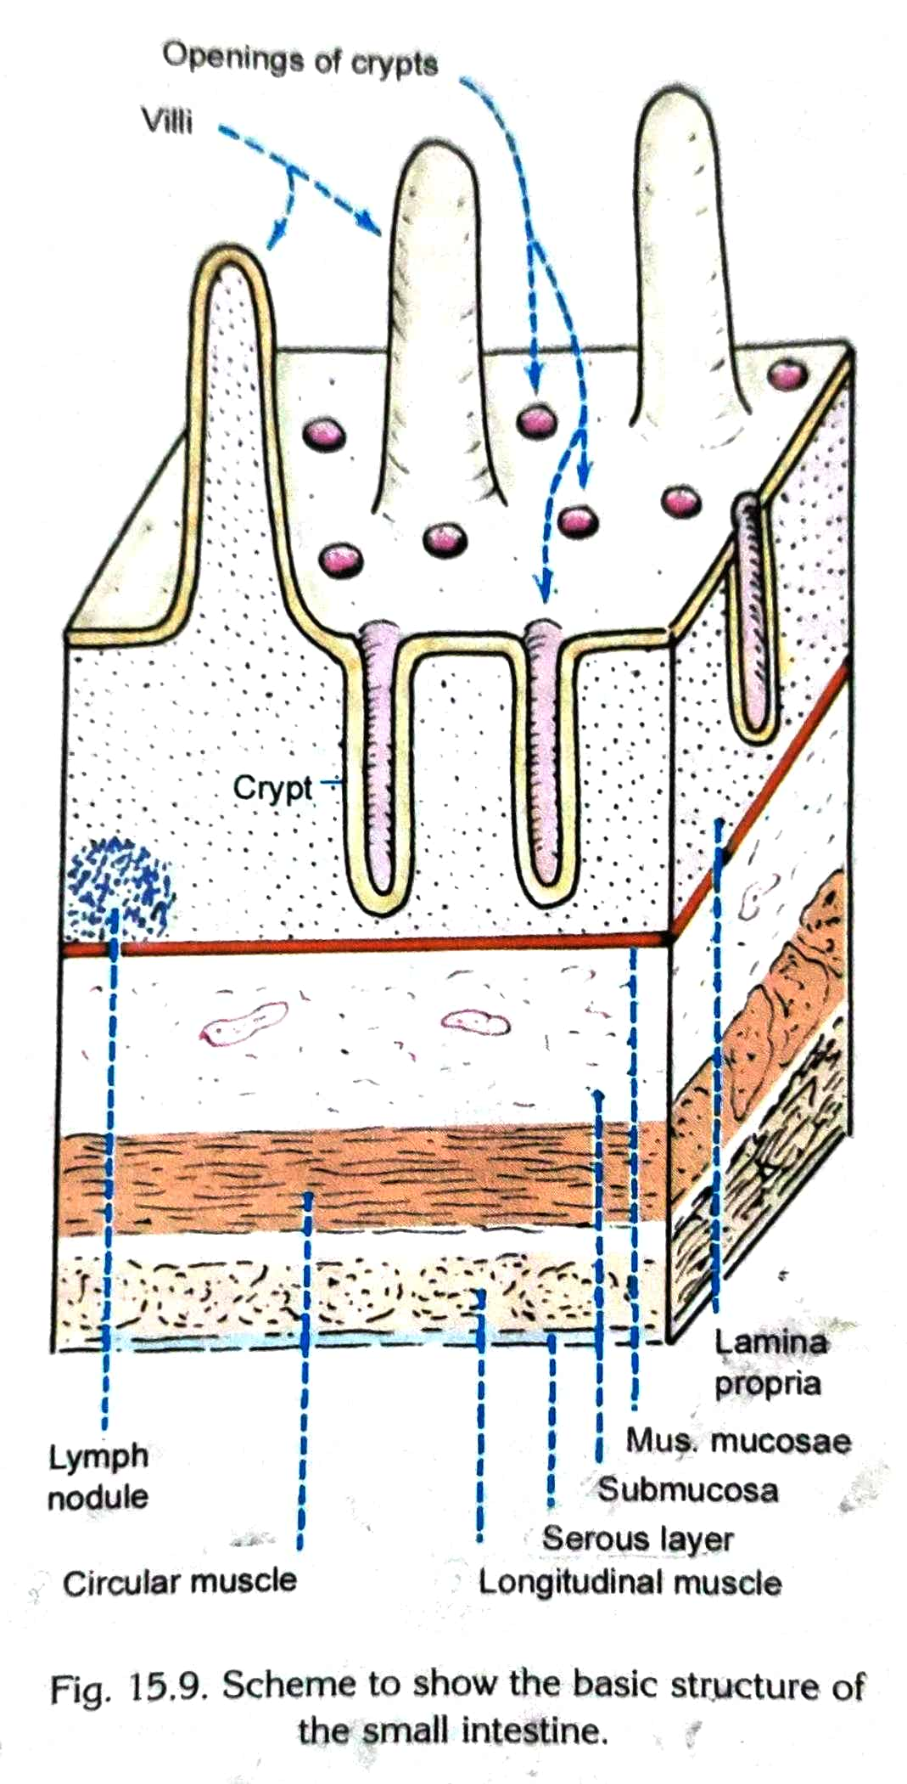
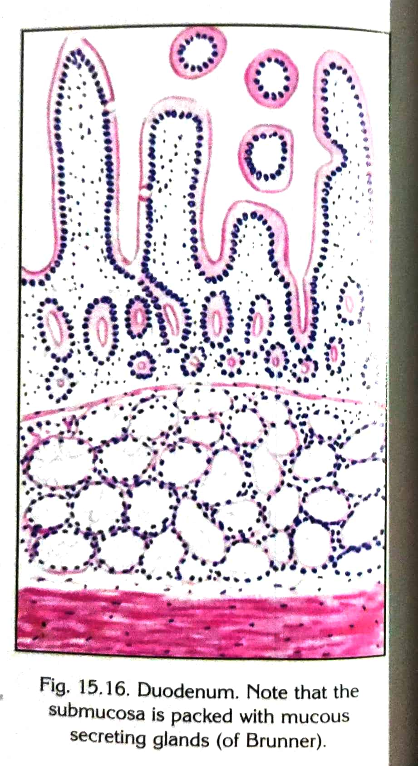
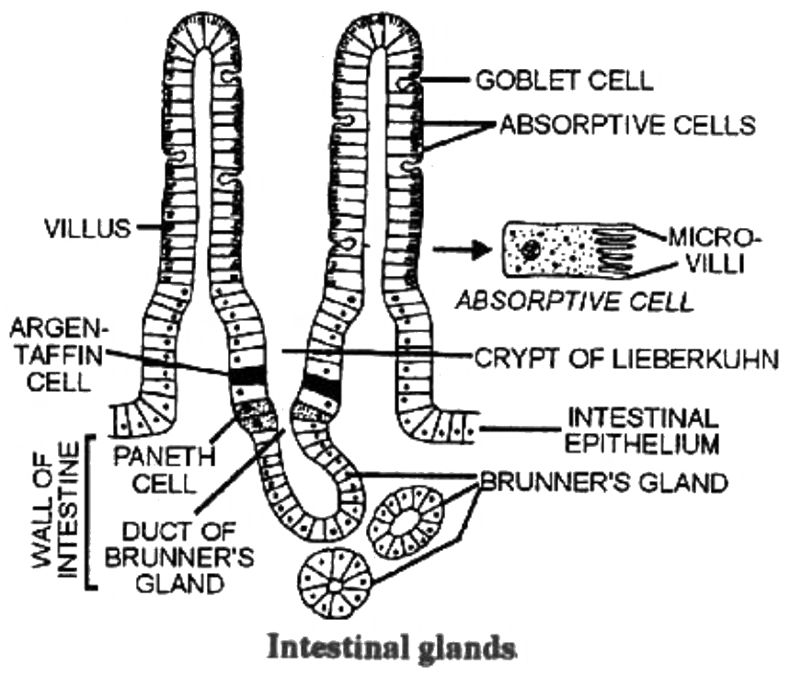
5. INTESTINAL GLANDS
(Mucosa of the small intestine)
These are of 2 types:
Crypts of Leiberkuhn
Tubular invaginations of the epithelium into the lamina propria
secretes mucus and enzymes.
2. Brunner’s Glands
Present only in the submucosa of duodenum secrete
alkaline watery juice (mucus & bicarbonates) and
enzyme that activates trypsinogen produced by pancrease

Slide 11
THANKYOU

