Slide 1
HISTOLOGY OF LIVER
Sarojmoni Sonowal
Assistant Professor
Pub kamrup College, Baihata Chariali

Slide 2
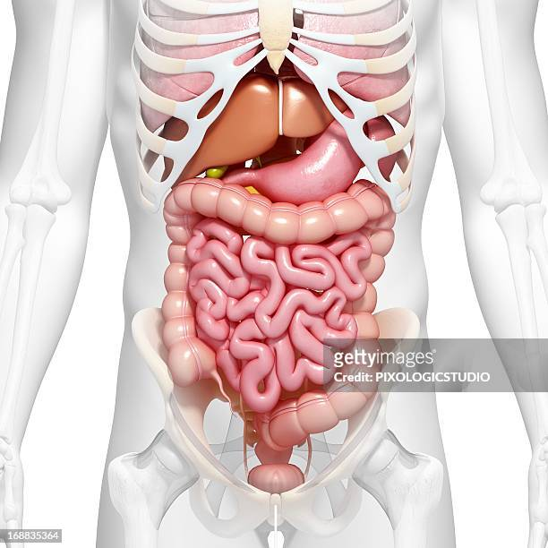
LIVER
Liver is the largest gland, reddish brown gland of human body.
Vital organ (biochemical and metabolic functions)
Heavier in males. Average weight is 1.6 kg
LOCATION
Situated on the right side of upper abdomen and partially on the upper left quadrant of the abdominal cavity.
Protected in ribcage
Suspended by mesentery (broad ligament).

Slide 3
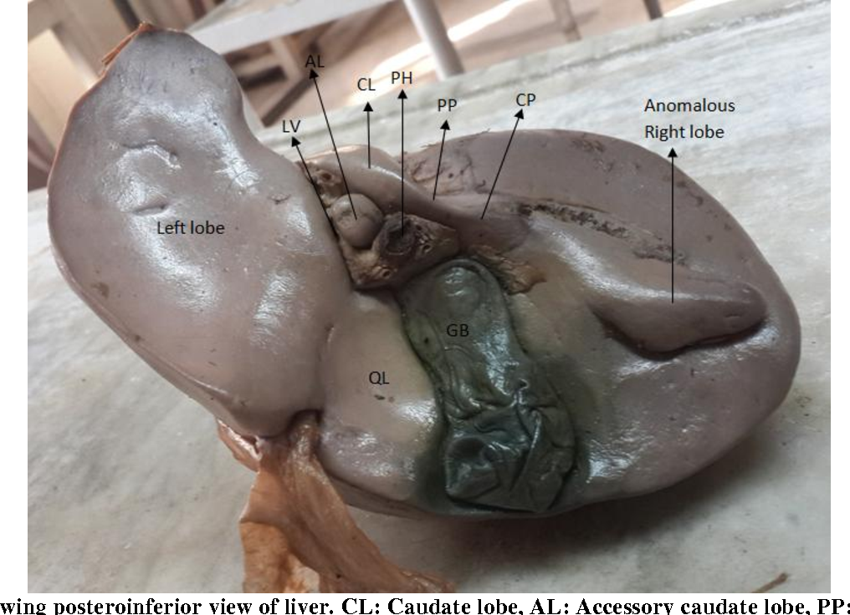
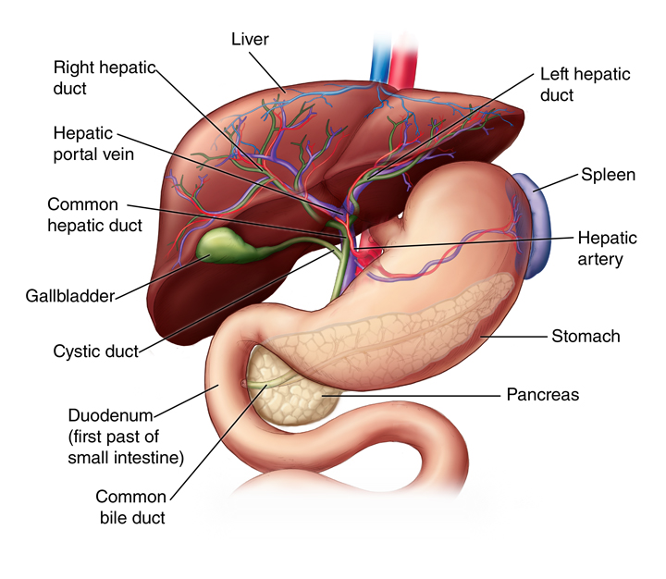
ANATOMY
Upper surface is convex and lower surface is concave
Glisson’s capsule covers the liver
Multilobulated gland- 2 main (anterior) and 2 small lobes (posterior)
On lower surface of the right liver lobe-gall bladder present(stores bile about 60ml)
Bile drains from liver to intestine by common bile duct.

Slide 4
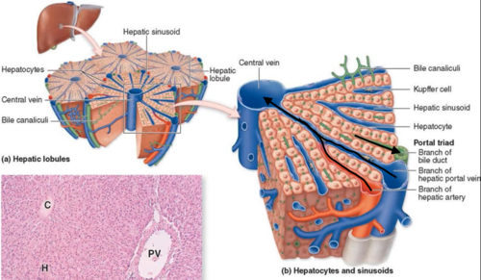
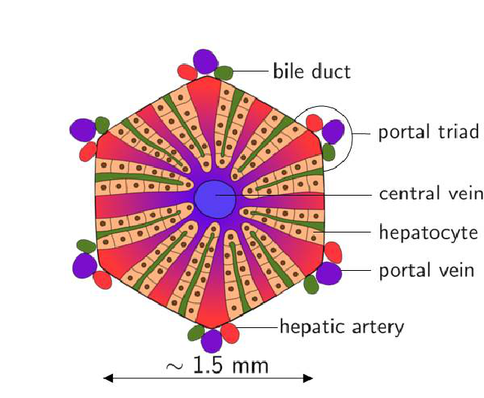
HISTOLOGY
Liver is a solid organ with 4 lobes
Each lobe consists of large no. of polyhedral lobules– structural unit
Each lobule surrounded by 2 layers
Under microscope, each lobule is found to be composed of rows of polygonal cells.
Along the periphery of each lobule, there are angular intervals filled by connective tissues

Slide 5
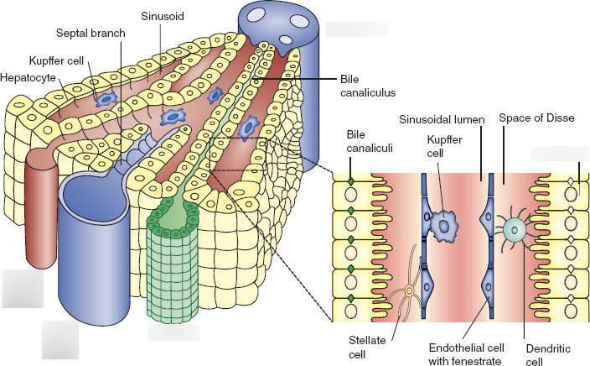
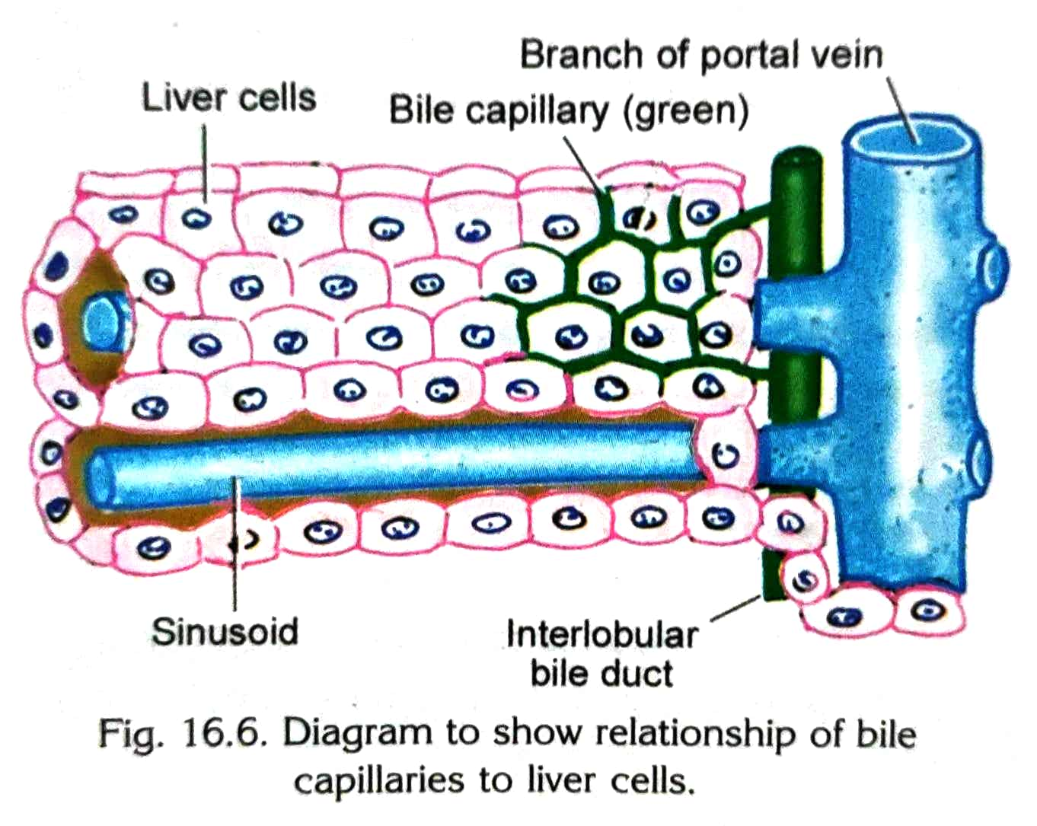
HEPATOCYTES
(cells of the liver)
Measures 20-30 µm
Nuclei large and spherical and occupy the centre of cell
2 or more well developed nucleoli visible in each nucleus
Cytoplasm contains numerous mitochondria, RER, SER, golgi complex lysosomes, free ribosomes– high metabolic activity of the liver cells
Hepatocytes stores glycogen, lipids and crystals of ferritin and haemosidrin-iron
Liver cells are arranged in the form of anastomosing plate, one cell thick.
In this way, liver cells has a sinusoid on two sides.
Sinusoids are lined by endothelium.

Slide 6
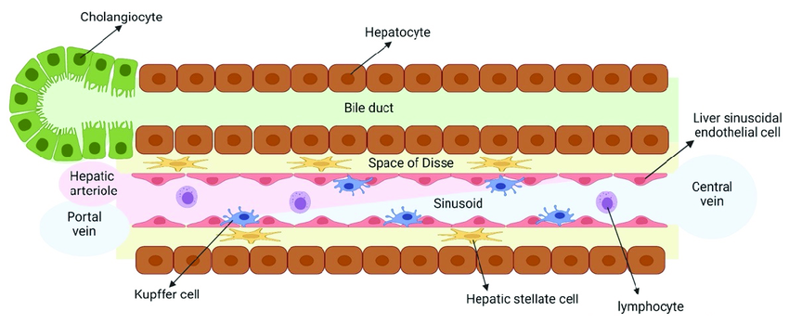
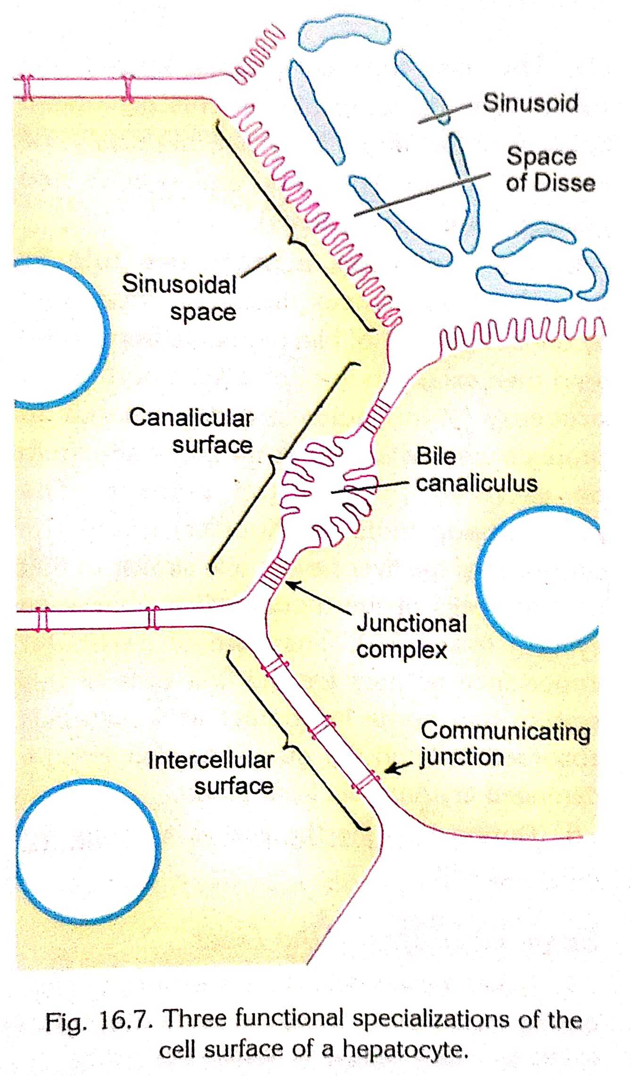
Interspersed among the endothelial cells are Kupffer cells (macrophages) and lymphocytes.
The surface of the liver cells are separated from the endothelial cells of the sinusoid by a narrow perisinusoidal space called Space of Disse contains stellate cells.
Microvilli present on the liver cells extend on this space (associated with active transfer of materials from sinusoids to hepatocytes or vice versa)
The surface of a hepatocyte can show three kinds of specialization-
Sinusoidal surface
Canalicular surface
Intercellular surface

Slide 7
THANKYOU

