Slide 1
Welfare economics

Slide 2
Meaning and definition
Welfare economics is concerned with the evaluation of alternative economic situations (states, configurations) from the point of view of the society’s well being.
Suppose the total welfare in a country is W, but given the factor endowments and the state of technology, the welfare could be larger for eg: W* . The task of the welfare economics are a) to show that in the present state W < W* and b) to suggest ways of raising W to W*
Various criteria are used to evaluate these alternative economic situations, among which Pareto Optimality criterion is one.
Oscar Lange, “welfare economics establishes norms of behavior which satisfy the requirements of social rationality of economic activity.”
The term “Social rationality” of economic activity is to be interpreted as that activity which ensures optimum allocation of resources and therefore guarantees maximum social welfare. In this context Oscar Lange says, “The norms of behavior established by welfare economics are supposed to guarantee the optimal allocation of economic resources of the society.”
Welfare economics studies the conditions under which the solution to a general equilibrium model can be said to be optimal.

Slide 3
Value judgements in WE
A value judgement is a judgement of the rightness or wrongness of something or someone or of the usefulness of something or someone based on a comparison or other relatively. It is a judgement based on particular set of value or on a particular value system. – the conceptions or ethical beliefs of the people about what is good or bad
The measurement of social welfare requires some ethical standard and interpersonal comparisons which involve subjective value judegments. Objective comparisons and judgements of the deservingness or worthiness of different individuals are virtually not possible
For example, imposing a tax of Rs. 1000 on individual A and giving it as a subsidy to individual B will certainly make B better off and A worse off. But who is to say that the society composed of both individuals is better or worse off as a whole? Determining this involves comparing the utility gained by individual B (i.e, making interpersonal comparison of utility).
And even if A has a high income and B has a low income to begin with, different people will have different opinions on whether this increases social welfare, reduces it or leaves it unchanged. Therefore, no entirely objective or scientific rule can be defined.
Controversy among economists

Slide 4
The value of judgements are unavoidable in welfare economics as ‘welfare’ itself is an ethical term. Any theorems pertaining to choices among various situations to maximize welfare are also ethical and must rest on some obvious or hidden value judgements.

Slide 5
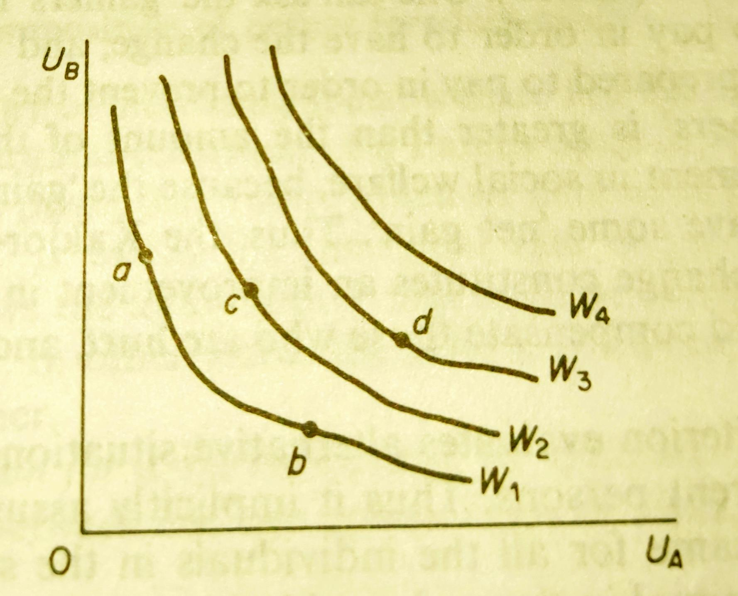
Bergson Criterion : Social Welfare Function
Used Social welfare function (SWF) as of the criterion to measure social welfare
SWF provides ranking of alternative states in which different individual enjoy different utility levels
In a economy of two individuals SWF can be presented by a set of social indifference curves
Each curve is a locus of combinations of utilities A and B which yield the same level of social welfare

Slide 6
Limitations:
There is no easy method of constructing
Somebody in the economy must undertake the task of comparing the various individuals or groups and rank them according to what he/ she thinks their worthiness is
A democratically elected government could be assumed to make such value judgements which would be acceptable by the society as a whole

Slide 7
Perfect competition(efficiency), Pareto optimality (equity) and market failures

Slide 8
First theorem of welfare economics : an equilibrium produced by competitive markets exhausts all possible gains from the exchange , or that equilibrium in competitive markets is optimal.
Second theorem of welfare economics : when indifference curves are convex to their origin , every efficient allocation (every point on the contract curve for exchange) is a competitive equilibrium for some initial allocation of goods or distribution of inputs (income)
For economic efficiency to be reached. There should be no market failure
Market failure is an economic situation defined by inefficient distribution of goods and services in free market. Under this situation individual incentives for rational behavior do not lead to rational outcomes
Market failures arise in the presence of imperfect competition, externalities and public goods .

Slide 9
EXTERNALITIES AND MARKET FAILURES
Unintended product or byproduct produced in an economic activity
are called externalities because they are felt by the economic units not directly involved with the economic units that generate them.
Are called external cost or negative externalities when harmful & external benefits or positive externalities when they are beneficial

Slide 10
5 types of EXTERNALITIES
External diseconomies of production
External diseconomies of consumption
External economies of production
External economies of consumption
Technical externalities

Slide 11
Externalities and market failures
When externalities are present, Pareto optimum is not achieved even in a perfect competition
Perfect competition leading to efficiency and Pareto optimality will hold true only when private costs equal social costs and private benefits equal social benefits

Slide 12
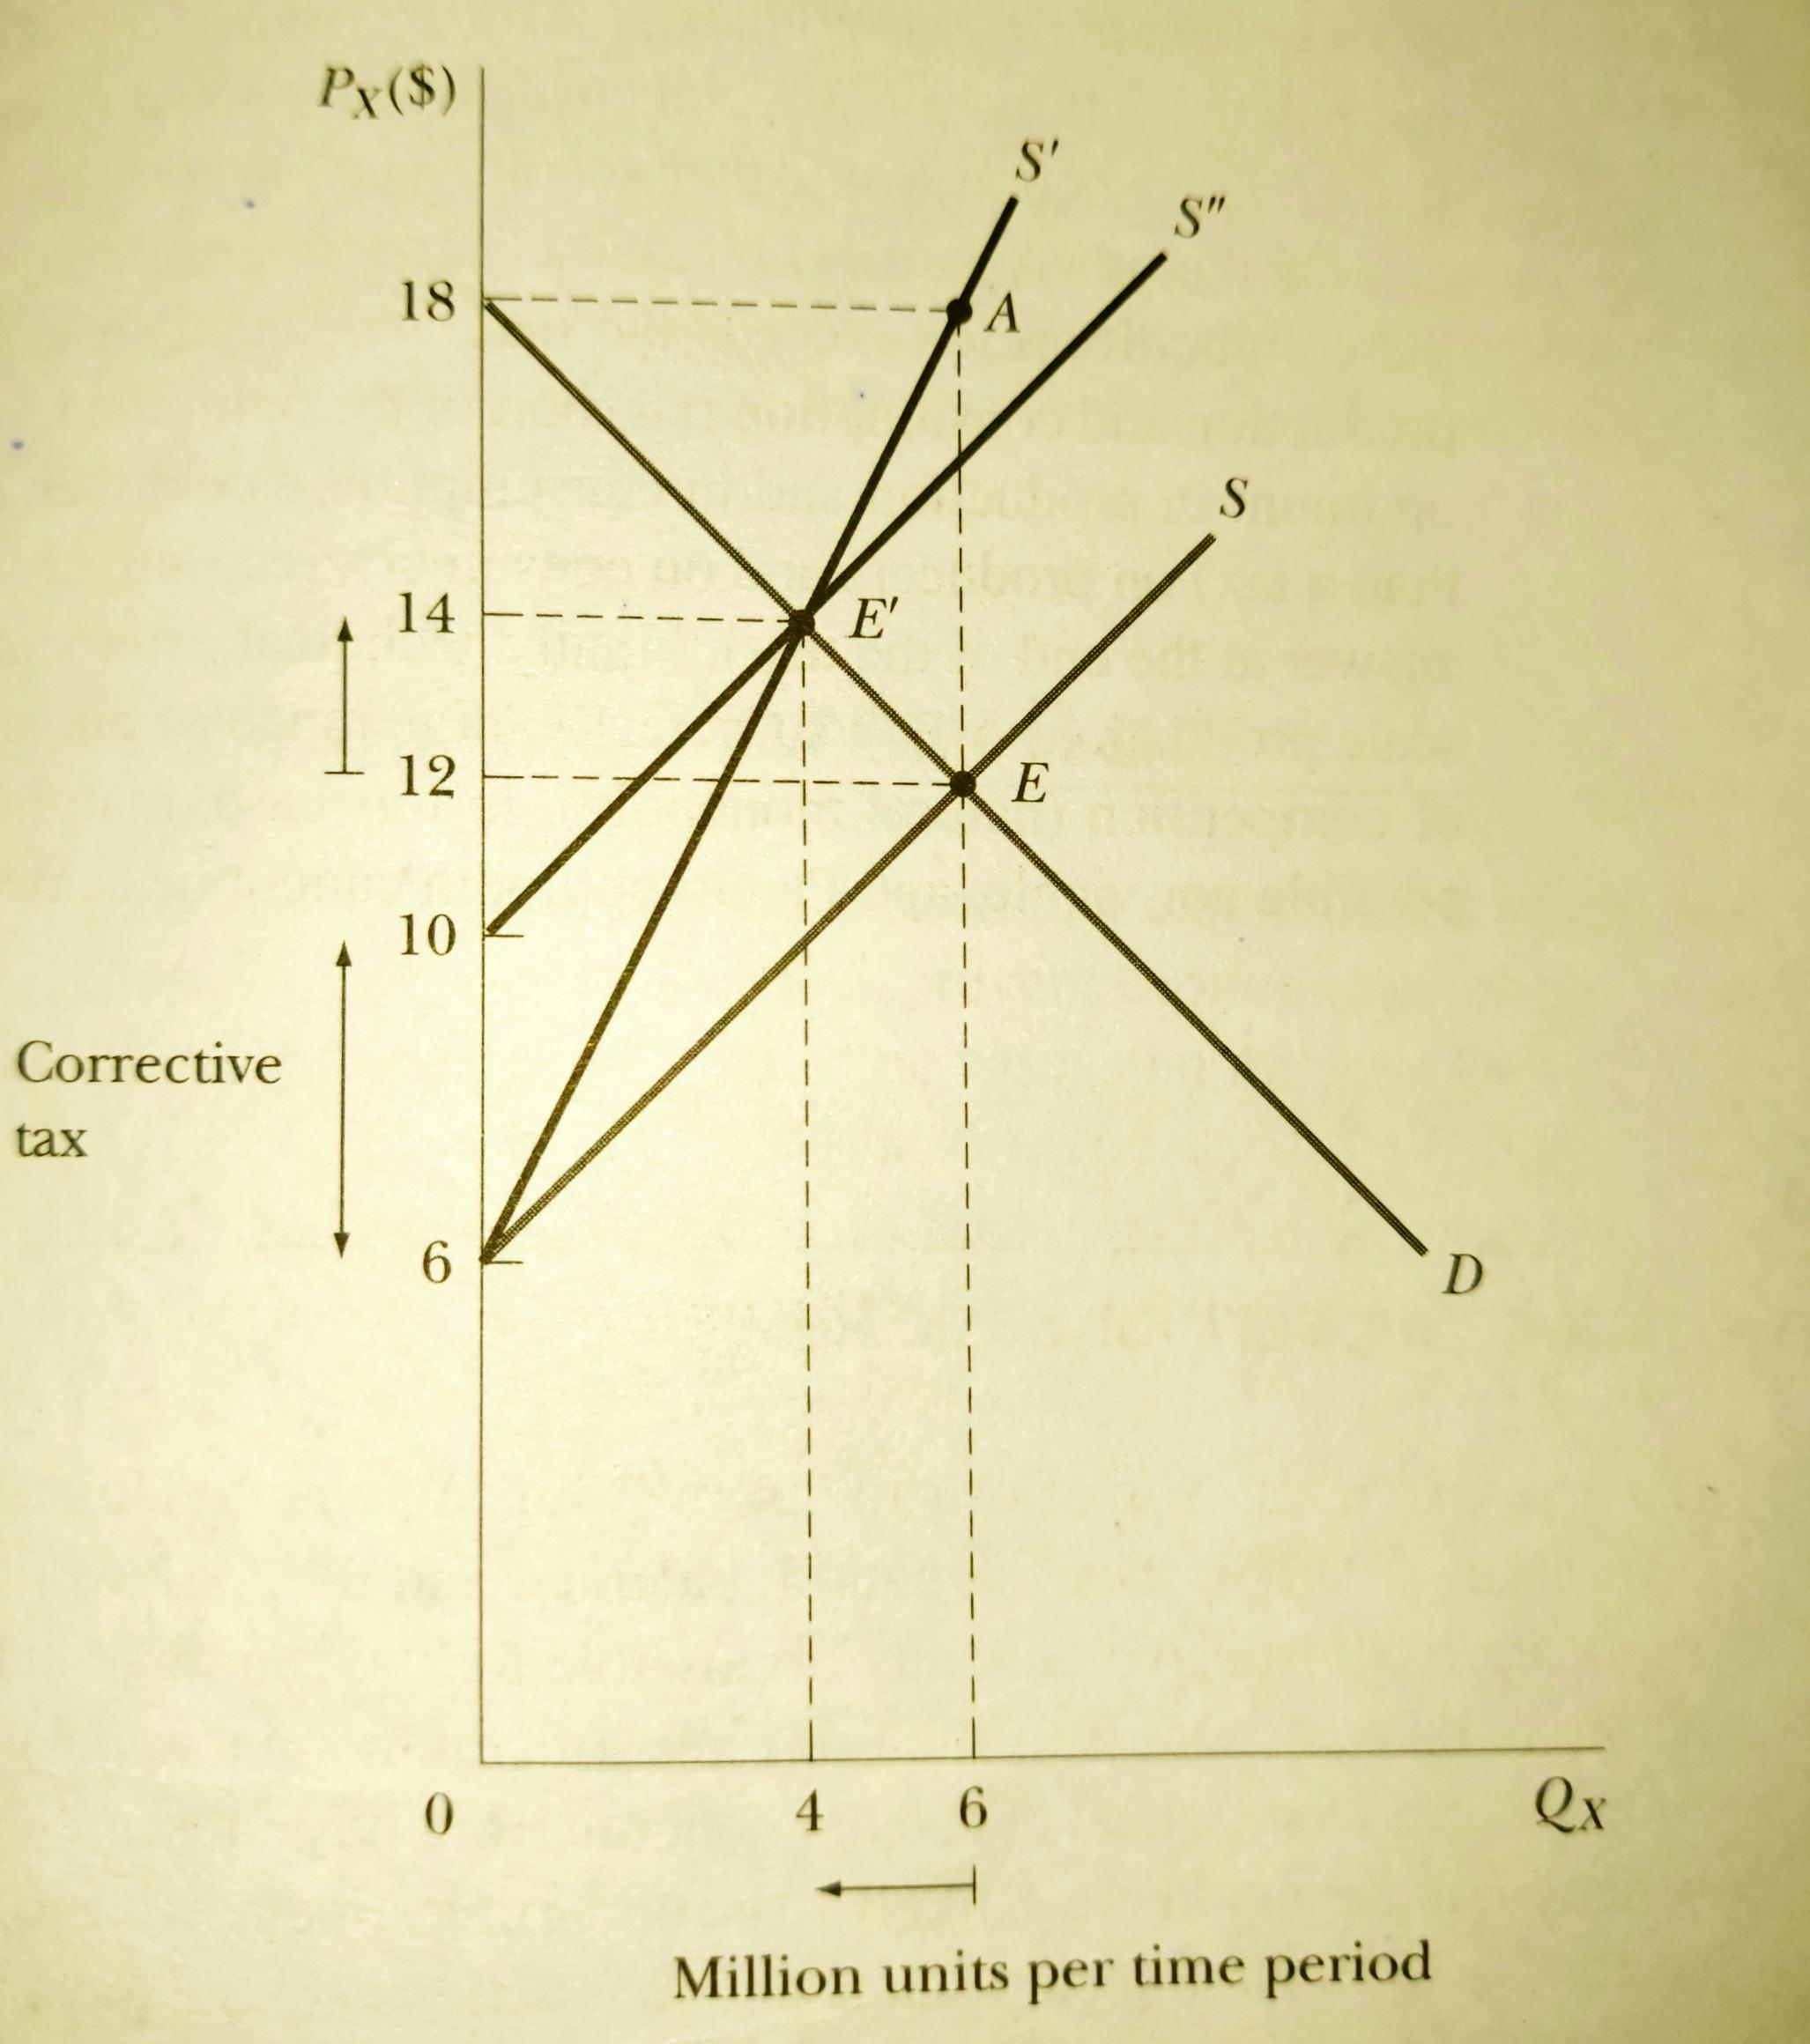
Assume : commodity X produced in a competitive industry
D = market demand curve
Equilibrium price = 12 , equilibrium quantity = 6
S = Σ MPC (Marginal Private Cost
S’ = MSC (industry supply curve including both private and external cost)
AE = MEC (marginal external cost)
MSC = MPC + MEC
efficiency or pareto optimality requires = equilibrium price = 14 & equilibrium quantity = 4

Slide 13
Pareto optimality are not achieved whenever private and social costs or benefits differ
Here MC pricing is neither possible nor viable and pareto optimum cannot be reached

Slide 14
Externalities and Property rights (coase theorem)
Externalities occur in the case of common property resources where property rights are not clearly defined
Coase theorem postulates that when the property rights are properly defined perfect competition results in the internalization of externalities, regardless of how property rights are assigned among the parties
Coase challenged Pigou’s argument and argued that the presence of externalities does not necessarily mean that government should intervene
There is a possibility of private deals that would achieve the same result as government taxes and subsidies

Slide 15
The model
Assumptions: income effects are small and transaction costs are negligible
There is a possibility of private deals that would achieve the same result as government taxes and subsidies
Consider the case of paper mill dumping the waste in a river thus hurting the fish
q1 is the socially optimal output but the competitive markets produce q2
If paper mill reduces production from q2 to q1: net loss in producers and consumers surplus = ACE ; but gain to fishermen= ABCE (excess of MSC over MPC for output range q1 and q2)
Possible for the fishermen to bribe the producers and consumers to cut production to q1
Therefore socially optimal level of output could be achieved without government taxing or subsidizing
MSC
D
Price, MC
B
MPC
A
C
E
q1
q2
qty
Possibility of private deals under externalities

Slide 16
“when the property rights are properly defined perfect competition results in the internalization of externalities, regardless of how property rights are assigned among the parties”
If the property rights are assigned to the fishermen : the paper mill would have to pay the fishermen for dumping waste in the river – compensation = MSC- MPC ; the private marginal cost curve for paper mill will now be MSC – paper mill will produce at q1 – externality internalized
If the property rights are assigned to the paper mill : therefore had the right to dump the waste – fishermen would now bribe the mill to not dump the waste – amount of bribe = MSC – MPC -- externality is neutralized.
TRANSACTION COSTS: these are the legal, administrative and informational expenses off drawing up, signing up and enforcing contracts. Expenses are small while contacting parties are few and vice versa. If contracting costs are large then externalities and efficiencies may arise

Slide 17
PUBLIC GOODS
Characteristic : non rival and non exclusion
Eg : national defense, law enforcement
NON RIVAL : consumption by one individual does not reduce the amount available to other individuals
NON EXCLUSION: it is impossible or prohibitively expensive to confine the benefits of consumption of s good to selected

Slide 18
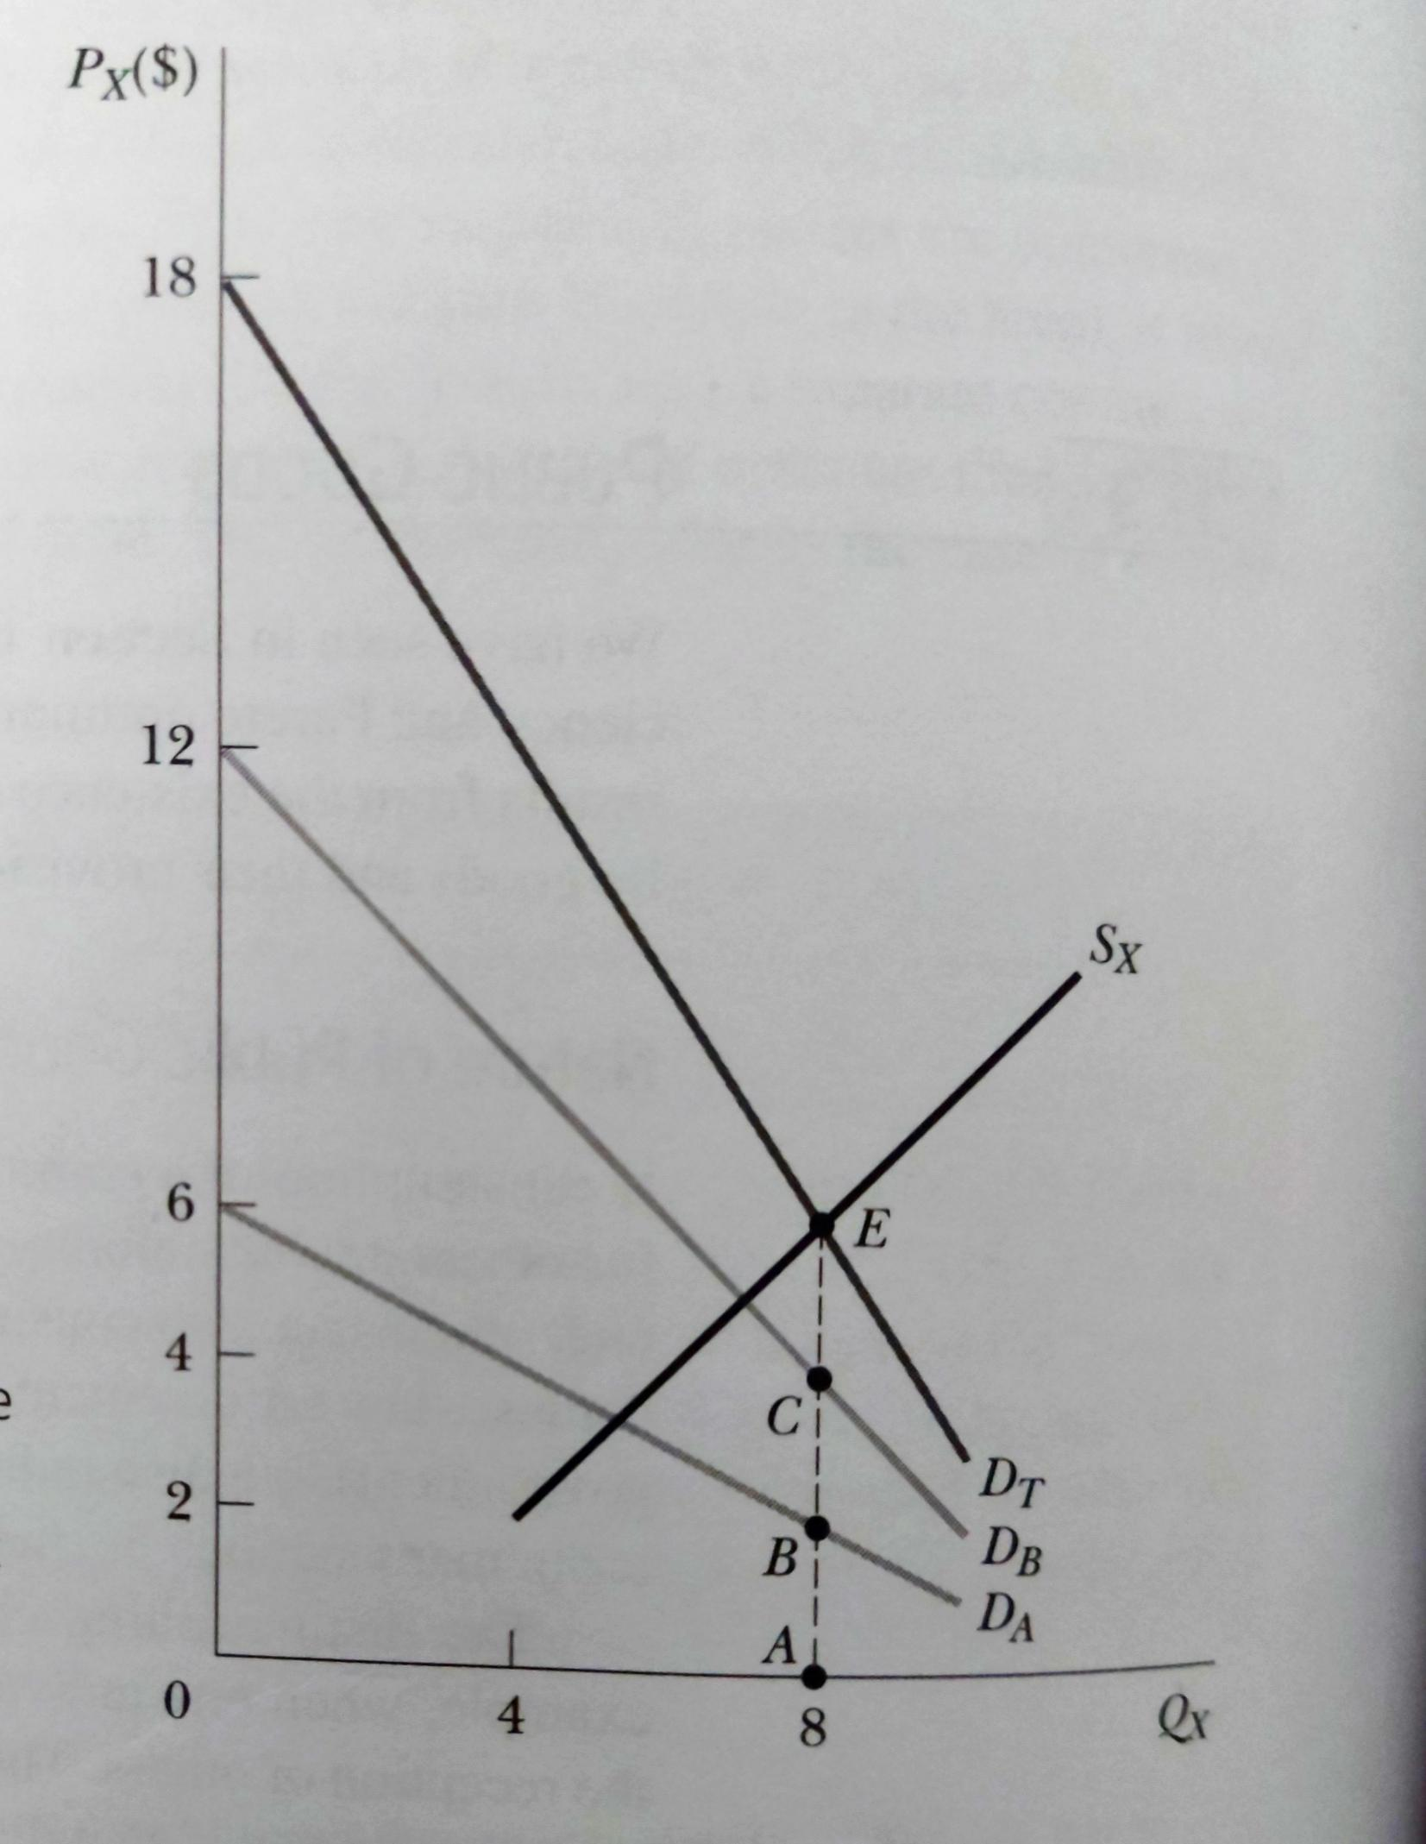
Because a given amount of public good can be consumed by more than one individual at the same, DT = DA + DB
Sx = market supply curve
Optimal amount = 8units at E where
MSB( i.e; AB+ AC) = MSC (i.e; AE)
problem : less than optimal amount of good will be supplied under perfect competition and this prevents the attainment of maximum efficiency of Pareto optimum
Optimal amount of public good

Slide 19
Provision of public goods
1. Free rider problem
2. individual has no incentive to accurately reveal his or her preferences / demand
Therefore it is practically impossible for the government to know exactly the what is the optimal amount of public good and there is also the problem of possible government inefficiency in providing public goods

