Slide 1
PRESENTATION
ON
WIND SYSTEM
&
ITS TYPES
COORDINATOR
KANGKAN MEDHI
PRESENTED BY
NIPJYOTI KUMAR
ABDUR RAHMAN
M.Sc 4TH SEM
DEPARTMENT OF PHYSICS

Slide 2
CONTEXT
INTRODUCTION
TYPES OF WINDS
FACTORS AFFECTING ON WINDS
CREDITS AND REFERENCES

Slide 3
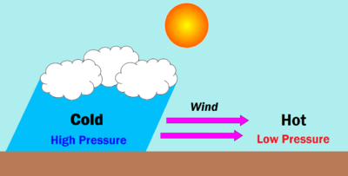
INTRODUCTION
DIFFERENCES IN AIR PRESSURE PRODUCE WINDS.
PRESSURE DIFFERENCE BETWEEN A
HIGH PRESSURE AREA AND A LOW
PRESSURE AREA DETERMINES THE
STRENGTH OF THE WIND.
( LARGER PRESSURE DIFFERENCE STRONGER WIND )
DIFFERENCE IN AIR TEMPERATURE ALSO LEAD TO
PRESSURE DIFFERENCES

Slide 4
TYPES OF WINDS
PRIMARY
WINDS
SECONDARY
WINDS
TERTIARY
WINDS

Slide 5
1. TRADE WINDS
PICTURE
PRIMARY WINDS
(PREVAILING WINDS/
PLANETORY WIND/
PERMANENT WINDS/
INVARIABLE)
2. WESTERLIES
3. POLAR
EASTERLIES
THE COMBINATION OF PRESSURE BELTS AND
THE CORIOLIS EFFECT CAUSE GLOBAL WINDS

Slide 6
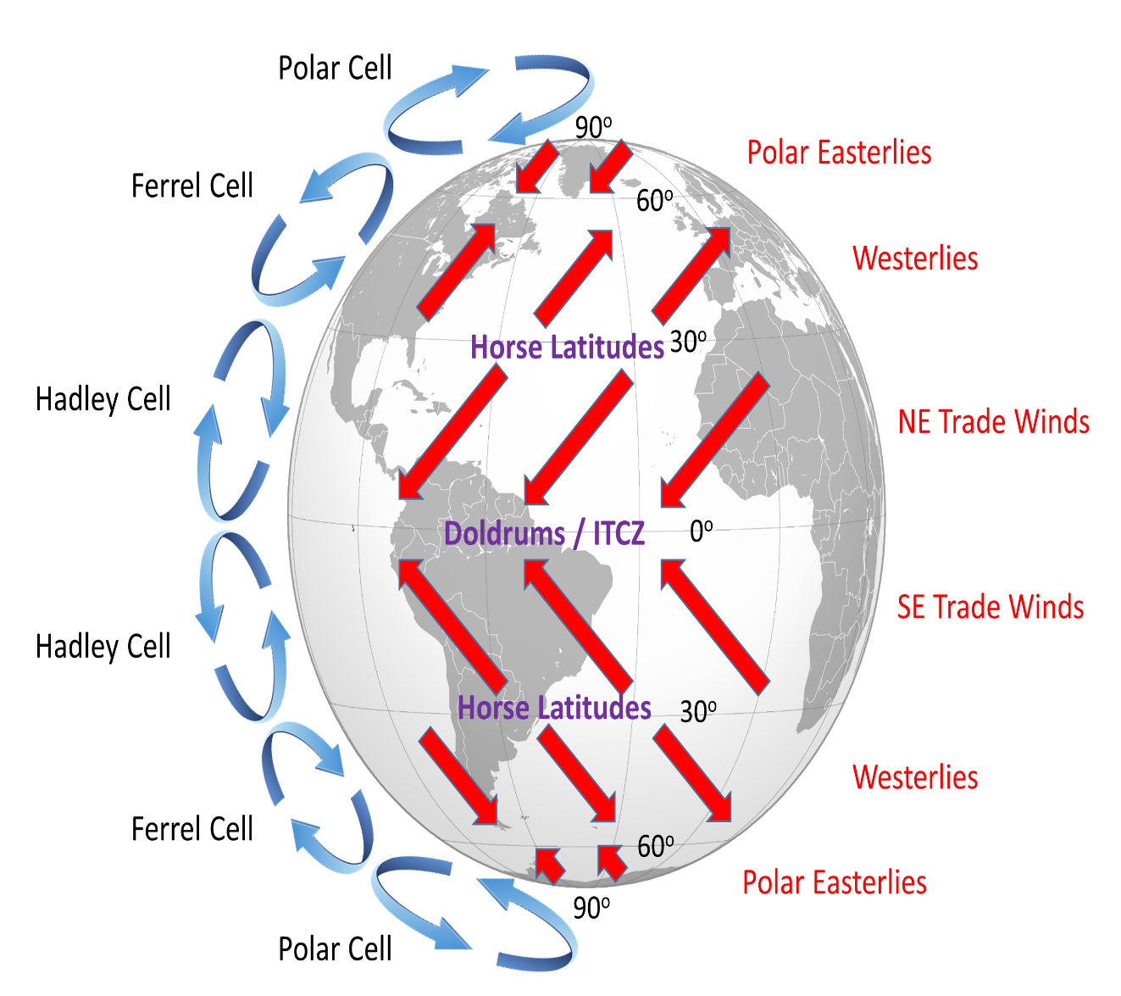
1. TRADE WINDS
BLOW AT 30* LATITUDE TO THE EQUATOR. (EARLY SAILORS
USED THE WINDS TO SAIL FROM
EUROPE TO AMERICA).
WHEN COLD AIR SINKS, PRODUCES HIGH PRESSURE.
HIGH PRESSURE WANTS TO MOVE TO AN AREA OF LOW PRESSURE(THE EQUATOR).
THESE WINDS THAT ARE BLOWING TOWARDS THE EQUATOR ARE DEFLECTED WEST BECAUSE OF THE CORIOLIS FORCE

Slide 7
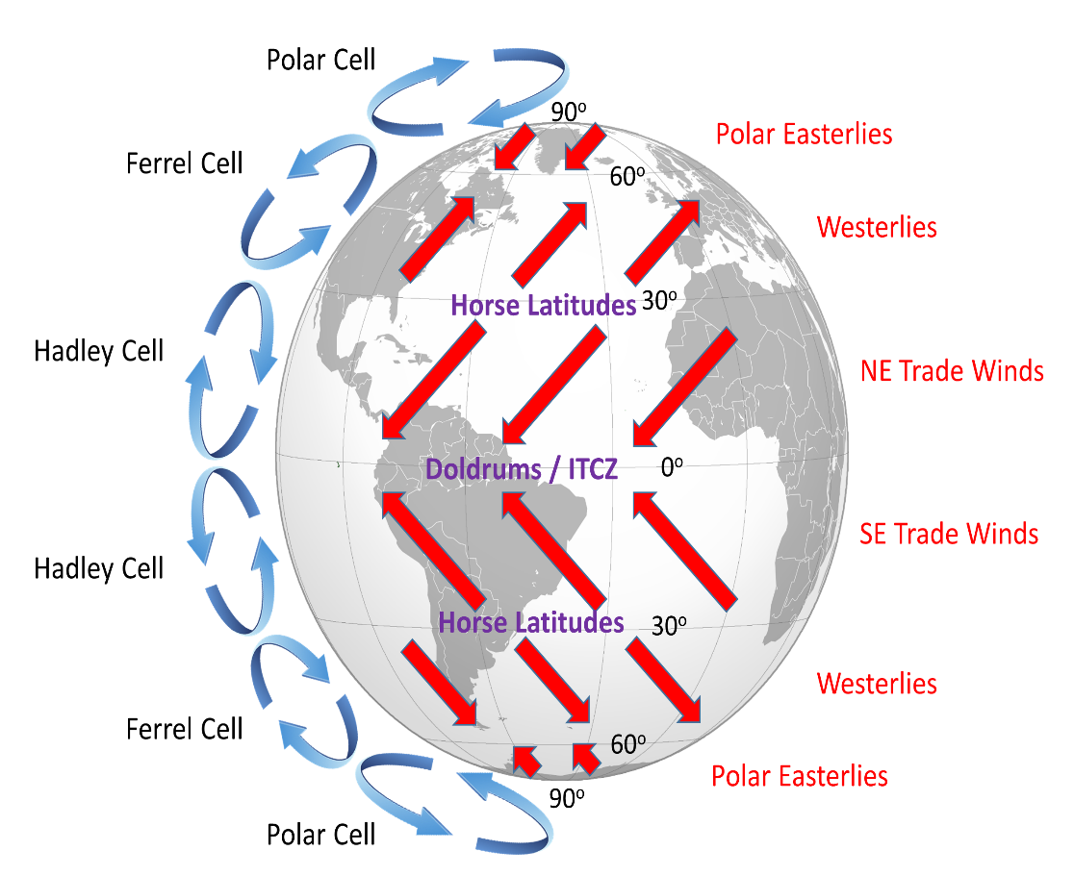
2. WESTERLIES
WIND BELT FOUND BETWEEN 30* AND 60* LATITUDE.
FLOW TOWARDS THE POLES FROM WEST TO EAST.
TURNED TOWARDS THE EAST FROM WEST BY CORIOLIS FORCE.
BEST DEVELOPED BETWEEN 40* AND 60*S LATITUDES. OFTEN CALLED –
ROARING FORTIES
FURIOUS FIFTIES
SHRIEKING SIXTIES
FIGURE

Slide 8
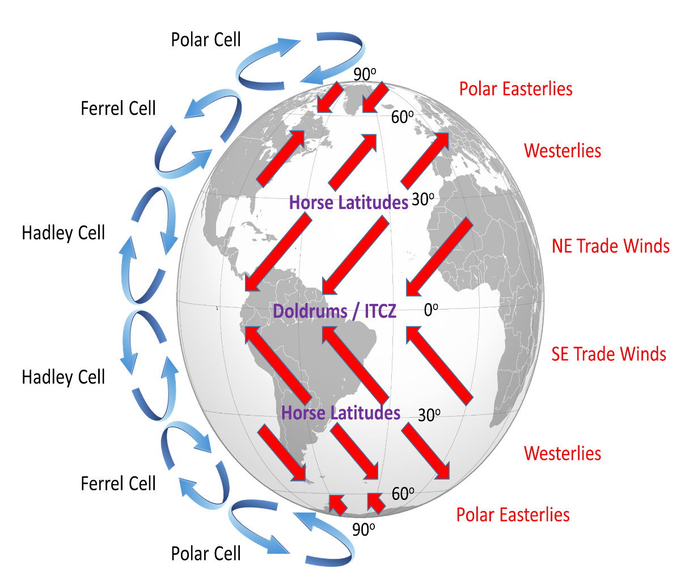
3. POLAR EASTERLIES
BETWEEN THE POLES AND 60* LATITUDE.
COLD AIR NEAR POLES SINKS AND FLOWS BACK TOWARDS LOWER LATITUDES.
CORIOLIS FORCE SHIFTS THESE WINDS TO WEST.

Slide 9
FACTORS AFFECTING ON PRIMARY WINDS
LONGITUDINAL VARIATION OF ATMOSPHERIC HEATING.
EMERGENCE OF PRESSURE BELTS.
DISTRIBUTION OF CONTINENTS AND OCEANS.
ROTATION OF EARTH.

Slide 10
Secondary winds
SECONDARY WINDS CHANGE THEIR DIRECTION PERIODICALLY WITH THE CHANGE IN SEASON.
ALSO KNOWN AS SEASONAL/ PERIODICAL WINDS.
FOR EXAMPLE : MONSOON, SEA & LAND BREEZE AND MOUNTAIN & VALLY BREEZE.

Slide 11
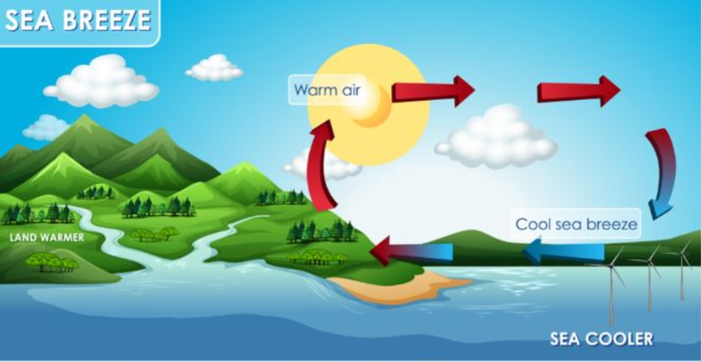
SEA BREEZE
OCCURS DURING THE DAY TIME. LAND HEATS UP FASTER THAN THE SEA. THE AIR RISES ON THE LAND AND LOW PRESSURE IS CREATED. THE PRESSURE OF THE AIR OVER THE SEA RELATIVELY HIGH. DUE TO PRESSURE GRADIENT, WINDS BLOWS FROM SEA TO LAND.

Slide 12
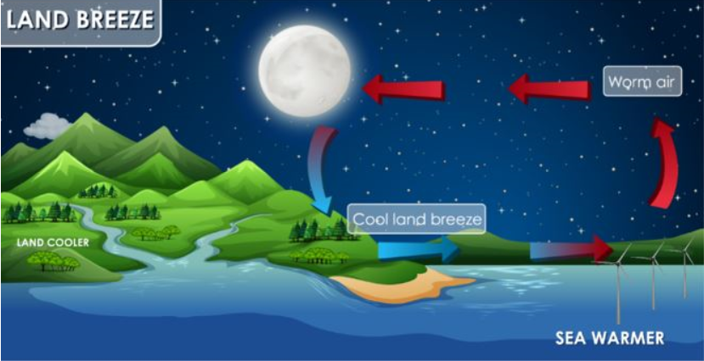
LAND BREEZE
OCCURS DURING THE NIGHT TIME. LAND COOLS FASTER THAN THE SEA. THE AIR ARISES OVER THE SEA AND LOW PRESSURE IS CREATED. THE PRESSURE OF THE AIR ON THE LAND RELATIVELY HIGH. THUS WINDS BLOWS FROM THE LAND TO SEA DUE TO PRESSURE GRADIENT.

Slide 13
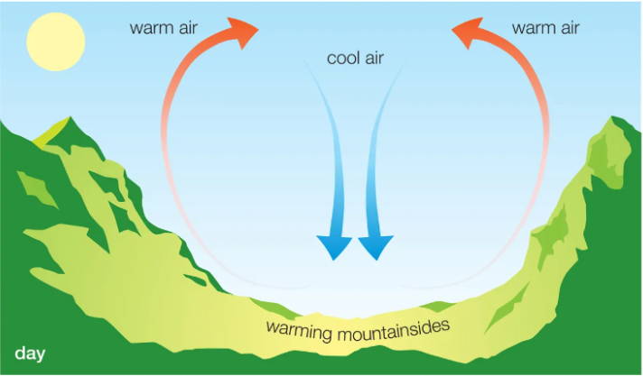
VALLEY BREEZE
OCCURS DURING THE DAY TIME. SLOPES OF THE MOUNTAIN FACING THE SUN GET HEATED UP FASTER THAN THE VALLEY. AIR RISES FROM THE SLOPES OF THE HILL AND LOW PRESSURE IS CREATED. AIR MOVES UPSLOPE TO FILL THE RESULTING GAP FROM THE VALLEY TO THE TOP OF THE MOUNTAIN. ALSO KNOWN AS UPSLOPE BREEZE OR ANABATIC WINDS.

Slide 14
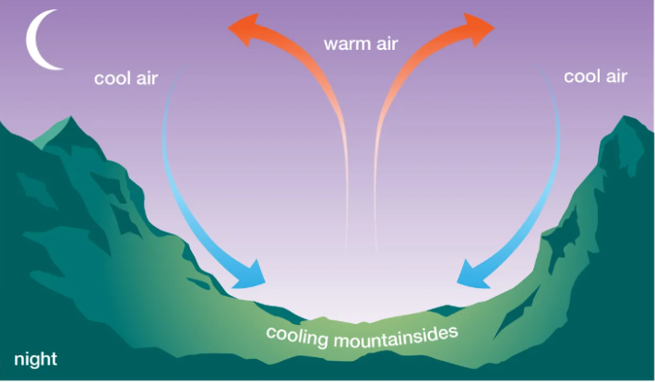
MOUNTAIN BREEZE
OCCURS DURING THE NIGHT TIME. SLOPES GET COOLED FASTER THAN THE VALLEY. AIR BECOMES DENSER ON THE TOP OF THE MOUNTAIN AND HIGH PRESSURE IS CREATED. RELATIVELY LOW PRESSURE IS CREATED ON THE VALLEY THAT’SWHY AIR DRAIN DOWNWARDS INTO THE VALLEY. ALSO KNOWN AS DOWNSLOPE WINDS OR KATABATIC WINDS.

Slide 15
MONSOONS
MONSOON WINDS ARE SEASONAL WINDS.
THEY ARE THE COMPLETE REVERSAL OF TRADE WINDS.
TRADITIONALLY EXPLAINED AS LAND AND SEA BREEZE ON A LARGE SCALE.
IN SUMMER, ACTS AS SEA BREEZE.
IN WINTER, ACTS AS A LAND BREEZE.

Slide 16
DIFFERENTIAL HEATING AND COOLING OF LAND AND WATER
HIGH PRESSURE OVER MADAGASCAR
MECHANISM
SHIFT IN THE POSITION OF ITCZ
(INTERTROPICAL CONVERGENCE ZONE)
INTENSE HEALING OF TIBETIAN PLATEAU

Slide 17
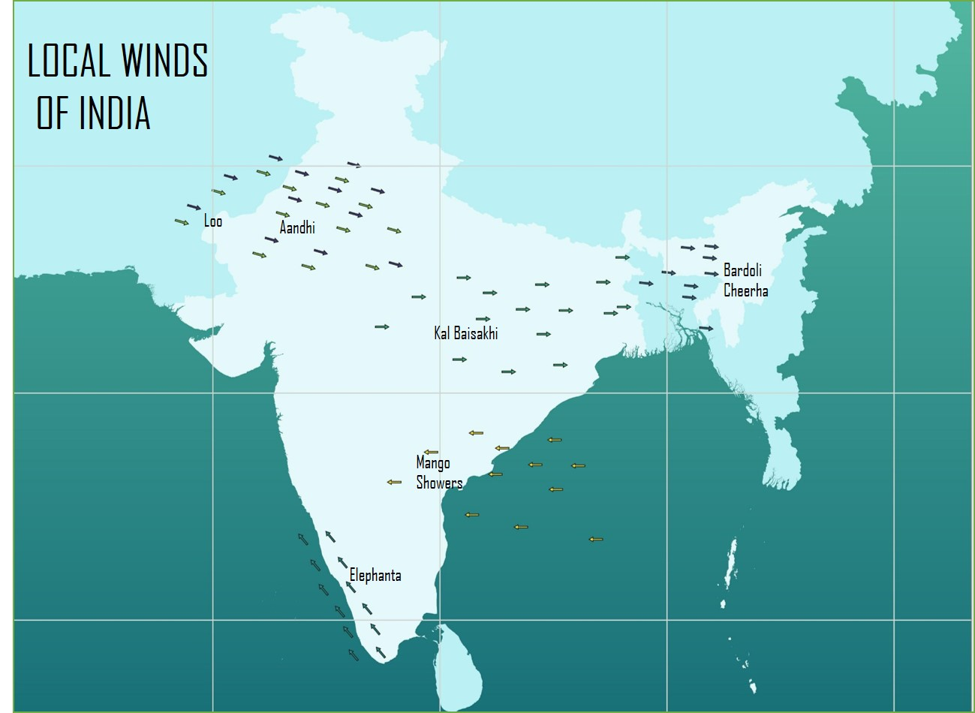
TERTIARY WINDS
LOCAL WINDS GENERALLY MOVES SHORT DISTANCES AND CAN BLOW FROM ANY DIRECTION.
LOCAL WINDS CAUSED BY THE UNEQUAL HEATING OF THE EARTH’S SURFACE WITHIN SMALL AREA.

Slide 18
COLD WINDS | WARM WINDS
PAMPERO | FOEHN OR FOHN
GREGALE | CHINOOK
BORA | ZONDA
TRAMONTANE | LOO
MISTRAL | SIROCCO

Slide 19
Credits and references
BOOK :
CLIMATOLOGY D.S. LAL
LINKS :
https://www.ncert.nic.in/ncerts/l/kegy210.pdf
https://education.nationalgeographic.org/resource/wind/
https://www.geeksforgeeks.org/the-important-factors-which-affect-the-wind/?ref=gcse

Slide 20
THANK YOU

