Slide 1
TOPIC :THUNDERSTORMS
Represent by
UMMA SALMA
PUB KAMRUP COLLEGEE
M.Sc in PHYSICS

Slide 2
CONTENT
INTRODUCTION
STAGES OF THUNDERSTORMS
TRIGGER ACTIONS OF THUNDERSTORMS
TYPES OF THUNDERSTORMS
REFERENCE

Slide 3
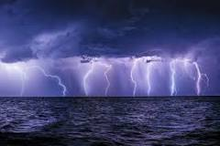
INTRODUCTION
What is thunderstorm…?
A Thunderstorm is weather condition characterized by heavy rain and wind accompanied by lightning, thunder , sometimes with hail . it can last for 30 min to several hours.
It is produced by cumulonimbus clouds.

Slide 4
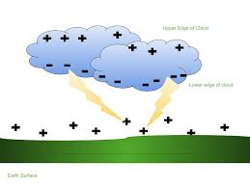
    What is lightning….?
    It is a discharging of electrical charge.
Types of lightning
Intra cloud lightning
Cloud to cloud lightning
Cloud to ground lightning

Slide 5
Every Thunderstorm Needs
Moisture : to form clouds and rain.
Unstable Air : relatively warm air that can rise rapidly.
Lift : fronts, sea breezes, and mountains are capable of lifting air to help form thunderstorms

Slide 6
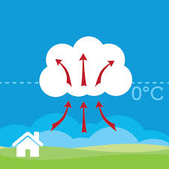
STAGES OF THUNDERSTORMS
CUMULUS STAGE
The sun heat the earth’s surface during the day . The heat on the surface warms the air around it. Since warm air is lighter than cool air, it start to rice known as updraft . warm air is moist, then warm air condenses into a cumulus cloud.

Slide 7
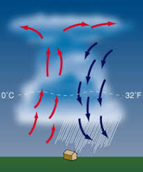
Mature stage
When the cumulus cloud is becomes large , the water in it becomes large and heavy . Rain starts to fall through the cloud when the rising air can no longer hold them up . Cool air is heaver than warm air it start to descend in the cloud know as downdraft . The downdraft pulls the heavy water downward , making rain.

Slide 8
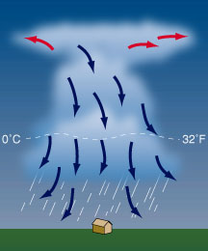
DISSIPATING STAGE
This occurs when the downdraft in the cloud begins to dominate over the updraft . Since warm moist air can no longer rise cloud droplets can no longer form. The storm dies out with light rain as the cloud disappears from bottom to top.

Slide 9
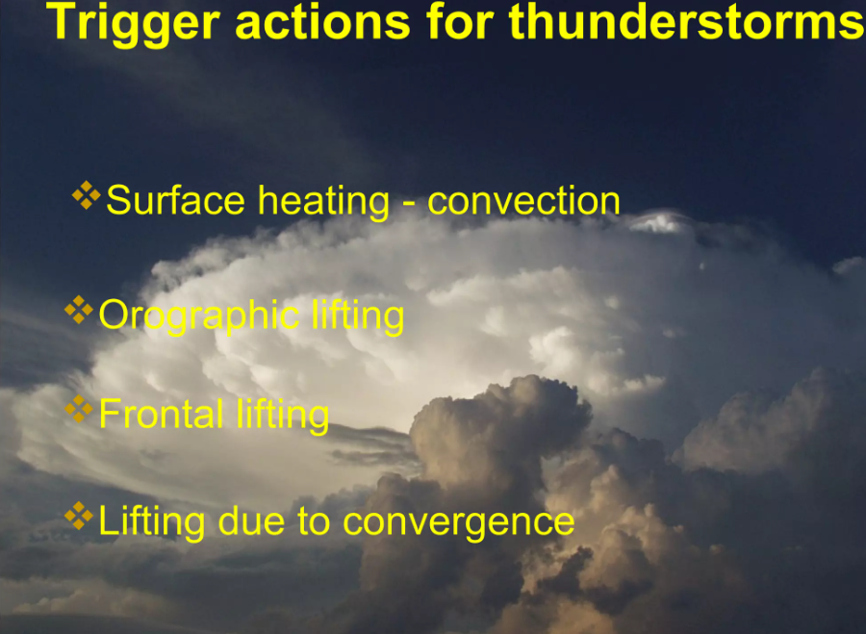

Slide 10
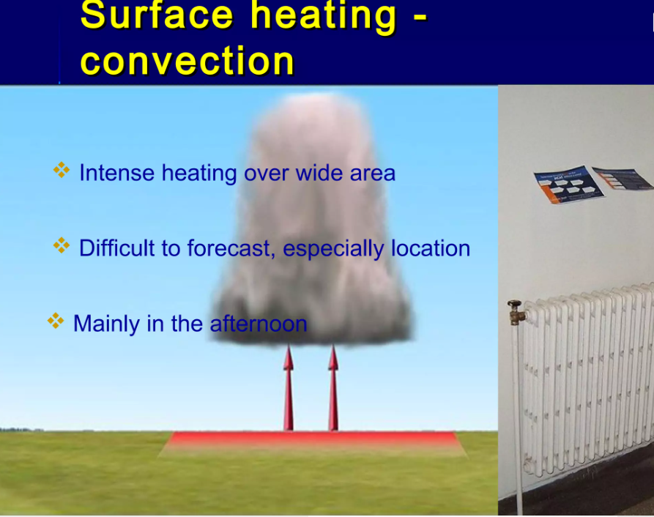

Slide 11
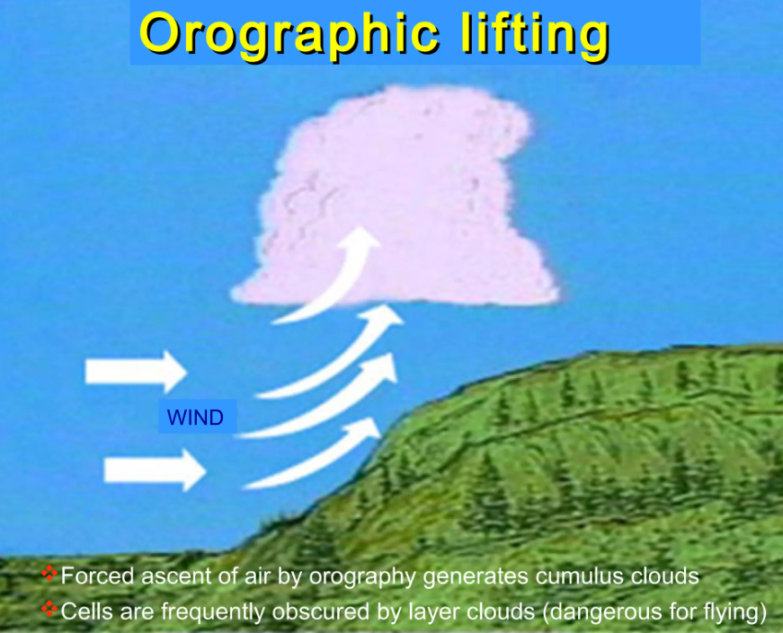

Slide 12
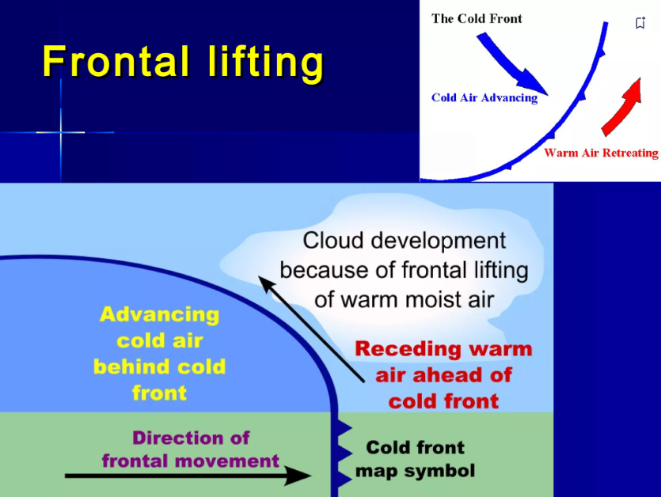

Slide 13
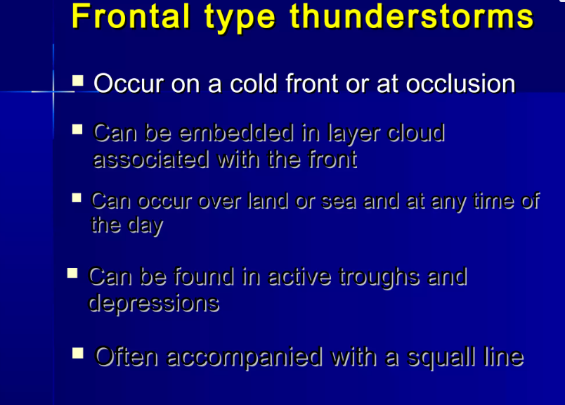

Slide 14
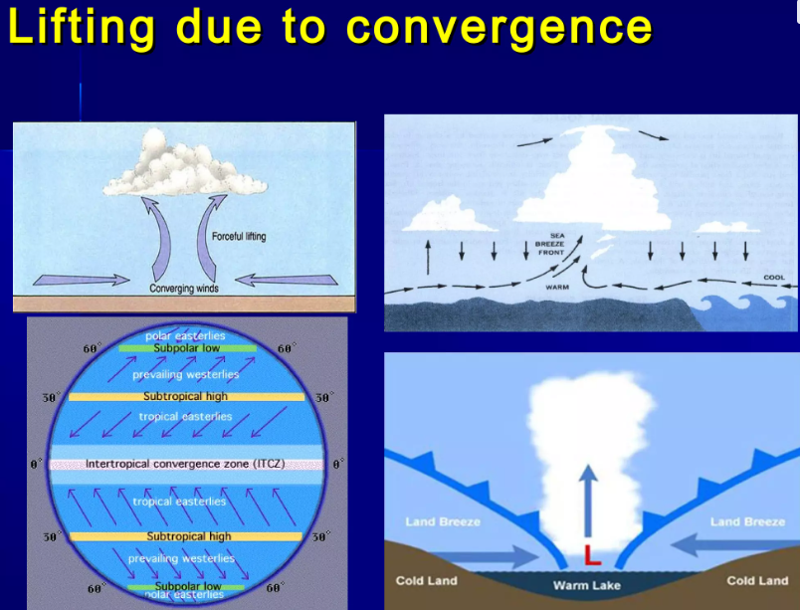

Slide 15
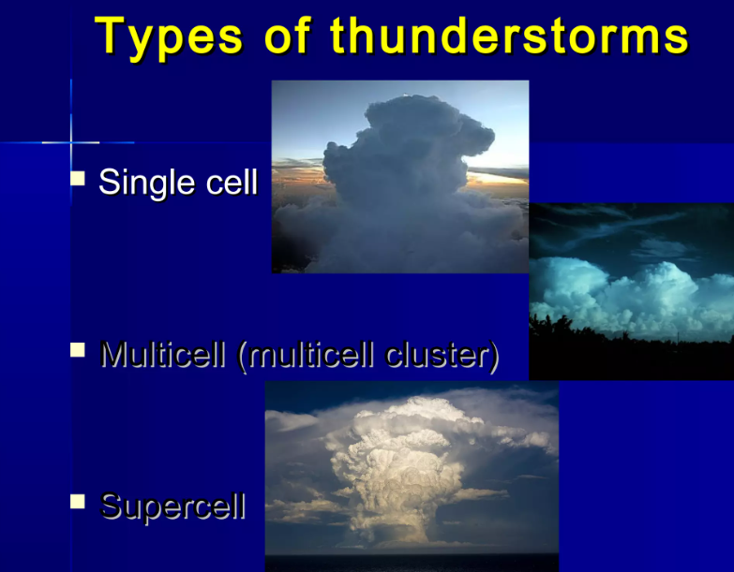

Slide 16
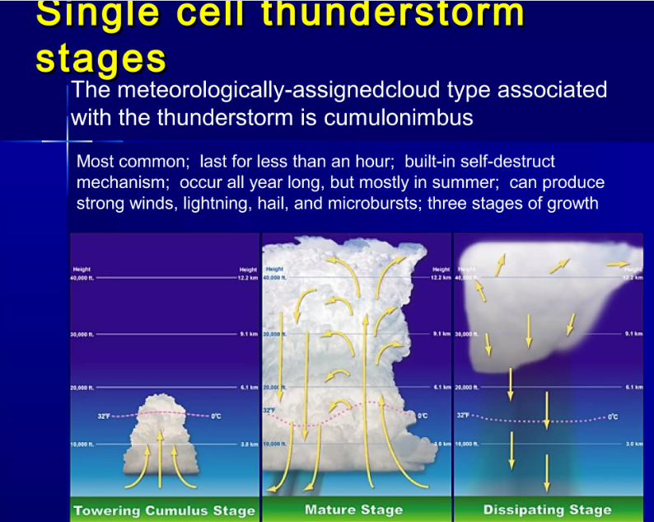

Slide 17
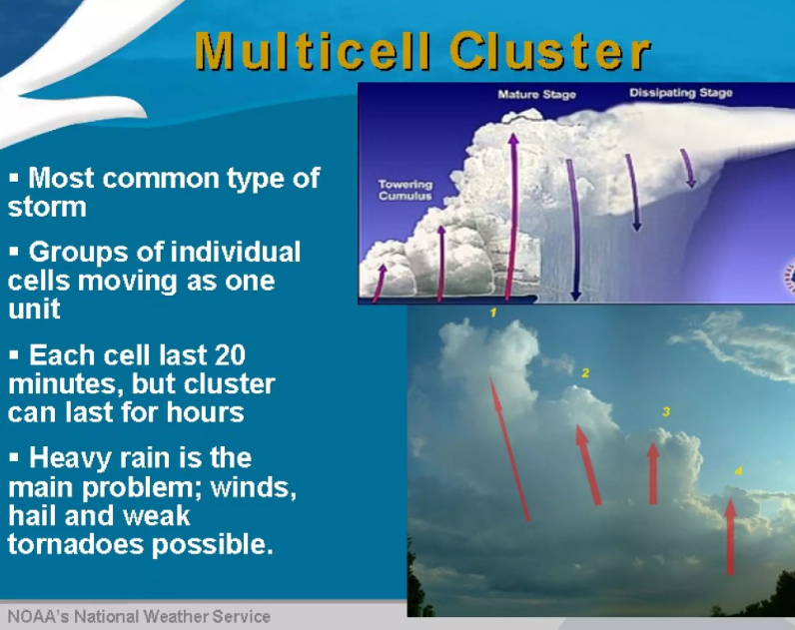

Slide 18
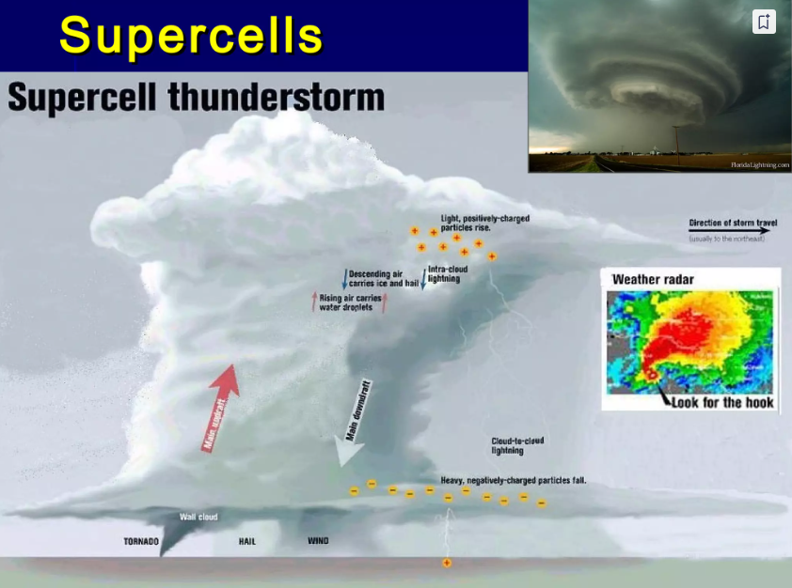

Slide 19
Reference
Climatology-D.S. LAL
Internet

Slide 20


