Slide 1
A PRESENTATION ON
CONDENSATION & PRECIPITATION
PRESENTED BY
ANEEK KUMAR BARMAN
&
MRINMOY BARKATAKI
M.Sc 4th Semester
Department of Physics
Pub Kamrup College

Slide 2
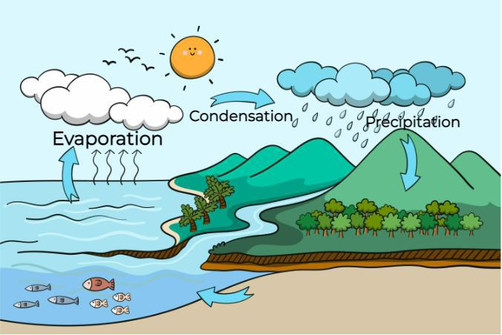
CONDENSATION: It is the process through which a substance Changes from its gaseous state to its liquid state.
Condition for condensation:
It depends on two factor.
1.Relative Humidity: When air has
100% relative humidity it is called
saturated air. When air becomes
saturated as relative humidity becomes
100%, then condensation begins.
Relative Humidity= Actual vapour density/
Saturation vapor density × 100
2. Dew Point: If dew point is above
freezing point, condensation will
occurs in liquid form
. Eg: Dew, fog, rainfall.
If dew point’s temperature
falls below freezing point, water vapors converts to ice by process of sublimation.Eg:Frost, ice, snow etc.

Slide 3
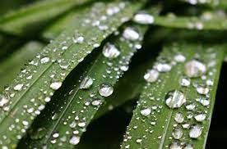
Forms of condensation:
1.Near the ground surface:
Dew: It is a form of condensation
When moisture is deposited in the form water
Droplets on cooler surface such as stones,
Grass blades and plant leaves,
it is known as Dew. Temperature is cooled down below
Dew point.
Conditions for dew formation:
Clear spies (cloud free) and calm air.
Long winter night so that the radiation cooling can takes place.
The temperature of substance must reach a dew point.

Slide 4
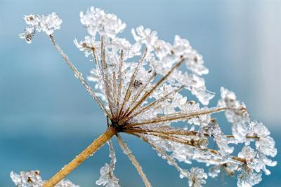
Frost: It forms on cold surfaces
When condensation takes place
Below freezing point i.e. dew point
Is at or below freezing point.
CONDITIONS FOR FROST:
1.Temperature: When temperature drops below freezing point.
2.Humidity: High humidity is required. Because there is more water vapours available in the air to deposit on to surface.
3. Clear Skies and Radiational Cooling: Frost formation is often associated with clear, calm nights. During such conditions, the Earth's surface loses heat rapidly through radiation into the atmosphere. As a result, surface temperatures can drop below the air temperature, leading to the formation of frost.

Slide 5
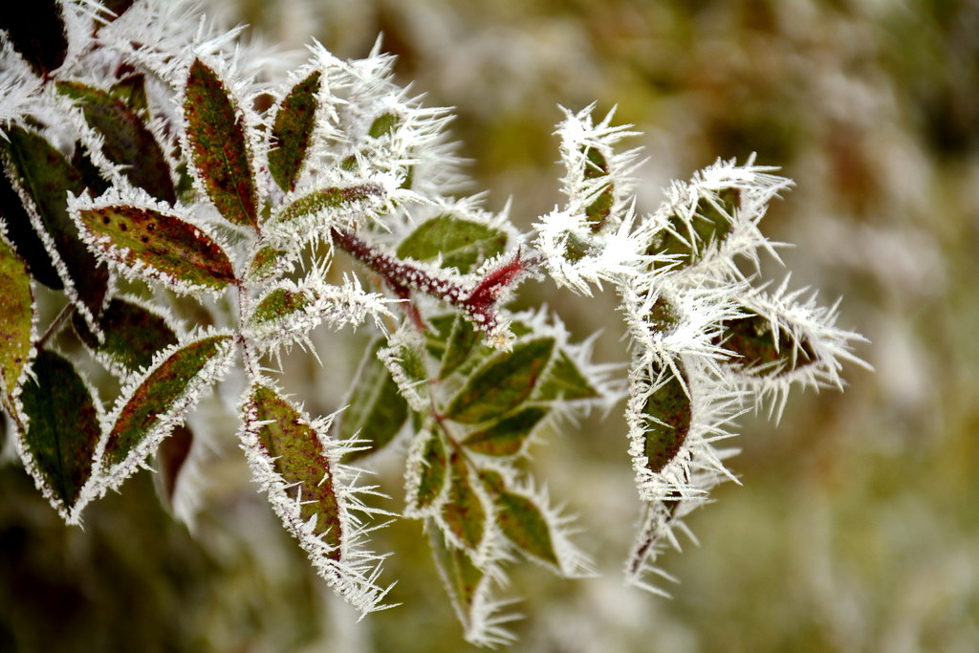
Rime: Rime is type of frost. It
Forms When supercooled water
droplet in fog or clouds
comes into contact With surface
and freeze instantly.
Condition for formation
of Rime:
1.Supercooled Water droplet: It is the water droplet that remain
A liquid state below the freezing point.
2.Contact with cold Surface
3. Presence of Fog or clouds: It occurs in foggy or cloudy condition when supercooled water droplets are abundant.

Slide 6
Fog: When temperature of air mass
Containing large quantity of water
Vapour falls of a sudden, condensation
Takes place within itself on fine dust
Particle.
CONDITION OF FOG
FORMATION:
1.High humidity: It forms when air
Contains high concentration of
Water vapour. When moist air moves over a cool surface, moist air is cooled by contact with cooler surface, reach dew point and saturated.
2. Radiational cooling: When earth’s surface heat rapidly, then surface of the air becomes cool. As the cool, it’s capacity to hold moisture decreases ,leading to condensation and fog.

Slide 7
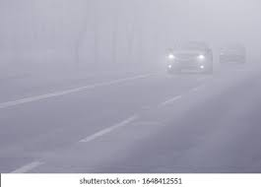
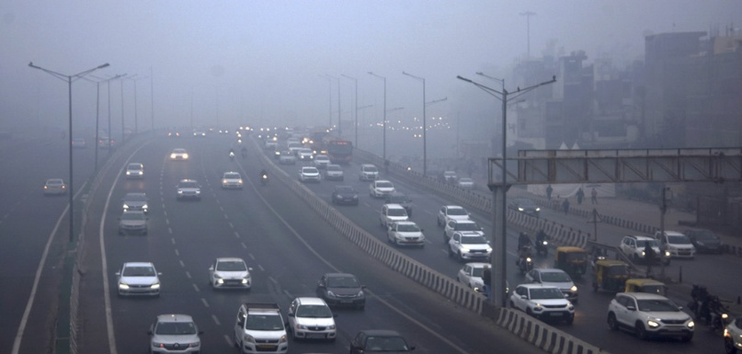
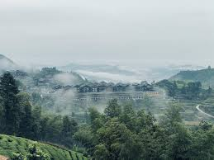
Classification of fog:
Thick Fog: Restricted visibility
Upto 45 metres.
Moderate Fog:
Restricted visibility
Upto 450 metres.
Thin Fog: Restricted visibility
Upto 900 metres.

Slide 8
Mist: It is characterized by tiny
Water droplets suspended in the
air. It forms when warm moist air
Comes into contact with cooler or
Air surfaces causing the water
Vapor in the air to condense into tiny
Water droplets.
Condition for mist
Formation:
High relative humidity: Mist forms when the relative humidity of the air near the surface is high, it contains a significant amount of water vapor relative to its temperature. High relative humidity indicates that the air is close to reaching its saturation point, where it cannot hold any more moisture.

Slide 9
Cooling of Moist Air: When relatively warm, moist air cools down, its ability to hold moisture decreases. As the air cools, its temperature approaches its dew point.
Saturation and Condensation: As the air reaches its dew point temperature, it becomes saturated with moisture. Condensation occurs around microscopic particles in the air called condensation nuclei, which provide surfaces for water vapor to condense onto.
Formation of Tiny Water Droplets: By condensation, formation of tiny water droplets suspended in the air. These droplets are typically less than 50 micrometers in diameter, when many of these droplets accumulate together, they become visible as mist or fog.

Slide 10
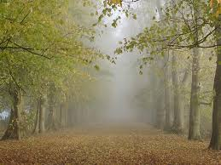
Haze: Unlike fog or mist which are
Composed of water droplets, haze
Contains various particles, including
Dust, smoke pollutant.
Condition for haze formation:
Pollution: Haze is formed when accumulation of pollutant emitted from various industrial processes, vehicle emission, agricultural and biomass is burning.
Geographical features: Valleys, mountains influence the formation and distribution of haze. Valleys and mountains can trap pollutant leading to accumulation of haze.

Slide 11
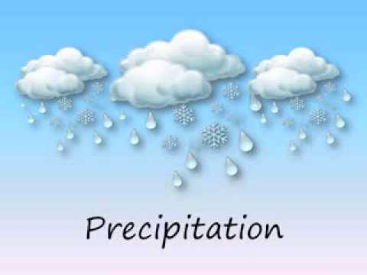
Precipitation: It refers to any
form of water or solid particles
That all from the earth’s atmosphere
To the surface. It occurs when
Moisture in the atmosphere
Condenses and forms larger
Droplets that become heavy
enough To fall under the influence of gravity.
Mechanism of precipitation:
1. Moisture Evaporation: It all begins with the evaporation of water from various sources such as oceans, lakes, rivers, and even plants. Solar energy heats the Earth's surface, causing water molecules to transition from liquid to vapor form and rise into the atmosphere.

Slide 12
2. Atmospheric Moisture: The water vapor rises into the atmosphere, where it encounters cooler temperatures at higher altitudes. As the air cools, it reaches its saturation point, and the water vapor condenses into tiny water droplets or ice crystals. This process forms clouds.
3.Cloud Formation: Clouds consist of countless water droplets or ice crystals suspended in the air. These droplets or crystals may collide and combine to form larger droplets or snowflakes under certain conditions.

Slide 13
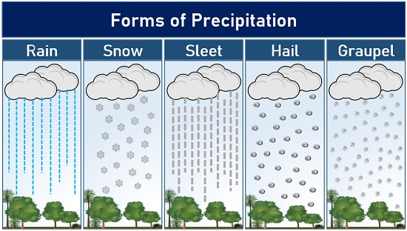
Classification of precipitation:
As a Solid state state, Precipitation can be classified as:
Hail
Sleet
Snow
Glaze

Slide 14
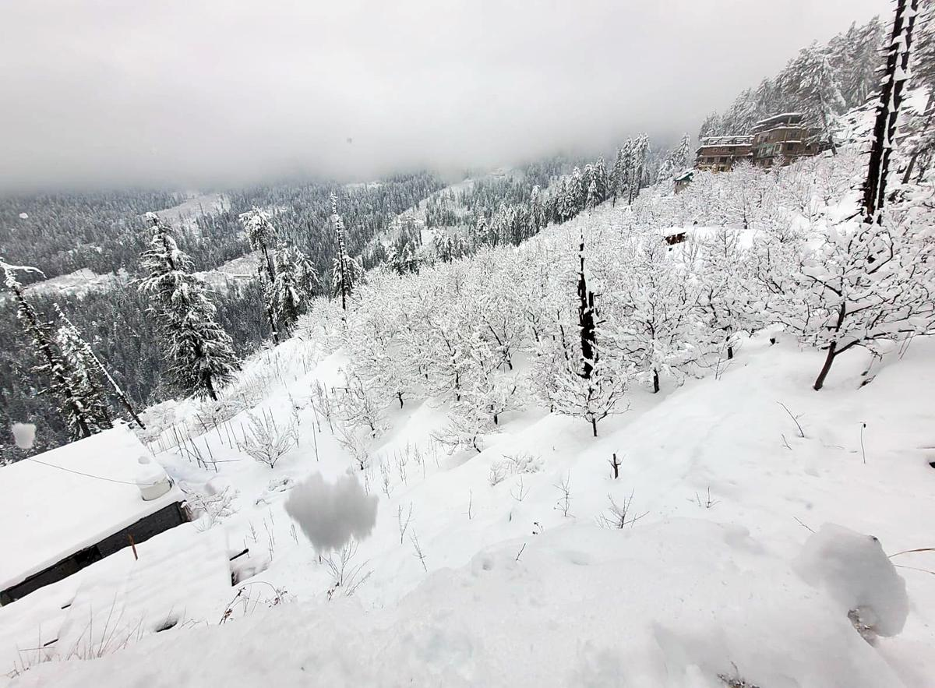
As a liquid state state, Precipitation can be
Classified as:
Drizzle
Rain
Snow fall: Snow fall is common
Occurrence in region with cold
Climate.
Process of Snow fall involves
Several stages:
1.Formation of ice
Crystal: When temperature are below freezing point, water
Vapours condense into tiny particles forming ice crystal.

Slide 15
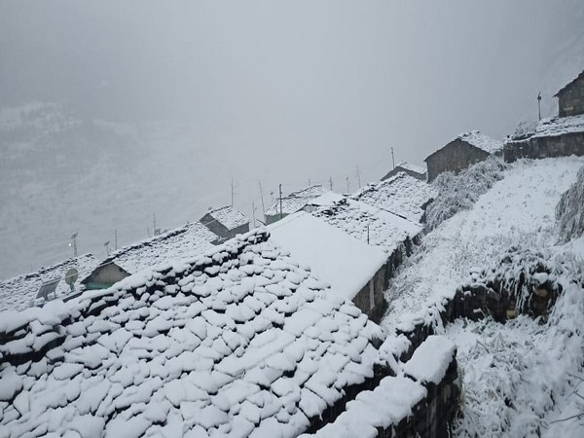
2.Growth of snow flakes: As the
Ice crystal move within the cloud
They may collide with each other
Merge forming snow flakes.
Size and shape of snow fall
Depends temperature,humidity
And atmospheric pressure.
3. Fall to the ground:
Once Snow fall becomes heavy
Enough they fall to the ground
Under the influence of gravity.

Slide 16
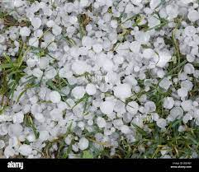
Hail: Hail is a type of precipitation
That occurs during thunderstorms,
Characterized by ice pellets falling
From the sky.
Mechanism of Hail:
1. Updraft: Cumulonimbus clouds
Have strong updraft. These
Updrafts are essential for lifting water droplets into
Atmosphere where temperature are below freezing.
2. Supercooled water: As water droplets encounter temperature below freezing point, due to a phenomenon
Supercooling, water droplet remain in a liquid state. This water droplet encounter dust particle, as they freeze rapidly.

Slide 17
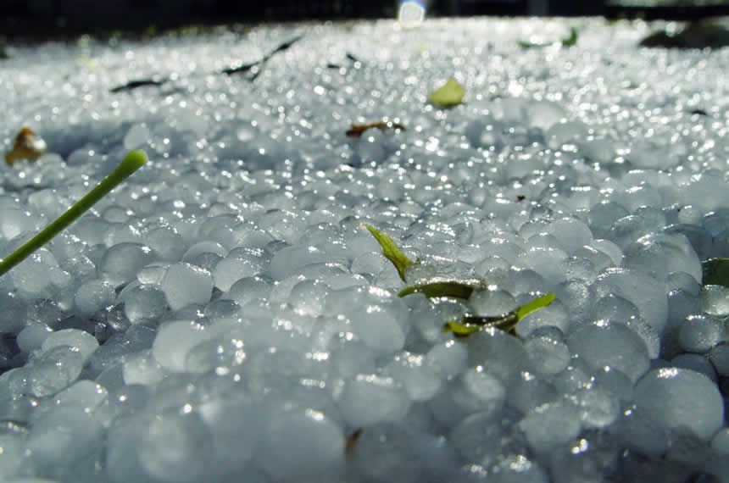
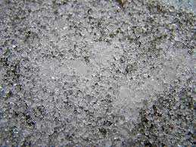
3. Accretion: As the water droplets
Collide with supercooled water
Droplets, the droplets freeze into
Ice particles gradually increasing
Their size. Thus they form
accretion.
Sleet: Sleet is a form of
Precipitation that occurs
When snowflakes partially
Melt as they fall through
A warmer air and then
Refreeze before reaching
The ground.

Slide 18
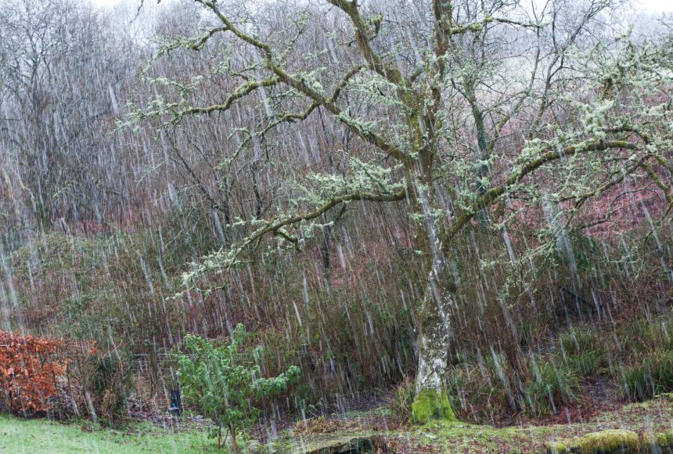
Mechanism of Sleet:
Formation of Snowflakes: Sleet form in the form of Snowflakes. It form when water vapour condense directly
Into ice crystal.
2. Encounter with warm air: As the
snowflakes Descend towards the
earth’s surface, they may pass
Through a layer of warmer air.
3.Partial melting: When snowflakes
Encounter this warmer layer of air
They start to melt. The ice crystal
Begins to transition into water
Droplets due to warmer temperature.
4. Refreezing: Partially melted snowflakes move into colder

Slide 19
Air, they encounter subfreezing again. Thus water droplets
Quickly freeze back into solid to ice pellets.
5. Sleet formation: These ice pellets are distinct from snowflakes, they are more contact and often bounch when they hit a surface.
Drizzle: Drizzle is a type of light
Precipitation characterized by
Small water droplets falling from
Low level clouds. These droplets
Are less than 0.02 inches
(0.5 millimeter) in diameter.

Slide 20
Mechanism of Drizzle:
Cloud formation: Drizzle typically originates from low-level clouds such as stratus clouds.
2. Condensation nuclei: Within these clouds,there are microscopic particles, pollen or other tiny solid or liquid particles suspended in the air
They provide surfaces upon
Which water vapour can condense
Forming cloud.
3.Collision:Tiny cloud droplets collide
And may merge toghether the droplet
Remain relatively small due to weaker
Drafts and turbulent motion within the
Cloud.

Slide 21
5. Drizzle formation: Some of these tiny cloud droplets grow
Large enough to overcome air resistance and begins to fall
Towards the ground.
Types of rainfall: Rainfall can be classified into several
Types based on various factors such as origin, mechanism of
Formation, intensity and duration.

Slide 22
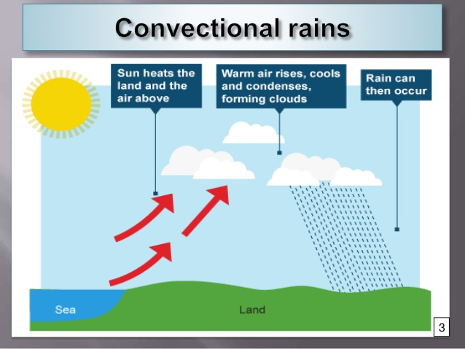
Convective rainfall: It occurs due to the rapid
Upward movement of warm, moist air.
Mechanism of Convective rainfall:
Formation of Convective cells: As the earth surface is
Heated, it warms the air above it causing to become less
Dense and rise.
2. Upward movement of air:
The warm moist air rises due to
Buoyancy, it cools adiabatically
Because decreasing atmospheric
Pressure with height. This
Cooling leads to the
Condensation of water vapour into
Tiny water droplets, forming clouds.

Slide 23
3. Raindrop formation: Within the convective clouds, water droplets continue to grow through collision.These droplets
Become large enough to overcome air resistance and begins
To fall as precipitation.
Importance: Convective rainfall plays an importance role in
Earth’s water cycle and supporting Ecosystem.
Orgographic Rainfall:
It is also known as relief rainfall,
Occurs when moist air is forced to
Rise over elevated terrain such as
mountain or hills.

Slide 24
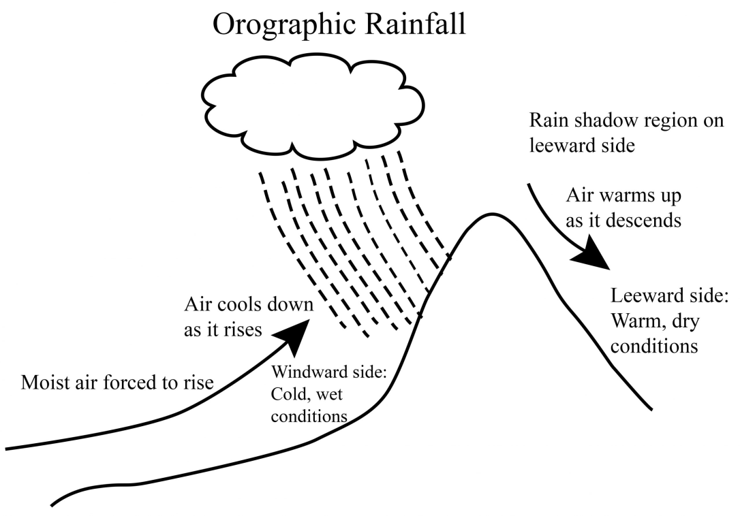
Mechanism of Orgographic Rainfall:
1.Adiabatic cooling: Rising air
Undergoes adiabatic cooling.
The rate of cooling is determined
By lapse rate, which is the
Rate at which temperature
Decreases with increasing
Altitude.
2.Condensation: As the air
Cools, its capacity to hold
Moisture decreases, leading to formation of clouds
And precipitation.

Slide 25
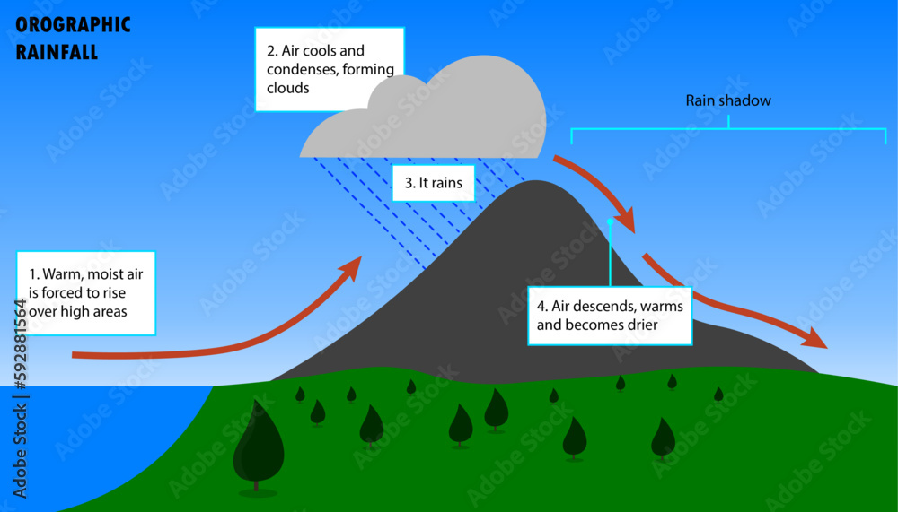
3. Rainfall: Once the clouds
Become sufficiently saturated
Rain or other forms of precipitation
such as snow, sleet
Or hail begin to fall. The intensity
and duration of rainfall
Depend on various factors
including moisture of air
Steepness and height of terrain,
stability of atmosphere.
Importance: Orographic rainfall is a crucial mechanism for redistributing moisture in the atmosphere and plays a significant role in shaping the climate and ecosystems of regions with mountainous terrain.

Slide 26
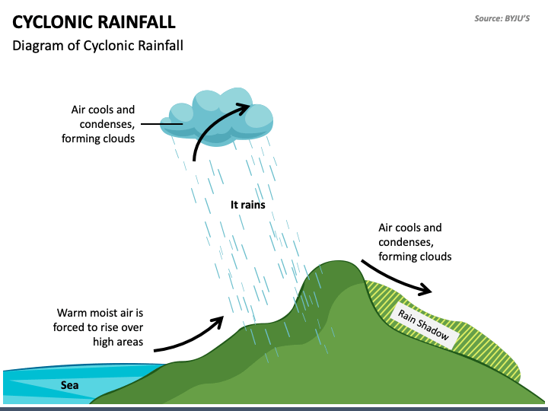
Cyclonic Rainfall: It is
Also known as frontal
Rainfall. Cyclonic
Rainfall occurs on
The front of a cyclone.
It occurs when
The hot air collides with
Cool air. Both these air
Masses have densities
And temperature.

Slide 27
Mechanism of cyclonic rainfall:
1.Air Masses Convergence: Cyclonic rainfall typically occurs when a warm air mass and a cold air mass meet along a frontal boundary. The warm air mass is less dense and tends to rise over the colder, denser air mass.
2. Cloud Formation: As the warm air is forced to rise over the cold air mass, it undergoes adiabatic cooling. This cooling leads to a decrease in the air temperature, eventually causing the air to reach its dew point temperature. At this point, the air becomes saturated, and moisture starts to condense, forming clouds.
3. Precipitation: Within the clouds, water droplets continue to coalesce and grow until they become large enough to fall as precipitation. The type of precipitation (rain, snow, sleet, etc.) depends on the temperature profile of the atmosphere and the vertical extent of the cloud.

Slide 28
References
Climatology: Savindra Singh
Climatology: D.S. Lal

