Slide 1
A PRESENTATION ON
WEATHER FORECASTINNG
PRESENTED BY
BHANITA DAS
&
SHEKHAR JYOTI BASHISTHA
MSc 4th Semester
Department of Physics
Pub Kamrup College

Slide 2
CONTENTS
1.Definition
2.Procedure
3.Tools
4.types

Slide 3
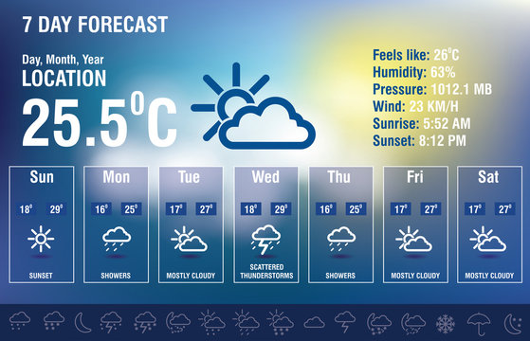
Weather Forecasting:
It is the process of predicting the atmospheric
conditions of a specific area over a given
period.

Slide 4
Procedures of Weather Forecast:
Recording of weather data: Temperature, Pressure, wind speed and direction, cloud forms, humidity and precipitation.
Collection of weather data from weather recording station scattered over world including both land and ocean surface.
Transmission of weather data collected from major weather stations to sub centre.
Completion of weather data
Plotting of weather data on maps and daily weather records, synoptic charts etc.

Slide 5
6.Analysis of weather charts and maps with the help of electric computers.
7. Final forecasting of weather of numerical modeling.

Slide 6
Tools in weather forecasting :
Weather forecasting relies on a variety of tools and technologies to gather data, analyze patterns, and generate accurate predictions.

Slide 7
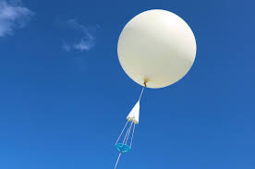
RADIOSONDES: Radiosondes are specialized instruments used in weather forecasting and atmospheric research. They are small, expendable devices that are typically attached to weather balloons and launched into the atmosphere to collect data on various atmospheric parameters as they ascend through different altitudes.

Slide 8
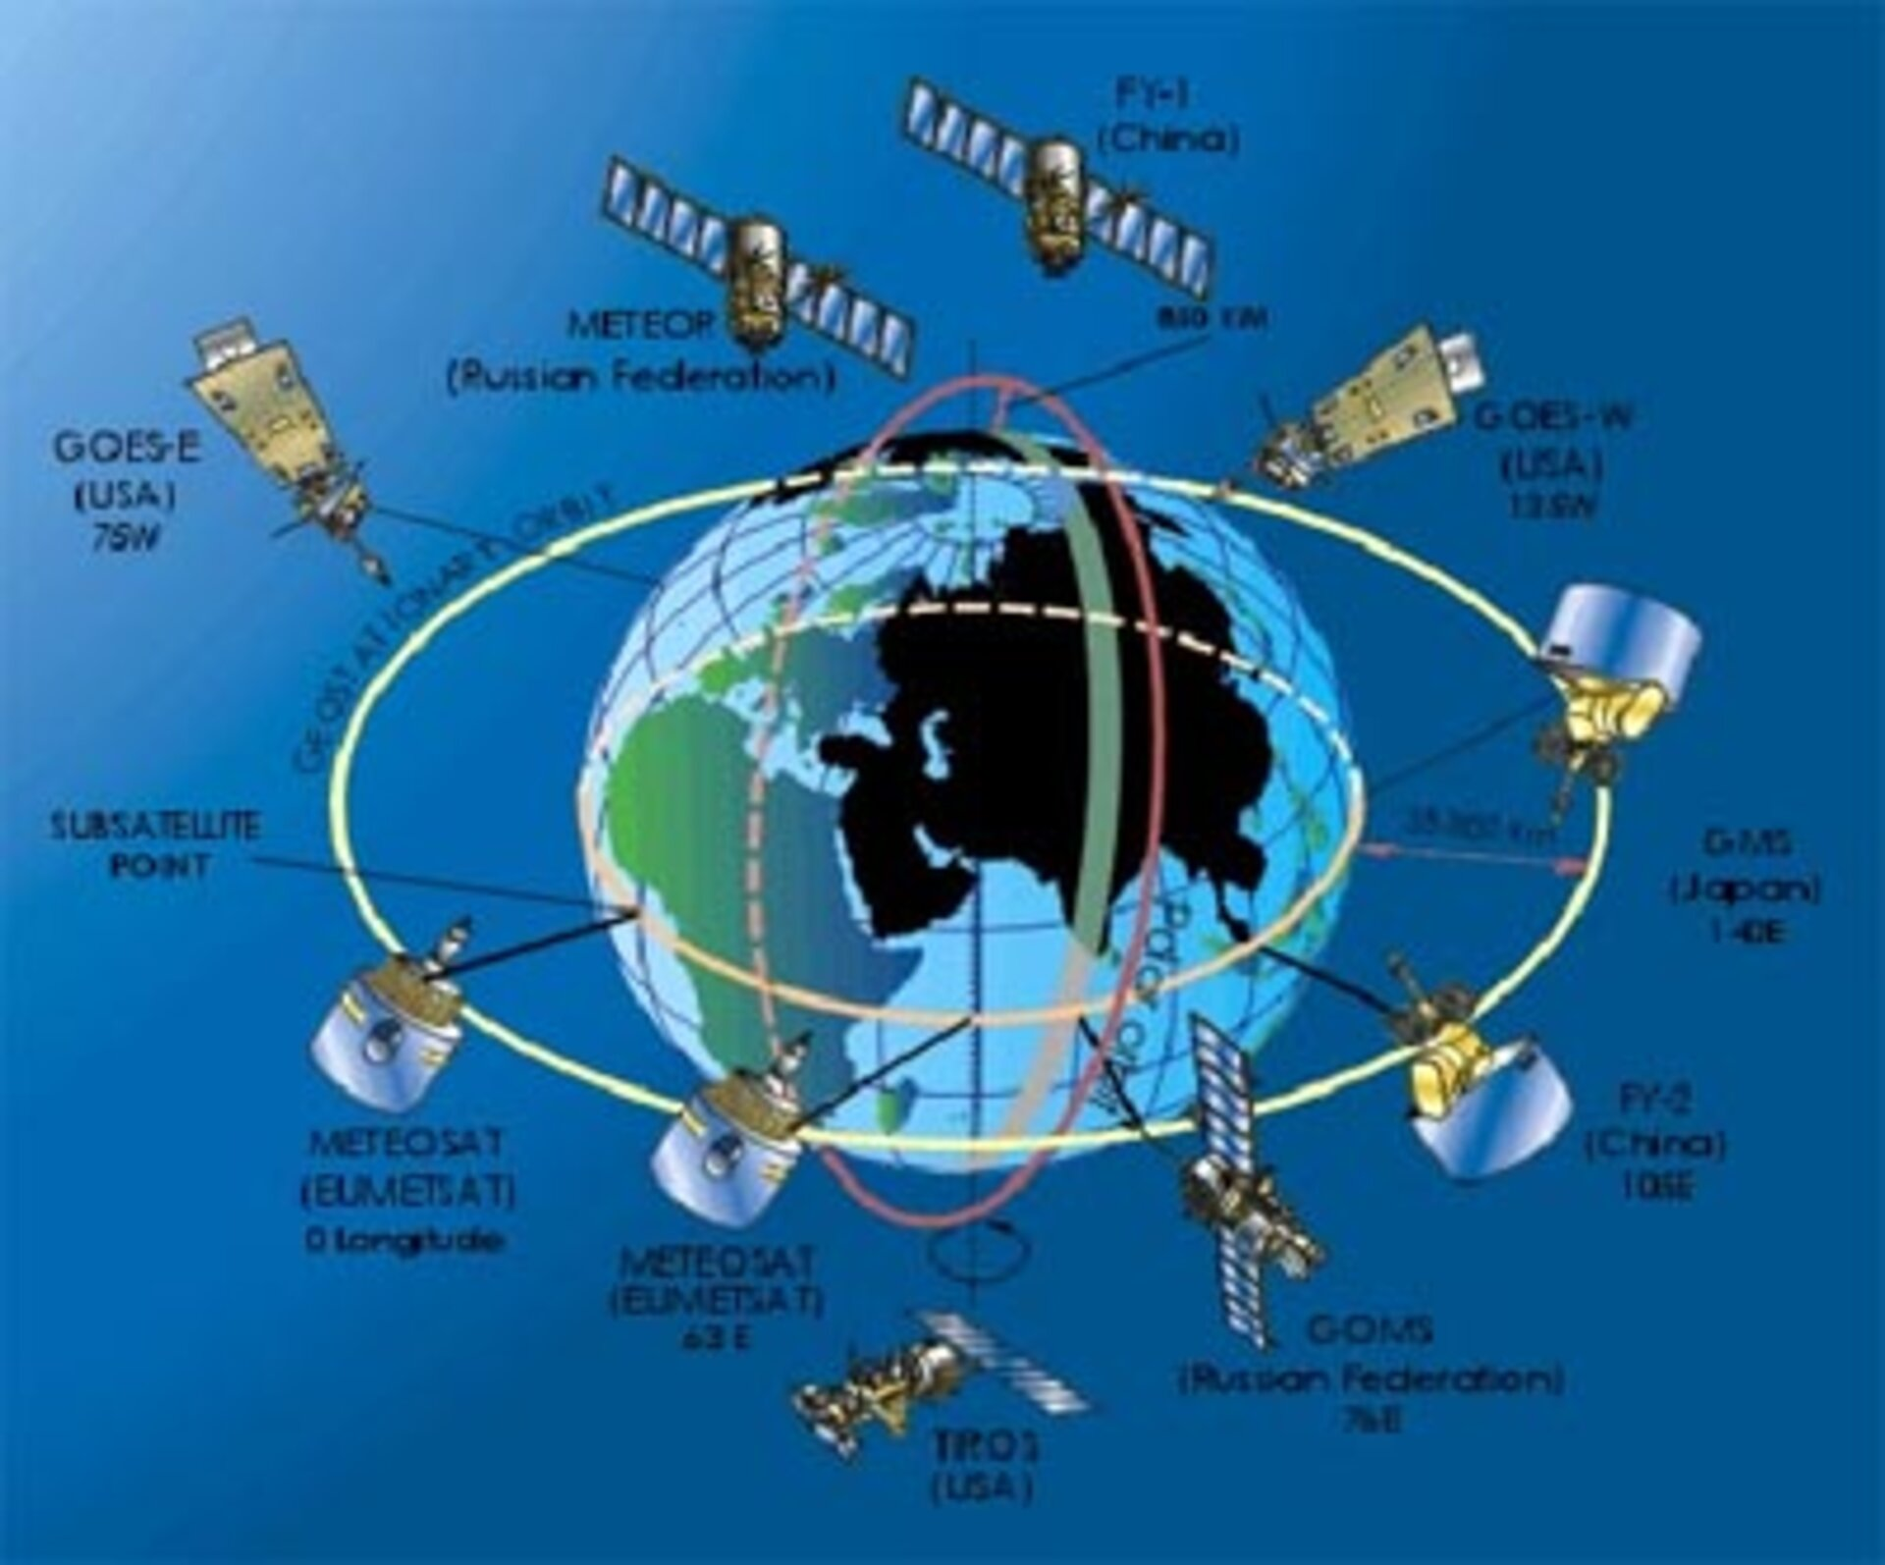
Weather Satellite
The global satellite observation system

Slide 9
The most significant device is weather satellite of different kind attach with different types of sensors for specific purpose and having varying orbital path around the earth.
The first weather satellite named TIROS-1 was launched in the year 1960.
The sensors which are attached with the weather satellite send back the images of clouds to the earth centre which are then verified at the weather forecasting centre. On the basis of orbital path, weather satellite are classified into two types
1.Geosychronous satellite
2. Polar orbiting Satellite

Slide 10
Geosynchronous Satellite
Geosynchronous Satellite as the word Geosychronige implies that they have the same rate of movement around the earth as that of the rotational speed of the earth as its equator so that the satellite orbiting around the earth is always position over the same loaction on the earth surface. The Geosynchronous weather Satellite are fixed at the altitude of 35,786 Kilometre from the sea level and this is why the satellites are called high altitude satellite. The Saellite provide scanned pictures of large area.
Example: ATS series and GOES series weather satellites

Slide 11
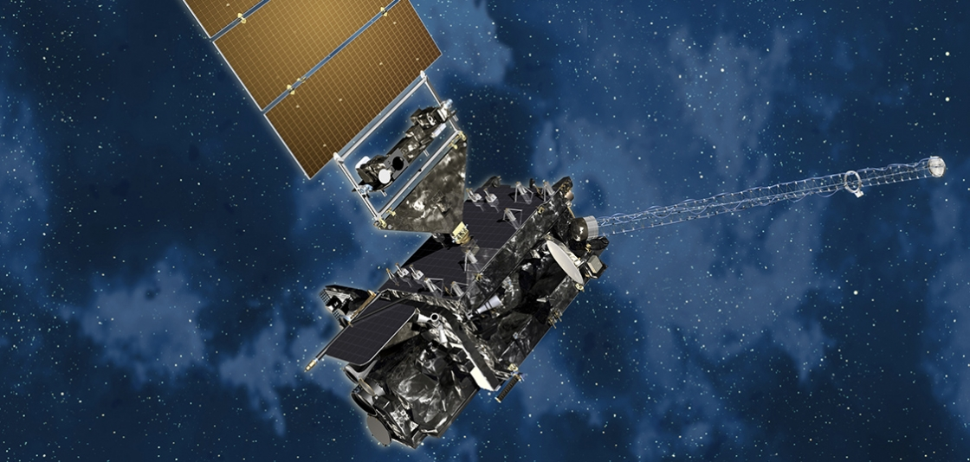
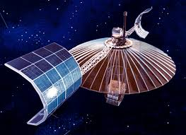
GOES and ATS

Slide 12
Polar Orbiting satellite
Polar orbiting weather orbiting satellite also known as low altitude orbiting satellite are positioned after their launching by rockets at the altitude ranging between 800-1500 KM above sea level.
This satellite have sound sensors naming ADVANCED VERY HIGH RESOLUTION RADIOMETRE(AVHRR).
Examples: TIROS AND NOAA

Slide 13
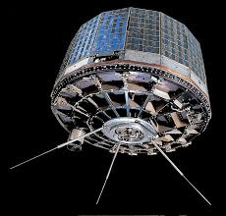
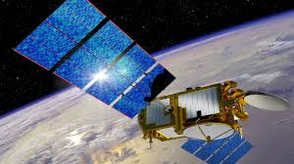
TIROS AND NOAA

