Slide 1
WEATHER FORECASTING METHODS
Presented by
SOBIAL HOQUE &
INZAMUL HOQUE
M.SC 4th Sem

Slide 2
Today’s Discussion
Introduction
Weather forecast
Why weather forecasting needed
Importance of weather forecasting
Tools used in weather forecasting
Methods of weather forecasting
Conclusion
References
Q & A

Slide 3
INTRODUCTION:
What is weather ?
Weather is the state of the atmosphere
describing for example the degree to which
it is hot or cold, wet or dry,
calm or stormy, clear or cloudy.

Slide 4
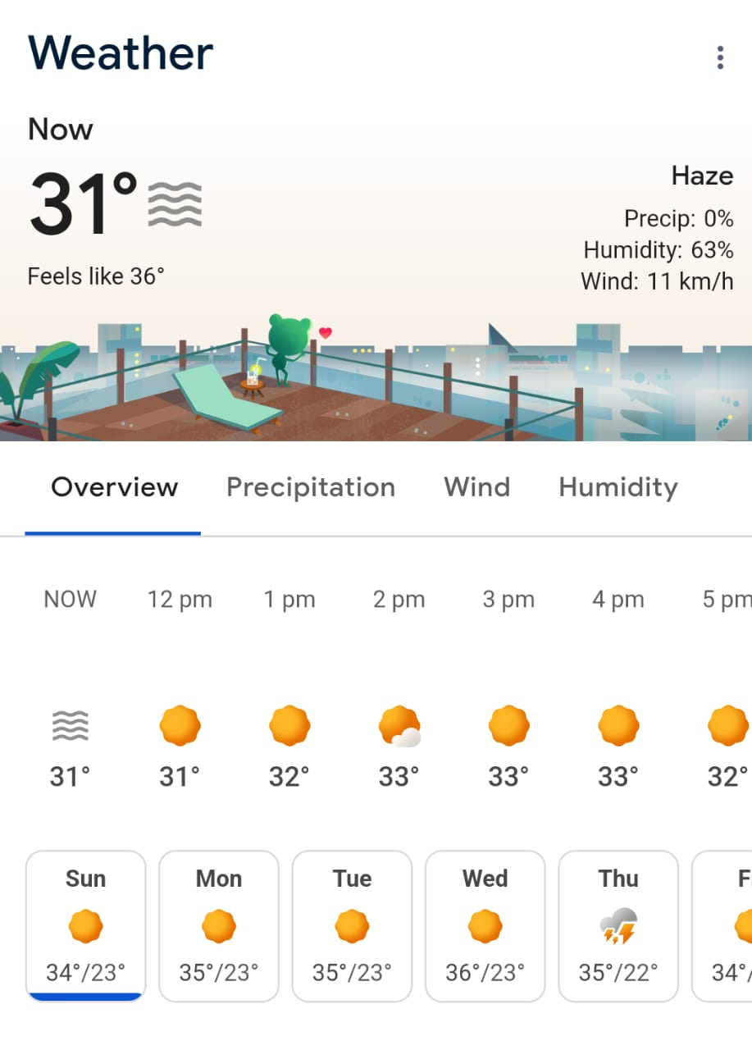
Weather forecast:
Weather forecasting is the application which
combines science and technology to predict
the state of atmosphere for future time at a
given location. It typically includes information
about temperature, humidity, precipitation,
wind speed and direction, cloud cover , and
atmospheric pressure.
Weather forecasting entails predicting how the
present state of the atmosphere will change.

Slide 5
Importance of weather forecasting:
Weather forecasting is used in many situation. few examples are discussed below
Agriculture :
Transportation :
Construction:

Slide 6
Public health:.
Scientific Research :
Natural resource management:

Slide 7
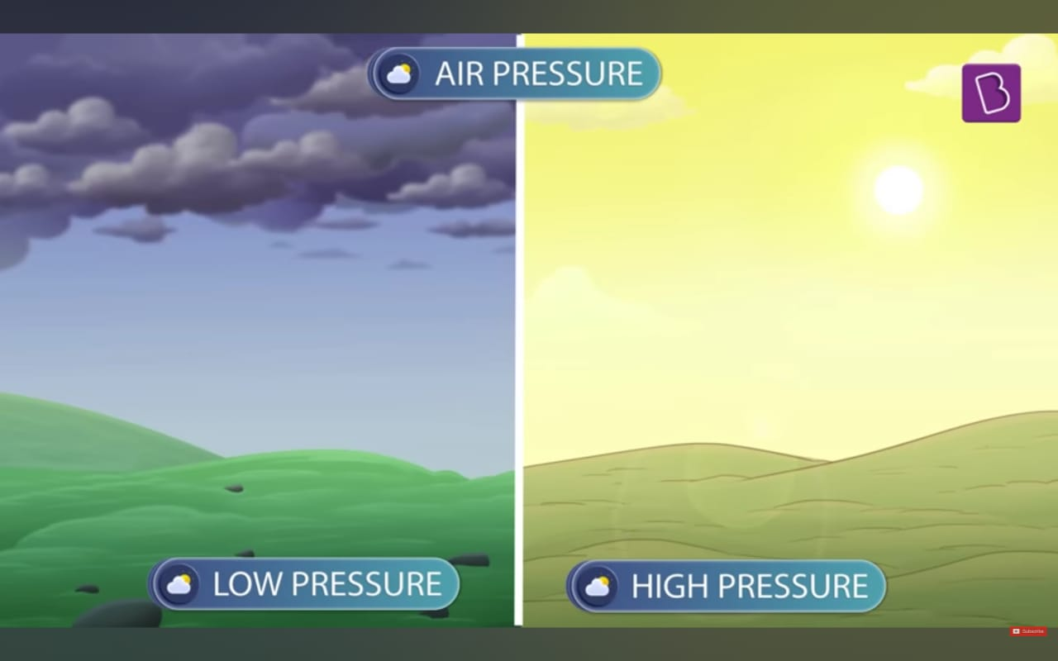
How weather is forecasted:
In ancient times, forecasting mostly based on weather pattern observation and guessing current weather condition.
The following technique used for weather prediction.
Persistence : This method of forecasting relies upon today’s
condition to forecast the condition of tomorrow.
Use of a Barometer: In this method atmospheric pressure is
measured. If the pressure drop is rapid, a low pressure system
is approaching, and there is a greater chance of rain. Rapid
pressure rises are associated with improving weather conditions,
such as clearing skies.
Looking at the sky: Thickening of cloud cover or the invasion
of a higher cloud deck is indicative of rain in the near future.

Slide 8
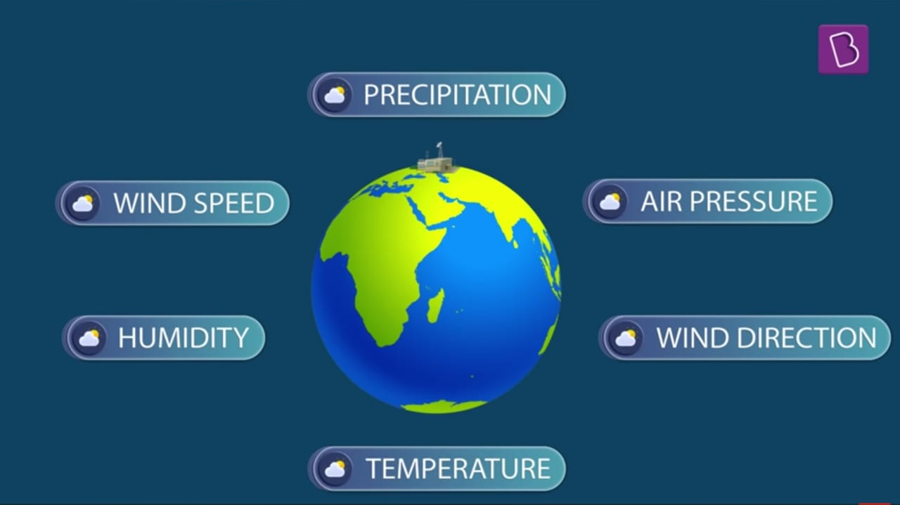
In the past, the human forecaster was responsible for generating the entire weather forecast based upon available observations. Today, human input is generally become wide range based on various parameters such as modern tools for observing atmospheric parameters(temperature, pressure, wind speed and direction, humidity ,etc.) and also can interpret with modern technology such as supercomputer to calculate complex problem. Thus nowadays weather forecasting becomes near accurate than the past.

Slide 9
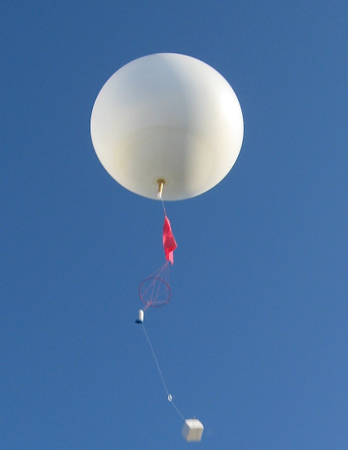
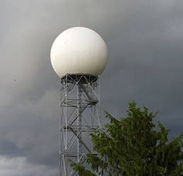
Tools used in weather forecasting:
Radiosonde 3. Satellite data
Doppler radar 4. Radar

Slide 10
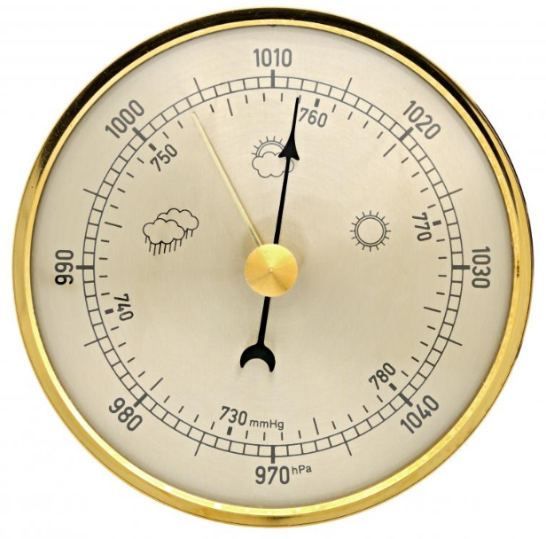
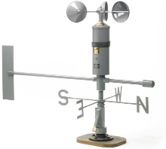
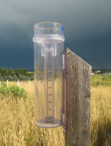
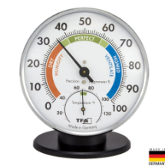
5. Barometer 6. anemometer
7. Rain gauge 8. hygrometers.
And many more.

Slide 11
Forecasting methods :
Basically there are three major scientific methods of weather forecasting which are followed by professional weather forecasting service as follows
Synoptic forecasting method,
Statistical forecasting method, and
Numerical forecasting method.

Slide 12
Synoptic Forecasting Method:
Synoptic forecasting methods involve analyzing large scale atmospheric conditions, such as air pressure, temperature, humidity, and wind patterns to predict weather on a regional or a large scale. In meteorology synoptic means overall view of weather conditions over larger area(around 2500 sq.km) at a given moment of time
This method is useful for present situation. This method is useful also for short range forecast. The success of the forecast depends on the skill and experience of the forecaster
This method of weather forecasting was the primary method upto 1950s.
Procedure: It involves the preparation of synoptic chart of current weather condition and prognostic/prebartic chart on the basis of just prepared synoptic chart for the future projection of weather condition for the next few hours.

Slide 13
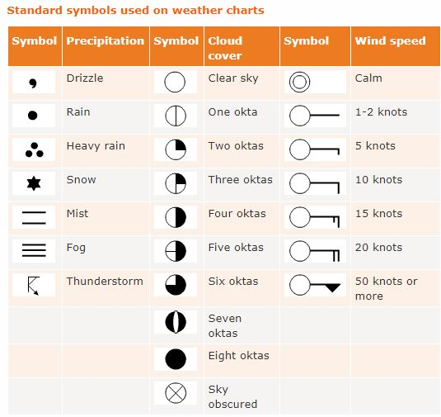
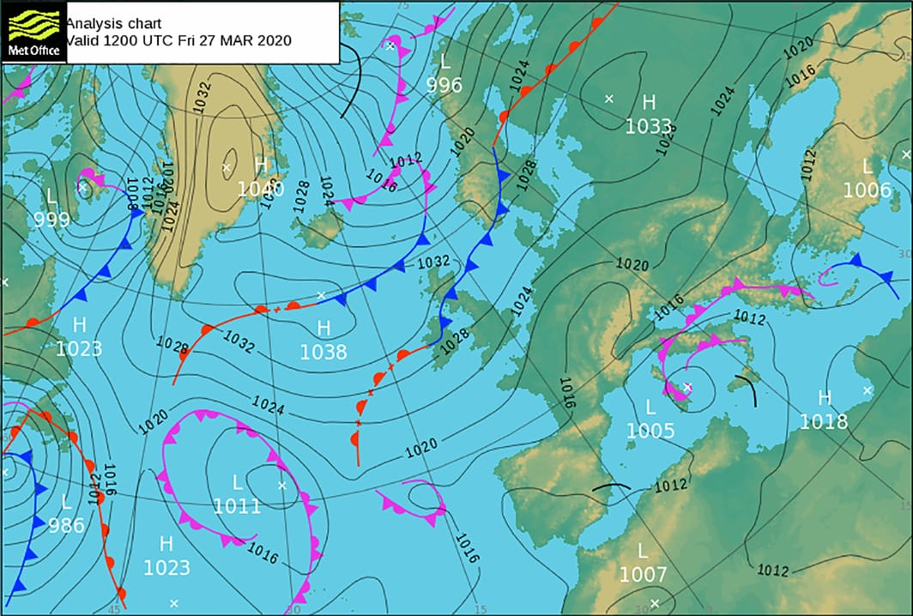
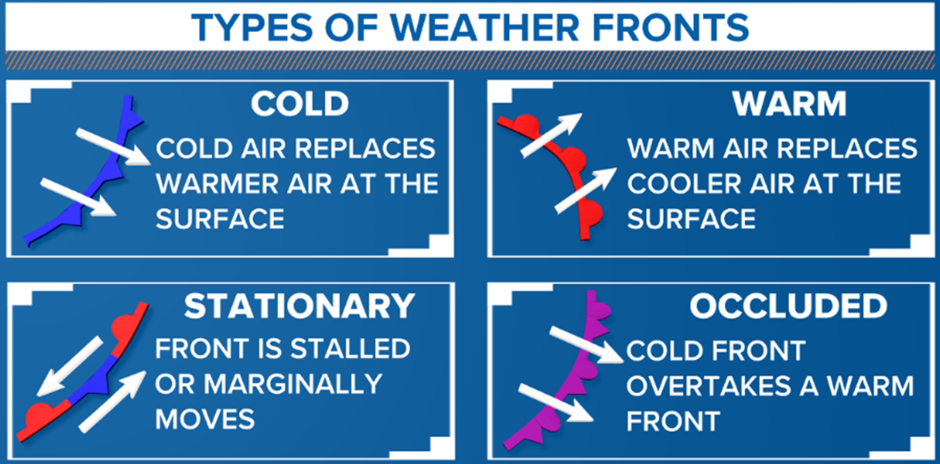
Synoptic chart: A chart showing distribution
of meteorological conditions through well
defined weather symbols on map covering
wide region of earth’s surface at a given
moment of time.

Slide 14
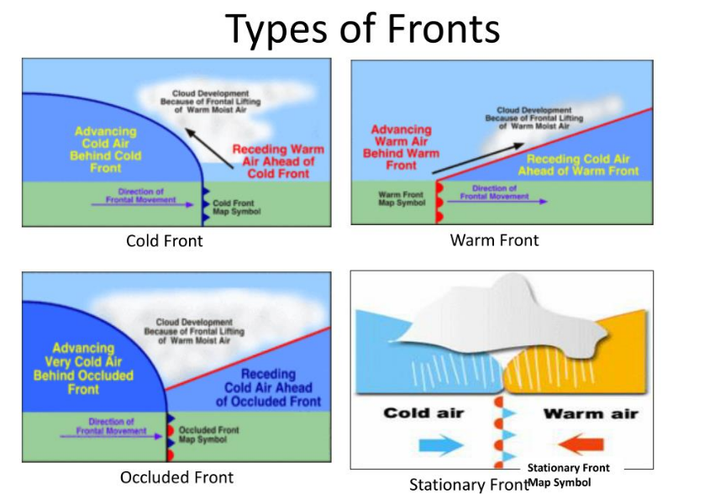
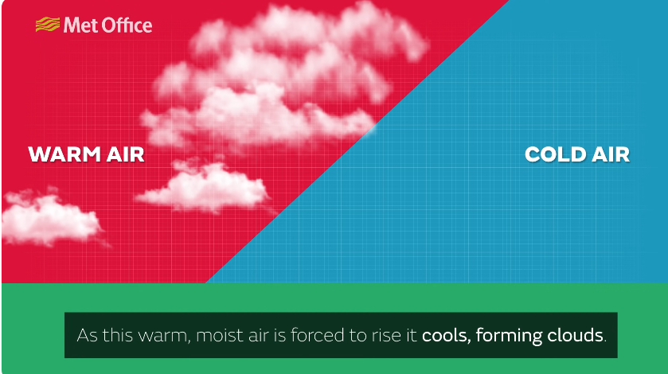
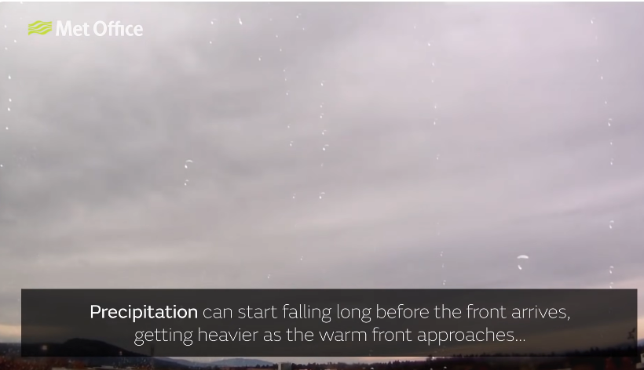
Weather front:

Slide 15
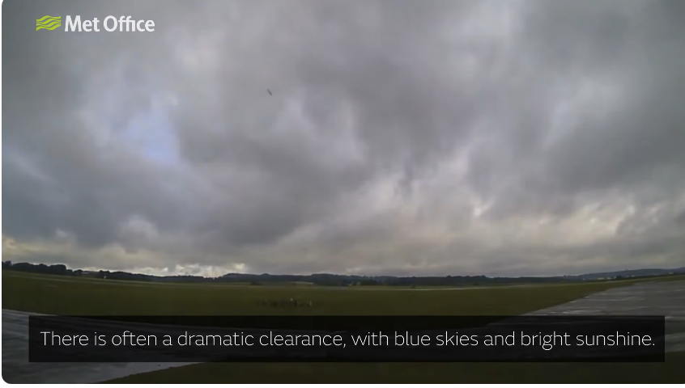
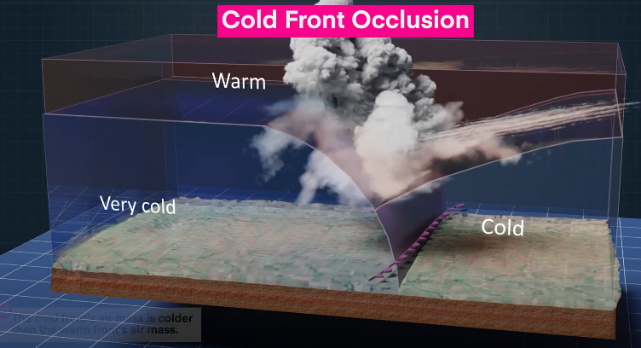
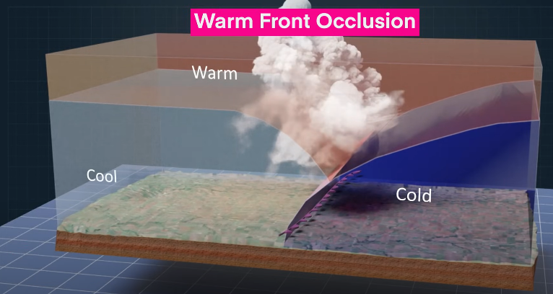

Slide 16
Prognostic Chart:
Prognostic chart is prepared on the basis of synoptic chart for the projection of weather condition for the next few hours.
The basis of prognosis(future prediction) is the belief that what happened during the past 24 hours may continue to occur for the next few hours.
It may be mentioned that such prediction may not always be true because of some changes may take place in the weather system during next few hours.

Slide 17
NUMERICAL METHOD OF FORECASTING:
Numerical weather prediction method uses the power of computers and complex computer programmers and equations concerning atmospheric variables like temperature, pressure, humidity etc. These equations are used by models which are run on supercomputers with the help of which weather forecasting is done. This method is considered the best of the methods discussed above and gives precise day-to-day weather forecast.
There are numerous equations employed in this work of forecasting models one of which is the hypsometric equation which can be derived from the hydrostatic equation written as

Slide 18
$dP=−P\left(\frac{g}{RT}\right)dZ$ ….……………….(1)
dividing by P
$\frac{dP}{P}=−\left(\frac{g}{RT}\right)dZ$ ………………......(2)
Integrating
$\int_{p0}^{p1}{\frac{dP}{P}=−\frac{g}{RT} \int_{Z0}^{Z1}{dZ +C}}$
Let c=0 $[{lnP]}_{p0}^{p1}=−\frac{g}{RT} [{Z]}_{z0}^{z1}$
$\left[lnP_{1} −lnP_{o}\right]=−\frac{g}{RT}(Z_{1} −Z_{0})$
$ln\frac{P1}{Po} =−\frac{g}{RT} \left(Z_{1}−Z_{0}\right)$ ………………………………(3)
Taking exponent of both sides of the equation (3) we have, $e^{\ln\left(\frac{p1}{p0}\right) }=e^{[−\frac{g}{RT }(z_{1}−z_{0})]}$

Slide 19
$\frac{P1}{Po} =−e^{\frac{g}{RT} \left(Z_{1}−Z_{0}\right)}$
$P_{1} = P_{0} e^{[ −\frac{g}{RT} (Z_{1} – Z_{0})] }$
At sea level,
${ Z}_{0}$= 0. Thus, P₁ = $P_{0} e^{[ −\frac{g}{RT} Z_{1}] }$ - (4)
Equation (4) is the Hypsometric equation, which gives the pressure $P_{1}$ of the atmosphere at a particular height Z₁,
Where P₀ is the pressure at the sea level,
g is acceleration due to gravity.
R is the molar gas constant and
T is the temperature at the surface.

Slide 20
STATISTICAL FORECASTING METHOD:
This methods involve using historical weather data and mathematical model to predict future weather conditions.
In this method correlations and regressions are calculated using weather elements.
Records of average temperatures, average rainfall and average snowfall over the years give forecasters an idea of what the weather is "supposed to be like" at a certain time of the year.
This method is useful for long range weather forecast.
Basically there are two statistical approaches to forecasting e.g
1) Data of past records
2) Regularity or periodicity approach

Slide 21
For the first approach i.e. past data approach, advance statistical methods such as correlation, regression, factor analysis etc. are used to derive average weather condition which may recur in future at least for a season or a year.
Regularity/periodicity or analogue approach includes the consideration and statistical analysis of
1)Selection of repetitive of common weather events.
2)Identification of recurrence intervals of some extreme weather events.
3)Establishment of continuity of weather events or periodicity of cyclic patterns.
4)Identification of analogous weather situation which occurred in the past and at
the present and future projection of occurrences of similar situations in future.

Slide 22
CONCLUSION:
Weather forecasting is a complex and challenging science that depends on the efficient interplay of weather observation, data analysis by meteorologists and computers, and rapid communication systems. Meteorologists have achieved a very respectable level of skill for shortrange weather forecasting. Further improvement is expected with denser surface and upper air observational networks, more precise numerical models of the atmosphere, larger and faster computers and more are to be realized. However, continued international cooperation is essential, for the atmosphere is a continuous fluid that knows no political boundaries. So far, the accuracy of long range forecasting has been minimal, but the short range forecasting has been of immense help and advantage to the world at large today

Slide 23
REFERENCES
http://www.justagriculture.in
International Journal of Engineering Research & Technology (IJERT) Vol. 2 Issue 12, December - 2013 IJERT ISSN: 2278-0181
Ackerman, S. A. and Knox, J. A. (2003). Meteorology: Understanding the Atmosphere. Brooks/Cole USA, pp 362 – 379

Slide 24
THANK YOU EVERYBODY

