Slide 1
Pressure Belt and Atmospheric Circulation
Presented By :-
Partha Pratim Sarma &
Nur Alom Ansari
M.Sc 4th sem
Department of Physics
Date of presentation:-
12/03/2024

Slide 2
Contents:
Abstract
Introduction
Definition (pressure belt)
Cause of formation of pressure belts
Types of pressure belts
Definition (Atmospheric Circulation)
Different types of Cells
Credits and References
Thank you
Q & A

Slide 3
Abstract:
This presentation aims to explore-
The global pressure belts and the atmospheric circulation and the interconnected relationship between them.
Their significance in shaping regional climates and global phenomena and also the driving forces behind atmospheric circulation.
By the end of the presentation, we will have a deeper understanding of the intricate mechanisms governing pressure belts and atmospheric circulation

Slide 4
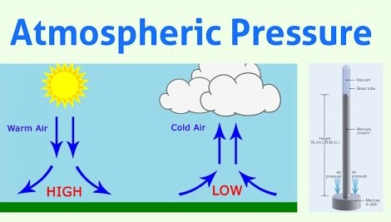
Introduction:
Global Pressure Belt:
In this presentation the term “pressure refers typically to the “atmospheric pressure”.
Presentation\atm.jpeg

Slide 5
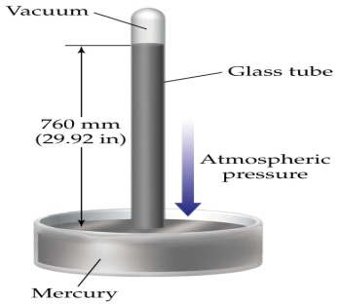
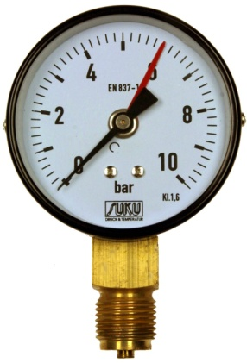
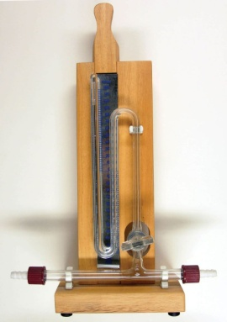
What is atmospheric pressure?
The force exerted on the earth surface by its atmosphere due to the gravitational pull of earth.
Atmospheric pressure is measured commonly in the unit of millibar, 1 millibar =100 Pa
Another well known unit is "atm“,1 atm=101325 Pa
Measured by an instrument called Barometer-mercury &aneroid
Presentation\1.jpeg
Presentation\pmi.jpeg
Presentation\2.jpeg

Slide 6
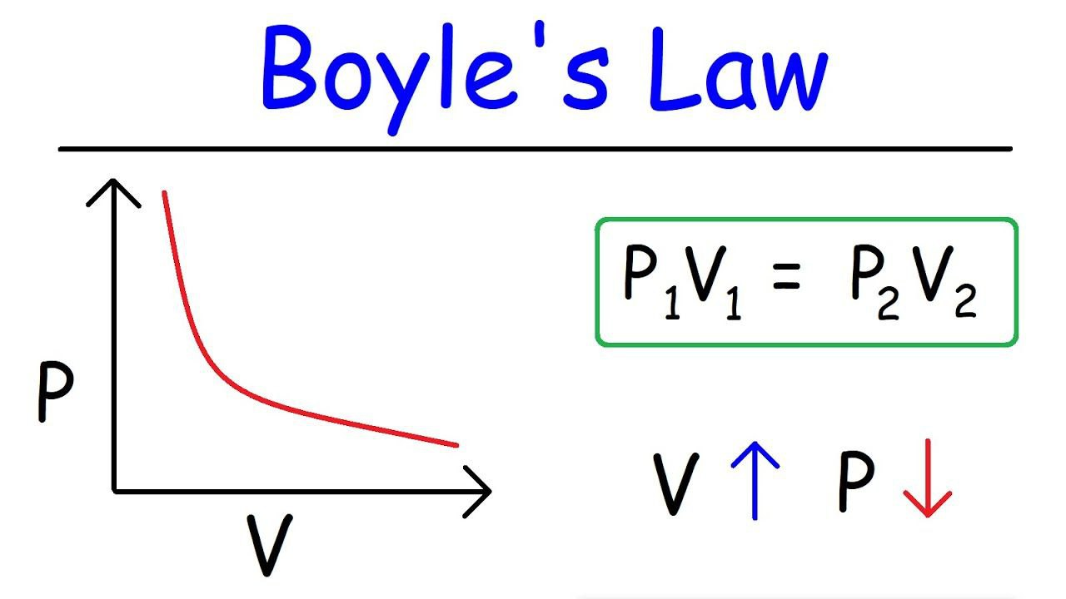
ATMOSPHERIC PRESSURE VARIATION:-
It refers to changes in air pressure at different altitudes or due to weather conditions.
Thermal expansion & compression of air results in atmospheric pressure variations.
This variation is typically described using concepts like Boyle's Law or the ideal gas law.

Slide 7
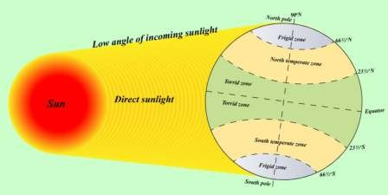
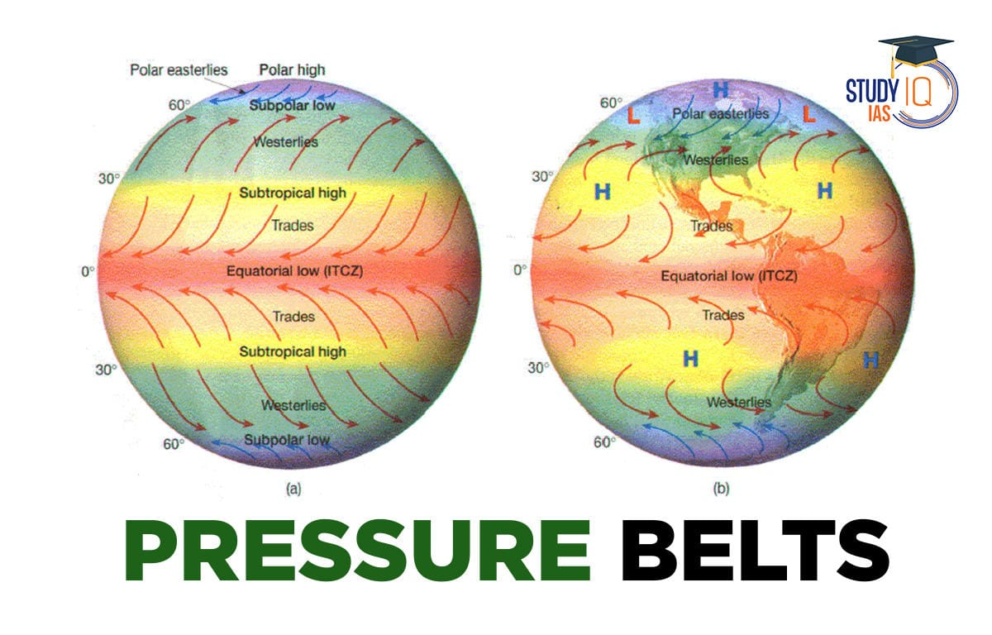
What is pressure belt ?
A region on the earth that is dominated by either high pressure cells or low pressure cells is called a pressure belt.
The horizontal distribution of air pressure across the latitudes is characterised by high or low-pressure belts.
Presentation\Picture1.jpg
Presentation\np.jpeg

Slide 8
Why pressure belt are formed?
Unequal Heating: The Earth's surface is heated unevenly by the sun due to variations in the angle of incidence of solar radiation
Convection Currents: Warm air rises at the equator and moves towards the poles, while cooler air sinks and moves towards the equator.
High and Low Pressure Areas: The convergence and divergence of air masses along the Earth's surface result in the formation of high and low-pressure systems
Coriolis Effect:
Presentation\np.jpeg

Slide 9
Coriolis force:-
Basically coriolis force is a force exerted by a rotating frame on a body in motion on that frame.
in the context of earth , earth is a rotating frame ,due to its rotation the fluids such as wind flowing in the earth's frame of reference experience a deflection of path
the wind flowing the northern hemisphere deflected towards right while in the southern hemisphere it is deflected towards left.
Presentation\cor.jpeg
Presentation\cor2.jpeg

Slide 10
Different types of pressure belt:-
There are Seven Different pressure belts-
Equatorial low
Subtropical High (North And South)
Sub polar low (North and South)
Polar High (North and South)
Presentation\np.jpeg

Slide 11
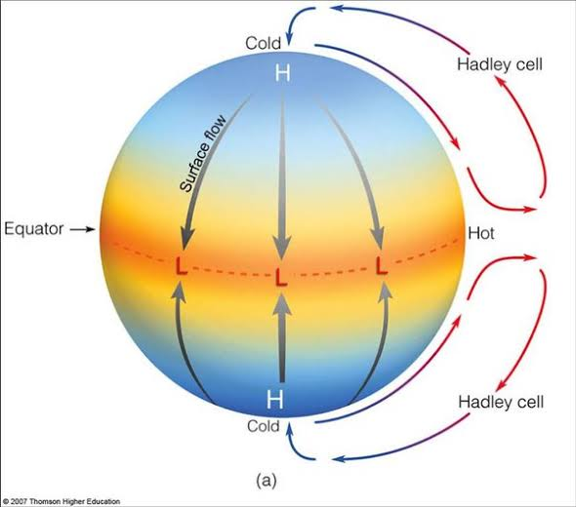
Equatorial low pressure belt
Also known as the Intertropical Convergence Zone (ITCZ).
Typically within the range of 5 degrees north and south of the equator.
Vertical rays of the Sun – High temperature – air becomes warm and rises over the equatorial region (convection) to the top of the troposphere – results in low pressure.
This belt is also known as the Belt of Calms or the Belt of Doldrums.
Presentation\vvv.jpg
Presentation\my1.jpg

Slide 12
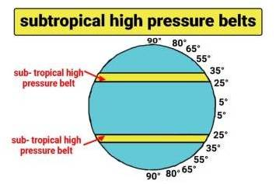
2. SUB TROPICAL HIGH BELT
Located between 25°N to 35°N and 25°S to 35°S.
As the equatorial jet stream moves toward the Poles, it begins to cool and sink down at about 30° North and South of the Equator.
pressure belt is referred to as the Horse Latitudes.
contribute to the formation of subtropical deserts such as the Sahara in Africa and the Sonoran Desert in North America.
Presentation\SUB TROPIC.jpg
Presentation\my1.jpg

Slide 13
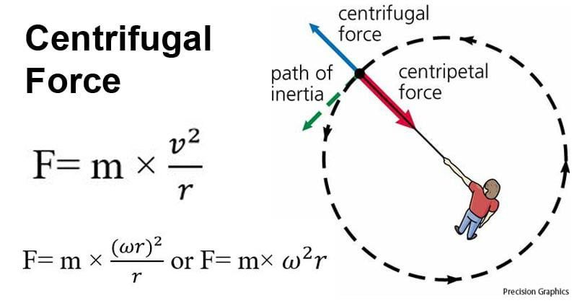
3. SUB POLAR LOW PRESSURE BELT
Located between 60°N to 65°N and 60°S to 65°S.
These belts experience stormy weather and cyclonic activity especially during the winters.
Coriolis force and pressure gradient force are balance by the centrifugal force in those region, leads to the low pressure.
Centrifugal force is the apparent outward force on a mass when it is rotated. It is maximum on Equator
Presentation\SUB POLAAAAR.jpg
Presentation\my1.jpg

Slide 14
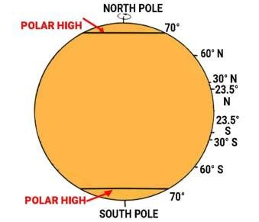
4. POLAR HIGH PRESSURE BELT
Located between 85°N to 90°N and 85°S to 90°S.
Polar Regions experience cold climatic conditions as the rays of the Sun are extremely slanting - the air is dense and heavy.
On the polar region centrifugal is minimum that leads high pressure.
Air from 60°N and 60°S also descends in the
polar region.
Presentation\POLAR H.jpg
Presentation\my1.jpg

Slide 15
GLOBAL ATMOSPHERIC CIRCULATION

Slide 16
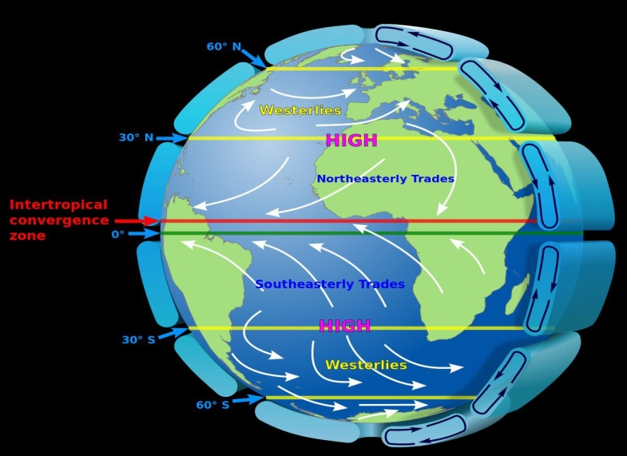
DEFINITION
Atmospheric circulation refers to the large-scale movement of air around the Earth driven by a combination of factors such as solar heating, the rotation of the Earth, and variations in surface temperature and pressure.
The atmospheric circulation can be viewed as a heat engine driven by the Sun's energy , its govern by the law of thermodynamics.
Presentation\NAAAAAAA.jpg

Slide 17
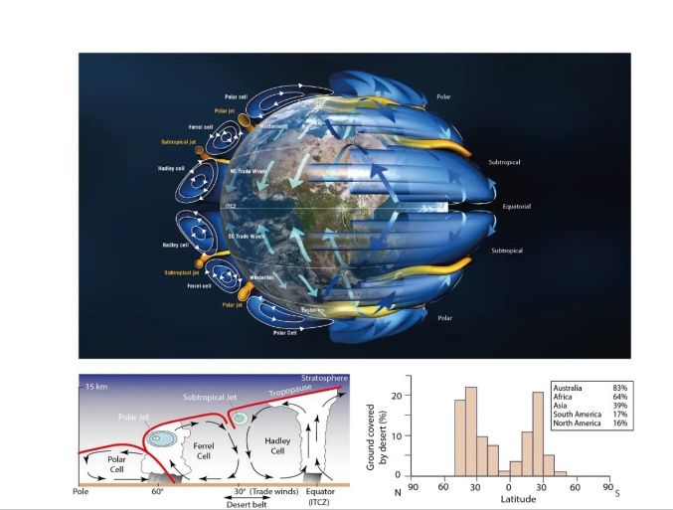
Hadley cell
It is a large-scale circulation pattern that occurs in both the Northern and Southern Hemispheres, primarily between the equator and about 30 degrees latitude in each direction.
Named after George Hadley
Plays a crucial role in redistributing heat and moisture around the globe.
Intense solar heating at the equator causes warm air to rise, creating a low-pressure zone. As the air rises, it expands and cools, leading to the formation of clouds and precipitation.
it is a thermal cell
Presentation\SSSSSSSSSS.jpg
Presentation\MMMMMMM.jpg

Slide 18
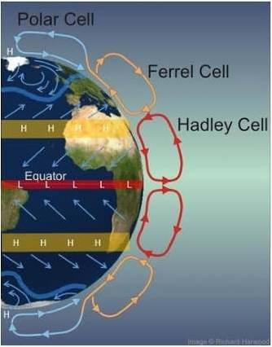
POLAR CELL
It features part of the air rising at 60° latitude flowing towards Poles, descending, and then returning towards sub-polar region.
Part of the air rising at 60° latitude diverges at high altitude toward the poles and creates the polar cell.
The descending air near the poles creates surface winds known as the polar easterlies. These winds blow from the poles towards lower latitudes, generally between 60 and 90 degrees latitude.
It is also a thermal cell.
Presentation\POLAR CELL.jpg
Presentation\SN.jpg

Slide 19
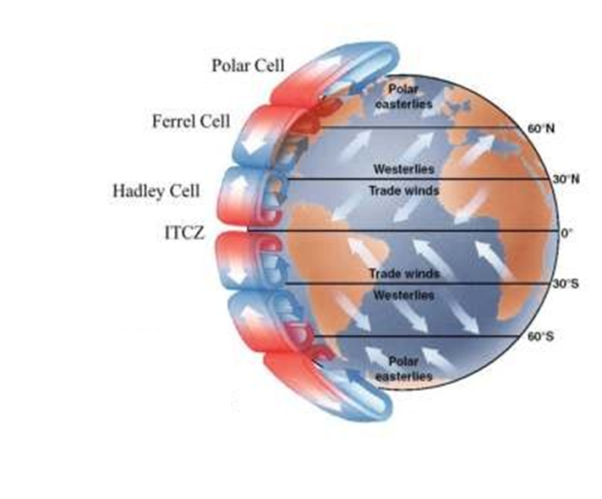
Ferrel cell
The term was first proposed by William Ferrel in 1856
It is a global atmospheric circulation that features part of the air rising at 60° latitude flowing towards Equator, descending in the subtropics, and then returning towards sub-polar region.
This circulation creates the Westerlies
wind flows in the direction opposite to Hadley cell and Polar cell.
Ferrel cell is a mechanical cell because it is created due to the pressure gradient
Presentation\FERREL.png
Presentation\ns.jpg

Slide 20
Credits and references
Meteorology for Scientists and Engineers, 3rd Edition Copyright ©️ 2011, 2017 by Roland Stull.
Fundamental of Physical Geography For Class - 11 - 11092 : NCERT: Amazon.in: Books.
https://www.reddit.com/r/worldbuilding/comments/10vz76u/circulation_pressure_and_wind_currents/?rdt=41601
https://images.app.goo.gl/HK3FmxUuHkCwuvH26

Slide 21
Sweet and simple questions will entertain : )
THANK YOU

