Slide 1
PUB KAMRUP COLLEGE DEPARTMENT OF PHYSICS Presentation on Cyclones
Presented by-
Naznin Faruki M.sc 4th Sem Dept of Physics Sani Mahanta M.sc 4th Sem Dept of Physics
coordinator-
Kangkan Medhi (Dept of Physics)

Slide 2
TITLE PAGE NO
TABLE OF CONTENTS :
1. WHAT IS CYCLONE 1 2. OTHER NAMES OF CYCLONE 2 3. HOW ARE THE CYCLONES FORMED 3 4. TYPES OF CYCLONE 5 5. CONCLUSION 10 6. REFERENCES 11

Slide 3
1.WHAT IS CYCLONE :
In meteorology,the term cyclone is defined as system of winds that are rotating inwards to an area of low barometric pressure, such that in the Northern Hemisphere it is anticlockwise and in the Southern Hemisphere it is clockwise circulation.
Cyclones are formed with an enormous amount of energy from the ocean to the atmosphere. According to studies, every year there are 70 to 90 cyclonic systems developed across the globe.
The cyclonic systems are not formed in the equatorial regions because the Coriolis force is negligible between the latitudes 5 degrees north and 5 degrees south.

Slide 4
2.OTHER NAMES OF CYCLONE :
The cyclone is known to have different names in different regions of the world, and they are:
Region | Other names for cyclone
Caribbean sea | Hurricanes
China sea | Typhoons
Indian ocean | Tropical cyclones
Japan | Taifu
Northern Australia | Wily willies
Philippines | Baguio
USA | Tornadoes

Slide 5
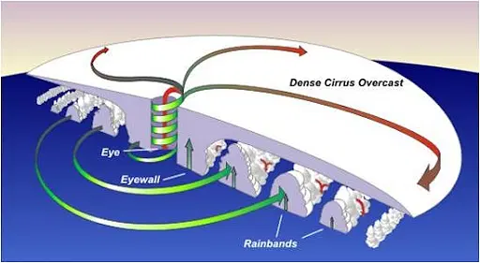
3.HOW ARE THE Cyclones FORMED:
Cyclones form in locations where there is a low level of pressure. The geography, severity, and frequency of the cyclone determine the susceptibility of the area where it strikes. Cyclones are usually formed by:
A large amount of warm temperature is near the sea's surface.
The atmosphere is unstable.
How the Coriolis force affects the area to create low- pressure.
When the humidity levels in the lower to middle troposphere are high.
Disturbance in the low-level area that already existed.
When there is less vertical wind shear. When warm, moist air moves upward over the ocean, a cyclone forms. As the air rises, a low-pressure area forms beneath it.
Fig: Cyclone Formation

Slide 6
The low-pressure area has now been filled with high-pressure air from the surrounding area. As the next wave of cool air moves higher, it becomes warm and moist as it passes over the ocean. This results in the creation of a low-pressure area once more, and the cyclone goes on.
Clouds form in the air as a result of this ongoing cycle. As the water from the ocean evaporates, more clouds form.
The storm system forms as a result of this. An eye forms in the center of the storm system as it rotates faster. The quiet and clear region of the storm is known as the eye. The air pressure in the storm's eye is extremely low.
Cyclones are classified into distinct classes based on the strength of the winds they produce.

Slide 7
4.TYPES OF CYCLONE :
Cyclone represents a meteorological pattern that is distinguished by swirling winds. Various types of cyclones occur around a low-pressure center. Cyclones vary depending on the sizes and environment in which they exist. There are four forms of cyclones and they are :
Tropical cyclone
Polar cyclone
Mesocyclone
Extratropical cyclone

Slide 8
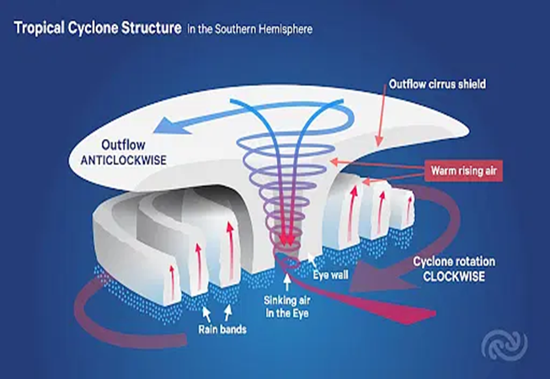
Tropical Cyclone :
Tropical cyclone is similar to a revolving system that contains clouds and thunderstorms . They are native to tropical and subtropical regions.
The North Atlantic (including the Caribbean), Southwest Indian Ocean, Eastern Pacific, North Indian Ocean, Western Pacific, Southern Pacific, and Australia regions are the most vulnerable to tropical cyclones.
Tropical cyclones normally form between 5 and 30 degrees latitude.
The production of these cyclones are at least 80 degrees Fahrenheit.
Fig: Tropical Cyclone Formation

Slide 9
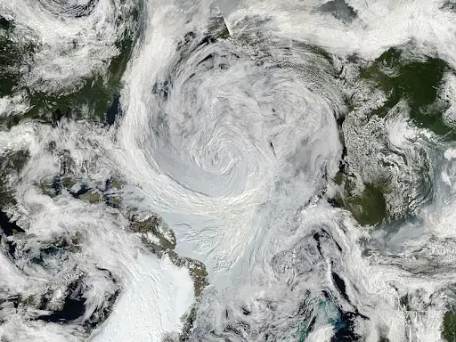
Polar Cyclone :
Over the Arctic and Antarctic oceans, hurricane-like cyclones known as “Polar lows” can form.
They are sparked by the passage of cold air over somewhat warmer ocean waters. Polar lows are sometimes referred to as "Arctic Hurricanes" by meteorologists in the Northern Hemisphere.
The heat is transmitted from water to air, while the latent heat is released in the form of cloud condensation.
Polar lows occur quickly, sometimes in less than 24 hours and are difficult to predict.
They form across the waters of the Arctic and Antarctic.
Fig: Arctic or Polar Cyclone

Slide 10
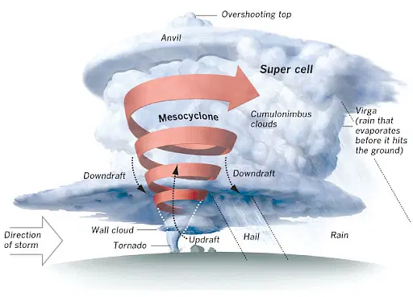
Mesocyclone:
Mesocyclone is a vortex of air that exists within a convective storm. Along the vertical axis, the air rises and rotates. In the given hemisphere, the direction of this air and the low-pressure system are equal.
The whirling air within the thunderstorms is accompanied by the mesocyclone.
The formation of wall clouds from these mesocyclones eventually leads to the formation of a funnel cloud. When it makes contact with the earth, it transforms into a tornado.
Fig: Mesocyclone

Slide 11
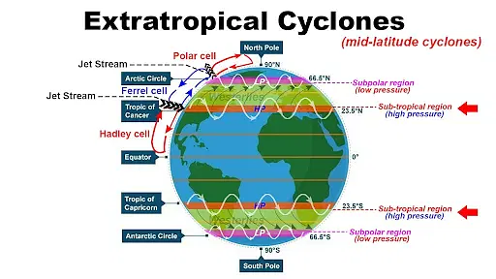
Extratropical Cyclone:
Extratropical cyclones or midlatitude cyclones are cyclonic storms that occur along frontal boundaries in the middle latitudes.
Unlike their tropical counterparts, these cyclones form where there are sharp temperature differences between connected air masses.
Even though their winds are normally weaker than Hurricanes, they can grow to be extremely massive.
The extratropical cyclone's winds are less, but the temperature gradients are strong.
Fig: Extratropical Cyclones

Slide 12
5.CONCLUSION:
Cyclones are powerful natural phenomena that have significant impacts on both human societies and the environment.
Through this presentation,we've explored the formation, structure, and impacts of cyclones.
Cyclones pose immense challenges, but they also present opportunities for proactive measures to mitigate their effects and enhance resilience. By understanding the science behind cyclones and implementing effective strategies for preparedness and response, we can minimize loss of life, reduce economic damage, and safeguard communities and ecosystems.

Slide 13
6.REFERENCES:
1. MICHIO YANAI,“Formation of Tropical Cyclones”,“REVIEWS OF GEOPHYSICS VOL. 2, No.2” 2. Kerry Emanue,“TROPICAL CYCLONES”. 3.NCERT Geography book 4.www.google.com 5.Chat GPT 6.www.youtube.com

Slide 14
THANK YOU

