Slide 1
ABSORPTION
OF
CARBOHYDRATES

Slide 5
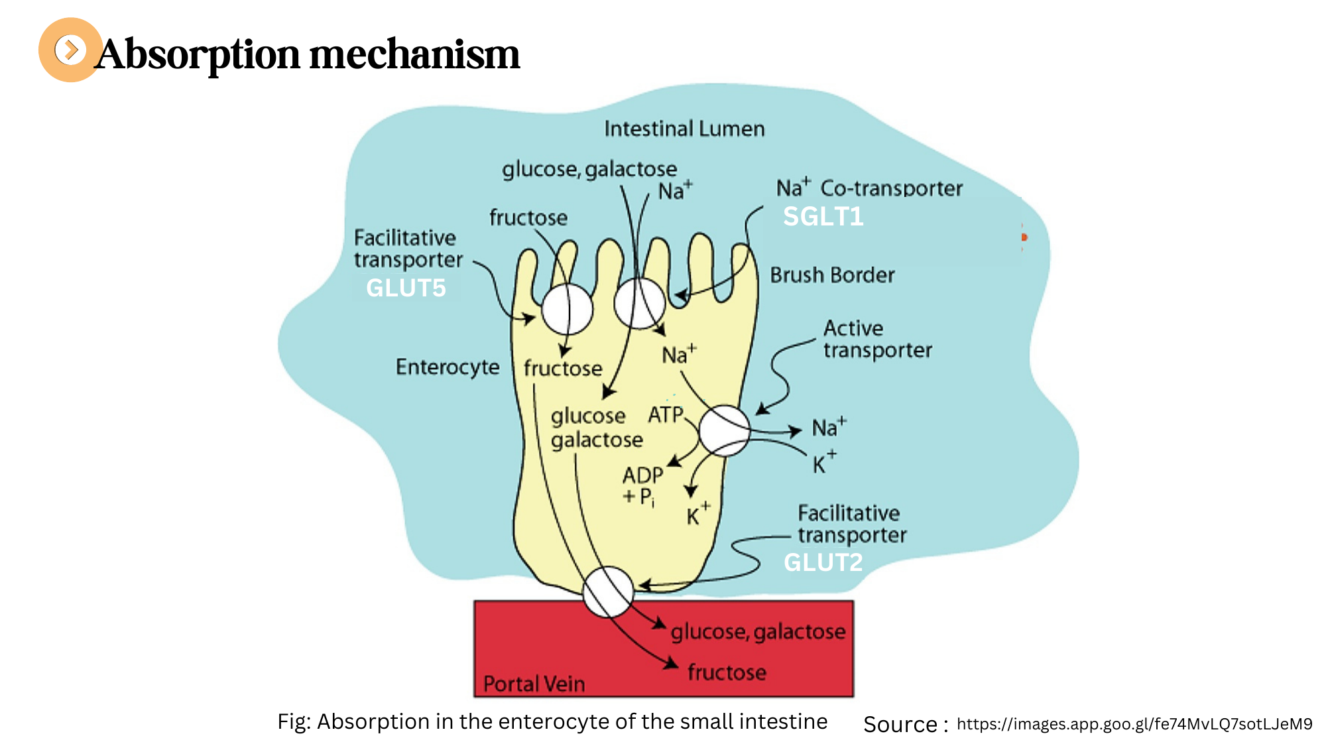
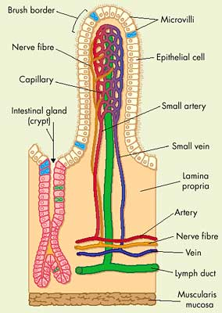
Fig: Structure of Villus

Slide 7
ABSORPTION
OF
LIPIDS

Slide 8
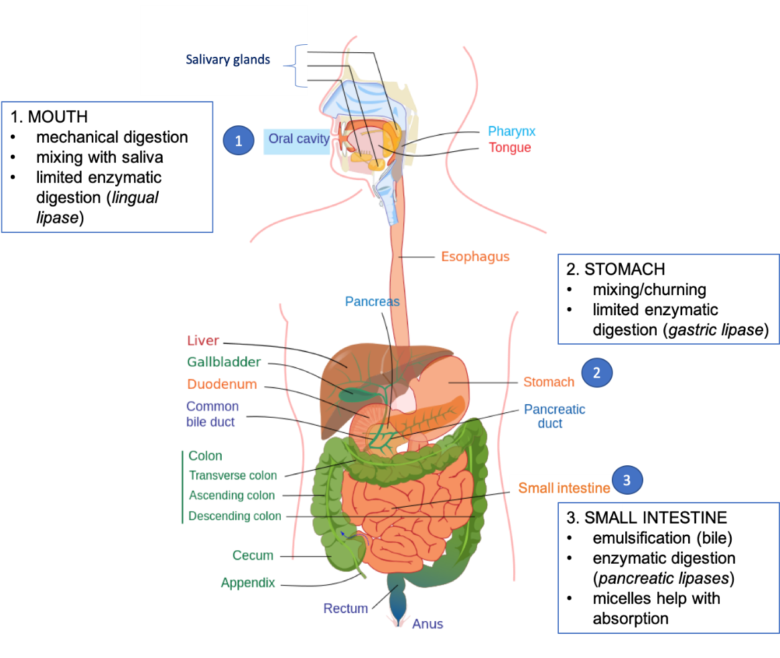
DIGESTION OF LIPIDS

Slide 9
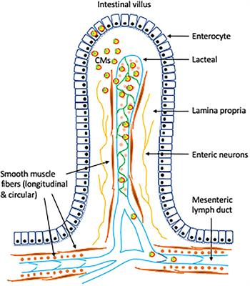
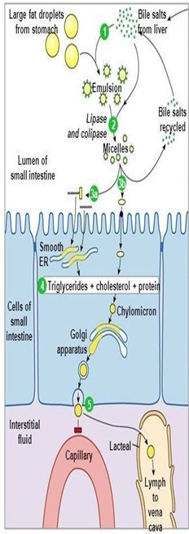
VILLUS
ABSORPTION OF LIPIDS

Slide 10
Note: Absorption of carbohydrate presented by Dhritima Kakati (UG 4th semester ) Department of Zoology

