Slide 1
A Presentation on Solar Radiaton (Meteorology)
Presented by – Ashim Ray
semester- MSc 4th sem.
Department of Physics
Pub Kamrup College
Date- 23-02-2024

Slide 2
what is Solar radiation?
Solar radiation is the energy emitted by the sun in the form of electromagnetic waves.
It's like the sun's way of sending us love letters, only instead of paper, it's energy-packed photons.
It plays a crucial role in driving Earth's climate and weather patterns.

Slide 3
Source-NASA

Slide 4
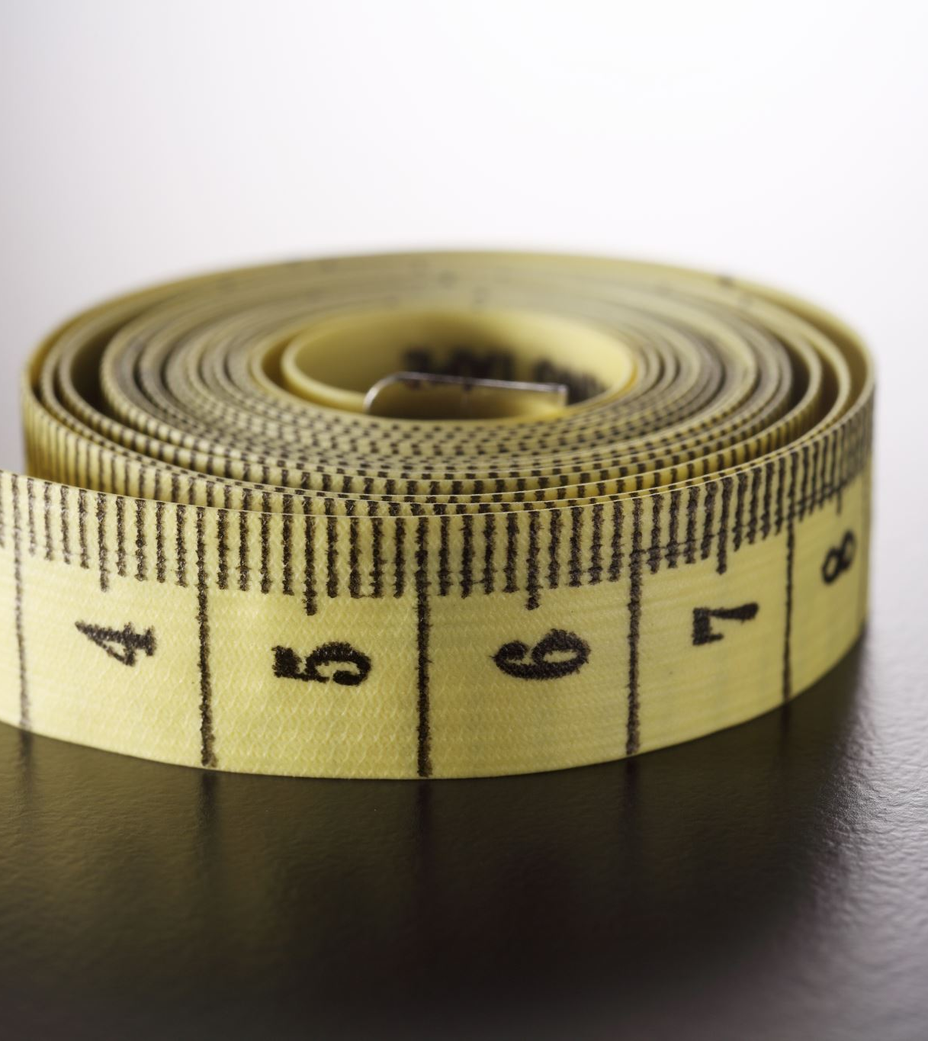
And how we suppose to measure it ?

Slide 5
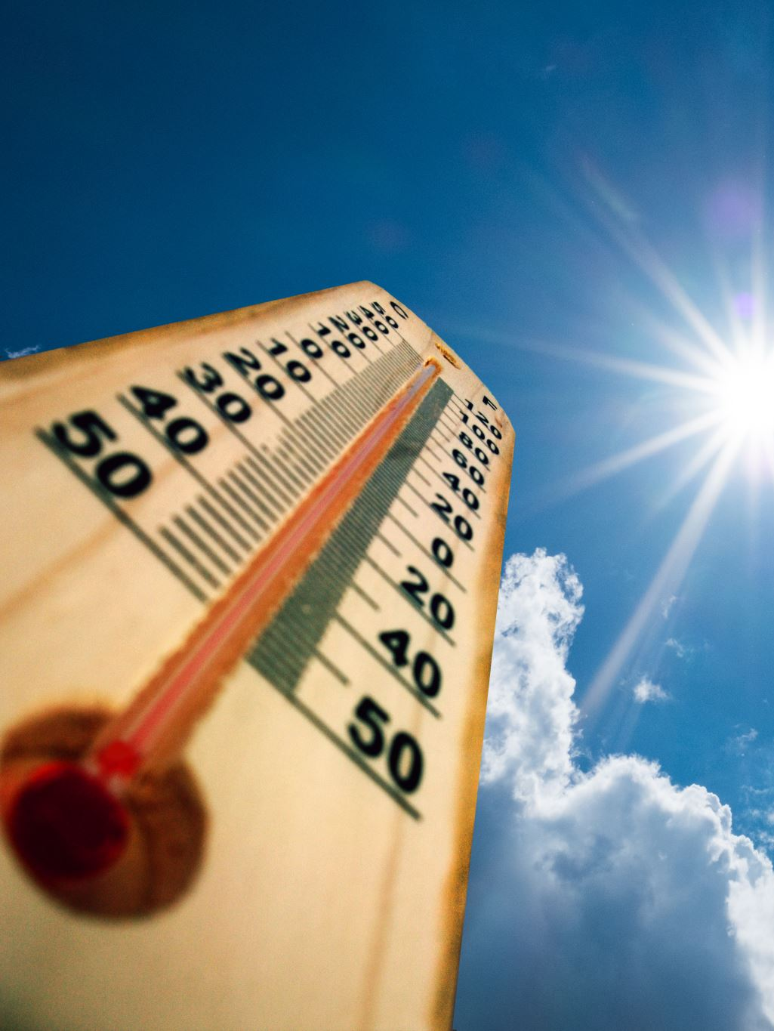
Measurement Solar Radiation
Solar radiation is measured using instruments like pyranometers, which quantify the amount of solar energy reaching the Earth's surface.
These measurements are crucial for understanding the distribution of solar energy across different regions.

Slide 6
Solar Radiation and Weather
Solar radiation is a fundamental driver of Earth's weather patterns, influencing both physics and meteorology.
This energy is absorbed by the Earth's surface, leading to heating, which in turn drives various meteorological phenomena such as temperature variations, wind patterns, and the formation of weather systems.
Meteorology, the scientific study of weather and atmospheric conditions, relies heavily on understanding the interactions between solar radiation and the Earth's atmosphere to forecast weather accurately.
Solar radiation influences atmospheric circulation, cloud formation, precipitation, and the distribution of heat across the globe, all of which are critical components of meteorological processes.
Solar Radiation and Atmospheric Circulation
Solar radiation drives atmospheric circulation by creating temperature gradients across the Earth's surface.
This leads to the formation of high and low-pressure systems, which influence weather patterns globally.

Slide 7
Atmospheric circulation
atmospheric circulation refers to the large-scale movement of air around the Earth driven by differences in temperature and pressure. This circulation pattern influences weather and climate patterns globally. There are several major circulation systems on Earth, including the Hadley cell, Ferrel cell, and Polar cell, which together create the planet's wind and weather patterns.
Solar radiation plays a significant role in cloud formation also by heating the Earth's surface and evaporating water, leading to the condensation of water vapor into clouds.

Slide 8
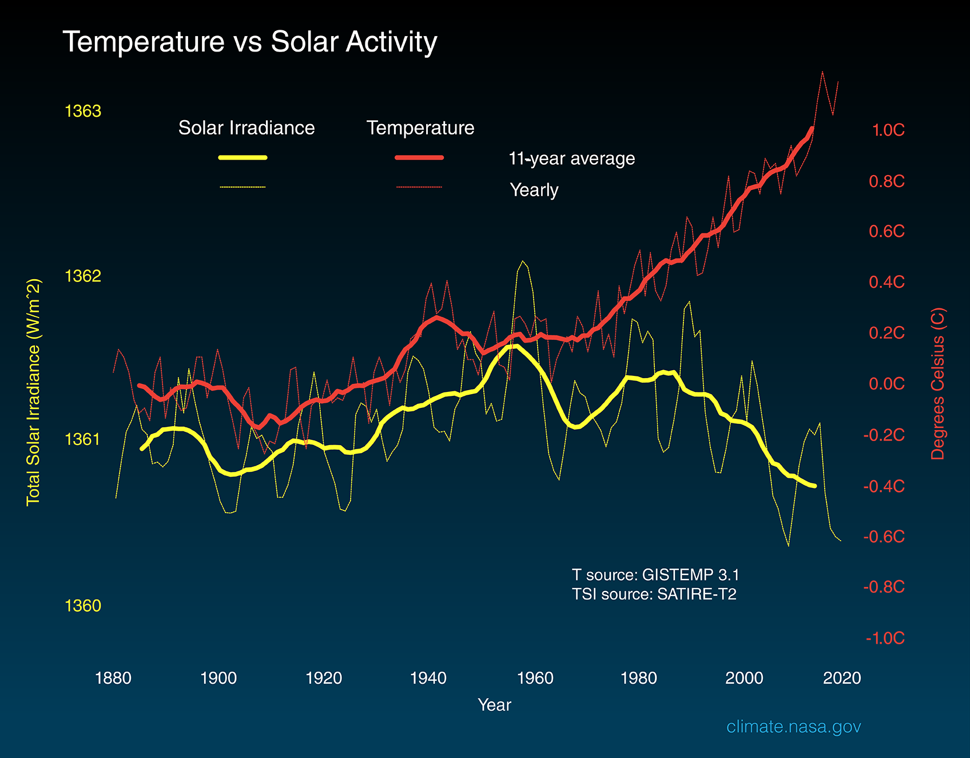
Solar Radiation and
Temperature Variations
A comparison of solar radiation data with temperature records reveals a direct correlation between solar energy input and temperature variations.
This relationship highlights the importance of solar radiation in driving local and global temperature patterns.

Slide 9
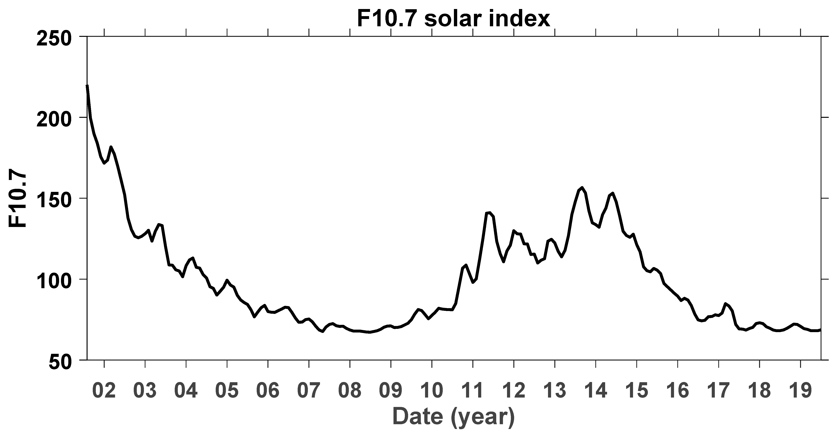
Solar Radiation Data Analysis
Data analysis of solar radiation measurements provides insights into regional variations in solar energy availability.
This information is valuable for renewable energy planning and meteorological research.

Slide 10
Figure 1 shows the temporal variations in the F10.7 solar flux index from 2002 to 2019:
Source- Internet

Slide 11
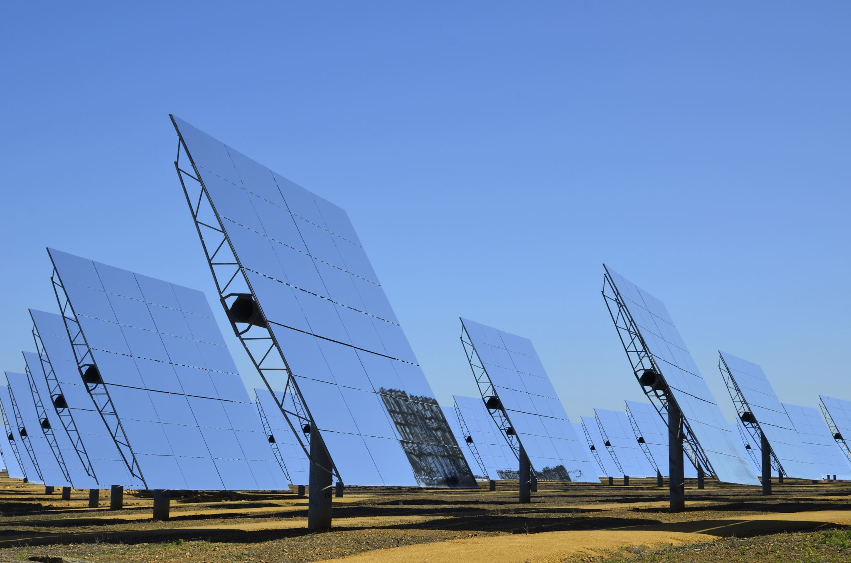
Solar Radiation and Renewable Energy
Solar radiation is a key driver of renewable energy sources such as solar photovoltaic (PV) and solar thermal systems.
Understanding solar radiation patterns is essential for optimizing the efficiency of solar energy technologies.

Slide 12
Solar Radiation Forecasting
Meteorologists use solar radiation data to forecast weather patterns and predict solar energy output.
Accurate forecasting helps in planning for renewable energy generation and mitigating the impacts of extreme weather events.

Slide 13
Solar Radiation and Climate Change
Solar radiation variability is a factor in understanding long-term climate change trends.
Changes in solar radiation can influence Earth's climate over extended periods, contributing to global warming or cooling trends.
Solar radiation plays a significant role in climate change, both as a driver of natural climate variability and as a factor influenced by human activities.
The above graph compares global surface temperature changes (red line) and the Sun's energy that Earth receives (yellow line) in watts (units of energy) per square meter since 1880. The lighter/thinner lines show the yearly levels while the heavier/thicker lines show the 11-year average trends. Eleven-year averages are used to reduce the year-to-year natural noise in the data, making the underlying trends more obvious.

Slide 14
Solar Radiation and Agriculture and
Solar radiation affects agricultural productivity by influencing crop growth and development.
Understanding solar radiation patterns helps farmers optimize planting schedules and irrigation practices.

Slide 15
Solar Radiation and Health
Sunlight exposure, facilitated by solar radiation, is essential for vitamin D synthesis and overall human health.
Balanced exposure to solar radiation contributes to physical and mental well-being.

Slide 16
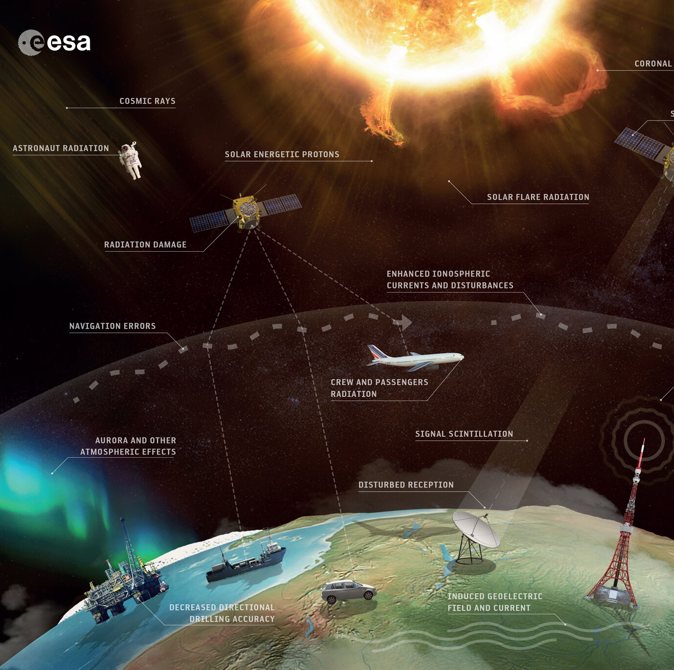
Solar Radiation and Space Weather
Solar radiation impacts space weather, affecting satellite communications and navigation systems.
Solar storms and flares can disrupt satellite operations and pose risks to space missions and astronauts.

Slide 17
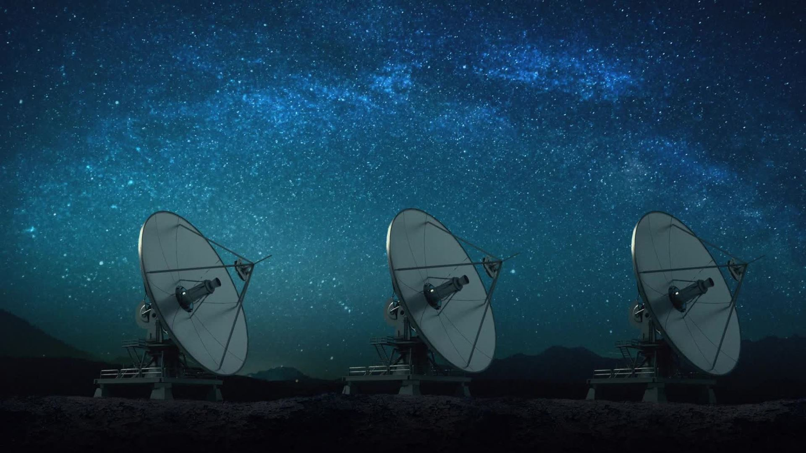
What kind of weather events occure in space, and when are they likely to strick?

Slide 18
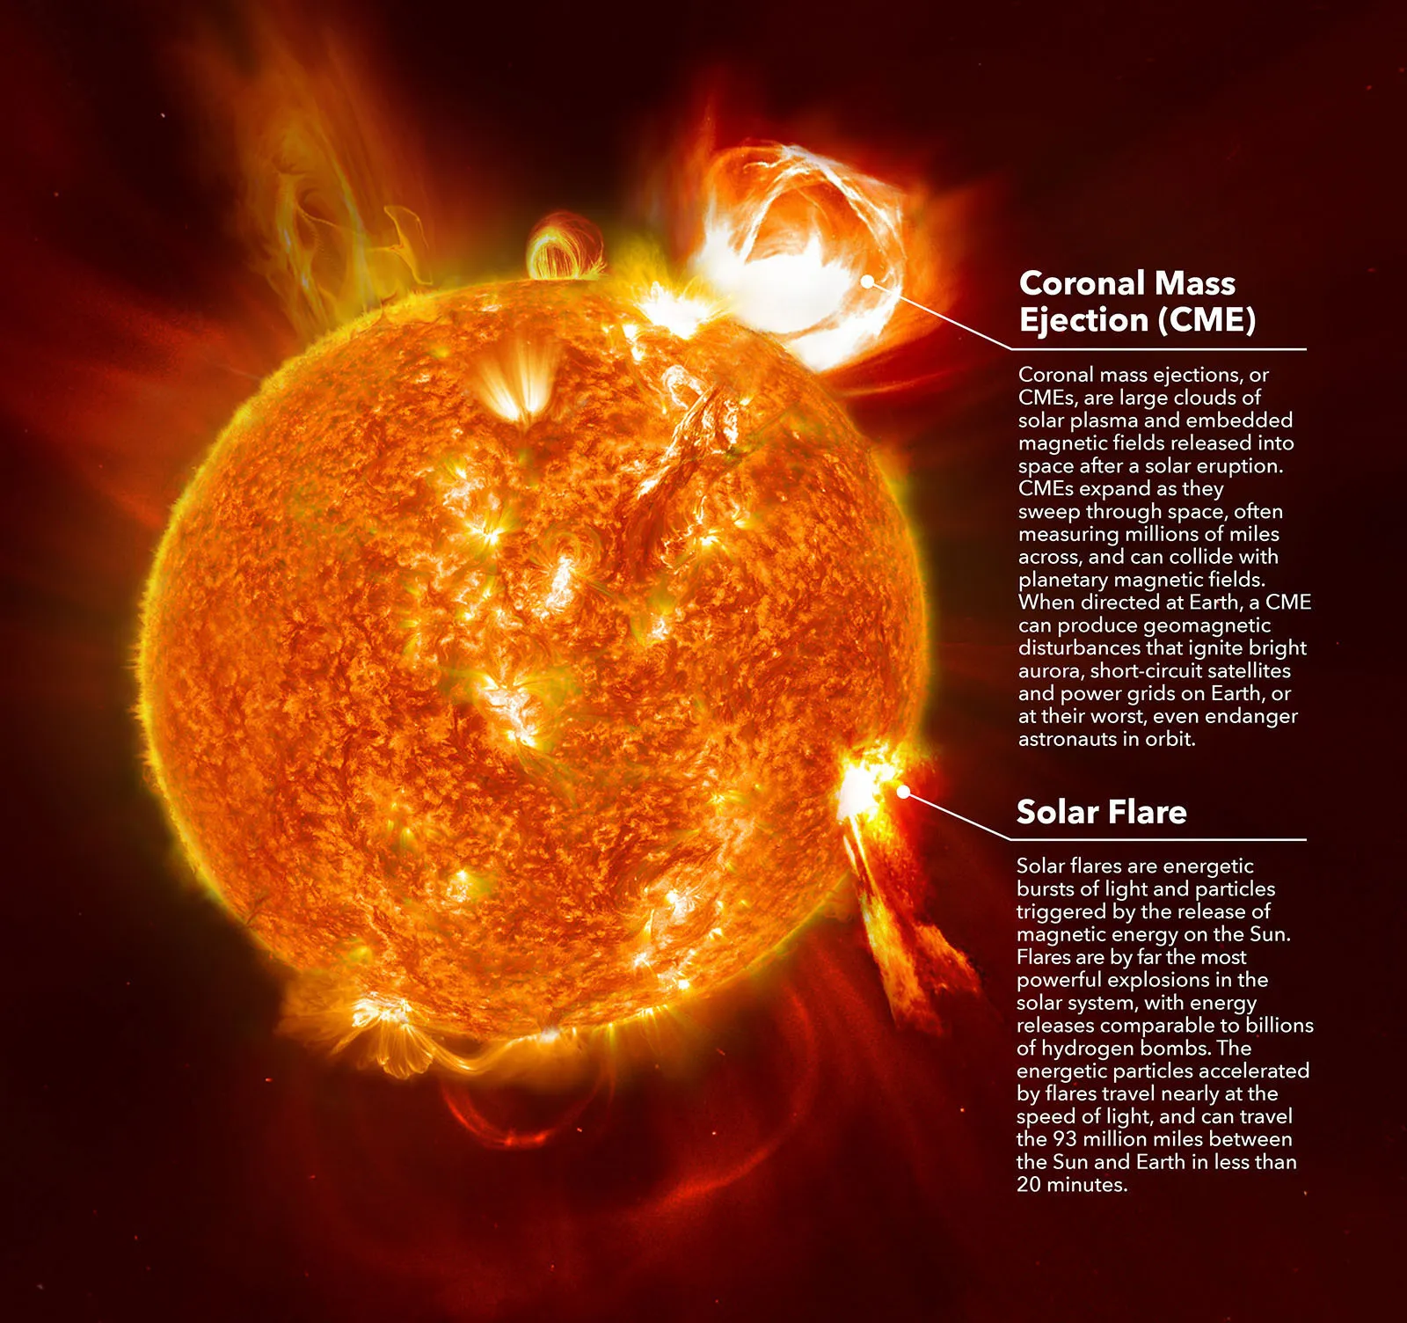
space weather in our solar system is composed of radiation and particles from the Sun.
The Sun is made up of superhot electrically charged plasma, the fourth state of matter. Plasma constantly streams toward the planets as solar wind, pouring energy into near-Earth space.
Solar flares, the tremendous explosions on the surface of the Sun, releasing energy which travels at the speed of light. Their effects on Earth are apparent in eight minutes.
Coronal mass ejections (CMEs) are eruptions of large clouds of solar plasma and magnetic fields from the Sun. The geomagnetic storms resulting from these events may occur one or several days later.
Source- NASA

Slide 19
Solar Radiation Monitoring
Various instruments, including pyranometers and satellites, are used to monitor solar radiation levels.
Continuous monitoring provides real-time data for weather forecasting, renewable energy planning, and scientific research.

Slide 20
Solar Energy Harvesting
Solar radiation is harnessed through solar panels to generate electricity.
It's like turning sunshine into gold, except instead of JADU’s skin, we have photovoltaic cells.

Slide 21
Now what is a photovoltaic cells?

Slide 22
Photovoltaic cell
A photovoltaic cell consists of two or more layers of semiconductors. One layer contains a positive charge, while the other has a negative charge. These layers are positioned adjacent to each other.
When sunlight (composed of small packets of energy called photons) strikes the cell, it can be reflected, transmitted, or absorbed.
If the photons are absorbed by the negative layer of the photovoltaic cell, their energy transfers to an electron within an atom of the cell.
As the electron gains energy, it escapes the outer shell of the atom and migrates naturally to the positive layer. This movement creates a potential difference between the positive and negative layers.
When the two layers are connected to an external circuit, the freed electron flows through the circuit, generating an electric current

Slide 23
And why Photovoltaic cell ?

Slide 24
Because :
Environmental Sustainability: Photovoltaic cells produce clean and green energy without emitting harmful gases (such as CO₂ and NOₓ) or causing noise pollution. They are ideal for residential areas.
Economically Viable: The operation and maintenance costs of solar cells are low. The initial cost includes purchasing and installing solar panels.
Accessibility: Solar panels are easy to set up and can be deployed in remote or sparsely inhabited areas at a lower cost compared to conventional transmission lines.

Slide 25
Solar Radiation and Water Resources
Solar radiation influences the water cycle by driving evaporation, condensation, and precipitation processes.
Understanding solar radiation's role in the water cycle is crucial for managing water resources and addressing water scarcity issues.

Slide 26
Solar Radiation and Ecosystems
Solar radiation influences ecosystem dynamics, including plant growth, photosynthesis, and biodiversity.
Understanding solar radiation patterns helps conservationists assess ecosystem health and resilience to environmental changes.

Slide 27
Solar Radiation and Human Adaptation
Human societies have adapted to solar radiation variations through cultural practices, architecture, and technological innovations.
Historical records and archaeological evidence provide insights into human adaptation strategies to solar radiation changes.

Slide 28
Conclusion
Solar radiation is a multifaceted phenomenon with profound impacts on meteorology, climate, ecosystems, and human societies.
By studying solar radiation and its interactions with Earth's systems, we gain valuable insights into our planet's dynamic processes and enhance our ability to address environmental challenges.

Slide 29
References
1. Meteorology for Scientists and Engineers, R Stull, Brooks/Cole, Thomson Learning 2. The Atmosphere: An Introduction to Meteorology, Frederick K. Lutgens, Edward J. Tarbuck, PHI Learning 3. Basics of Atmospheric Science, A Chandrasekar, PHI Learning 4. Meteorology Today: An Introduction to Weather, Climate, and the Environment, C. Donald Ahrens, Cengage Learning

Slide 30
Thank you

